Slide 1
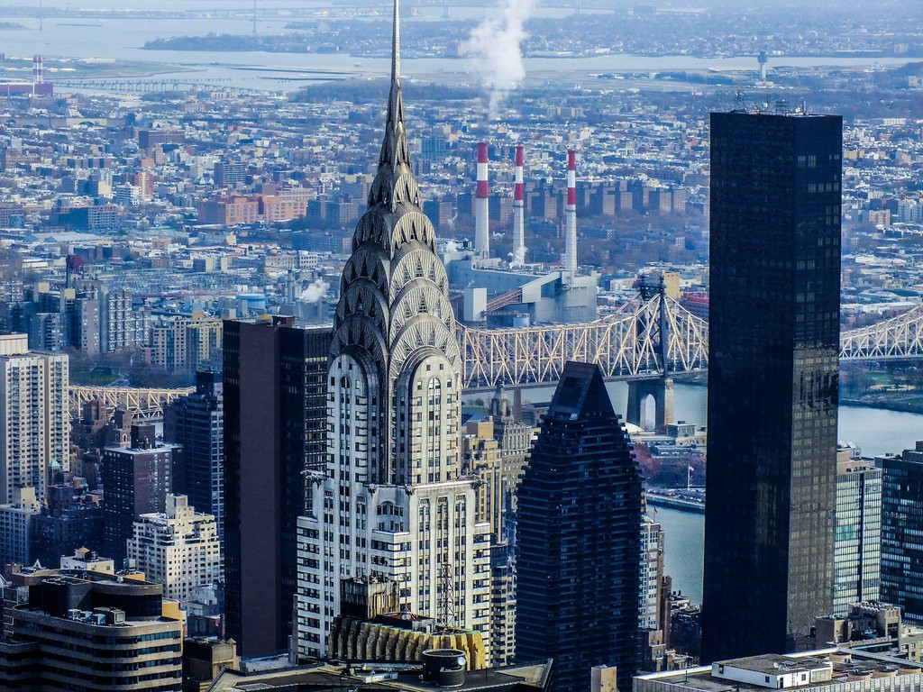
WHAT MAKES A NEW YORK BUILDING ART DECO?
Chrysler Building, Midtown East (Manhattan)
© Art Deco Society of New York

Slide 2
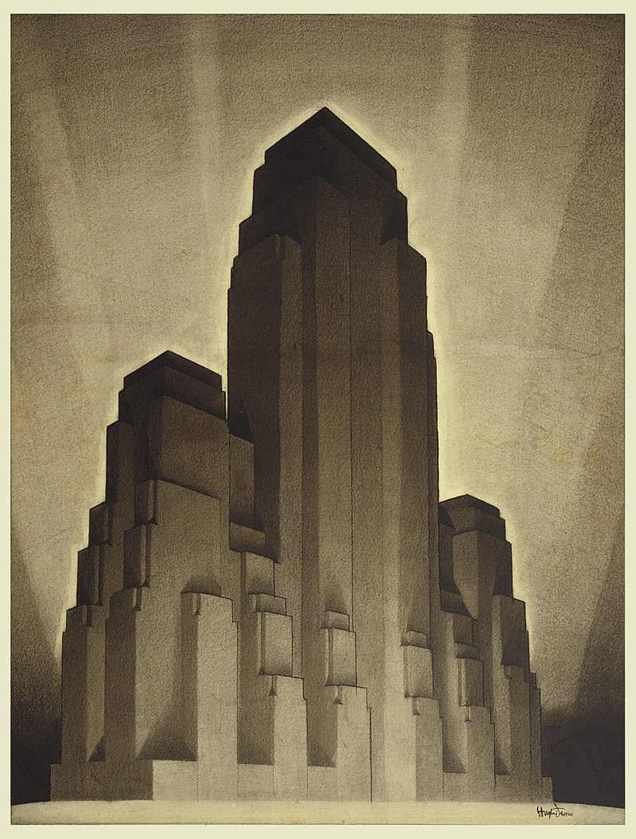
PART I:
STRUCTURE
Hugh Ferriss,
1916
© Art Deco Society of New York
© Art Deco Society of New York

Slide 3
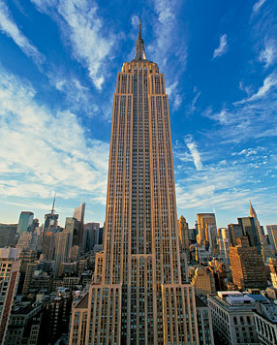
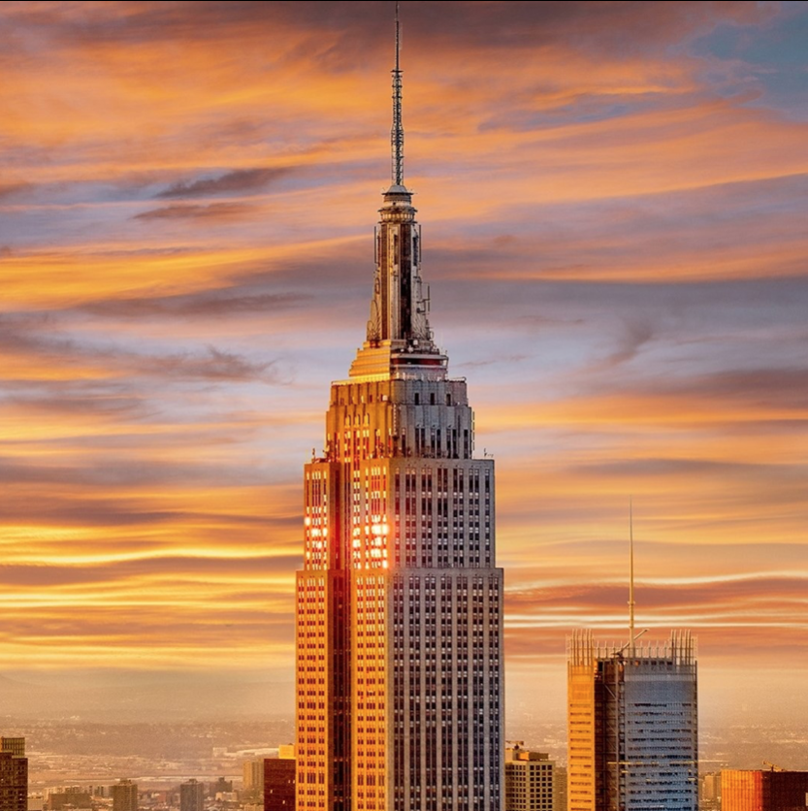
All buildings have STRUCTURE and design.
Empire State Building (Manhattan)
© Art Deco Society of New York
© Art Deco Society of New York

Slide 4
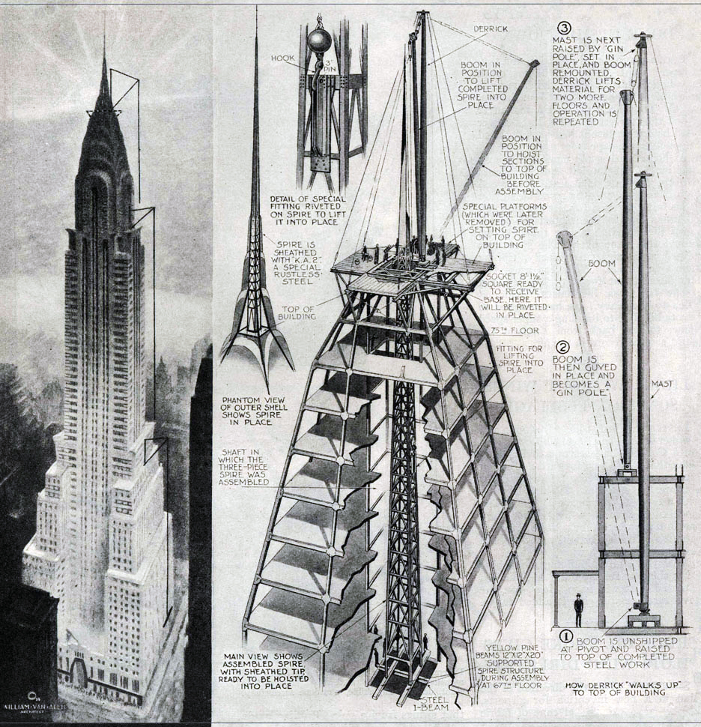
Internal structure includes the parts of a building that:
give it support
keep it standing
make it function
Chrysler Building (Manhattan)
© Art Deco Society of New York
© Art Deco Society of New York

Slide 5
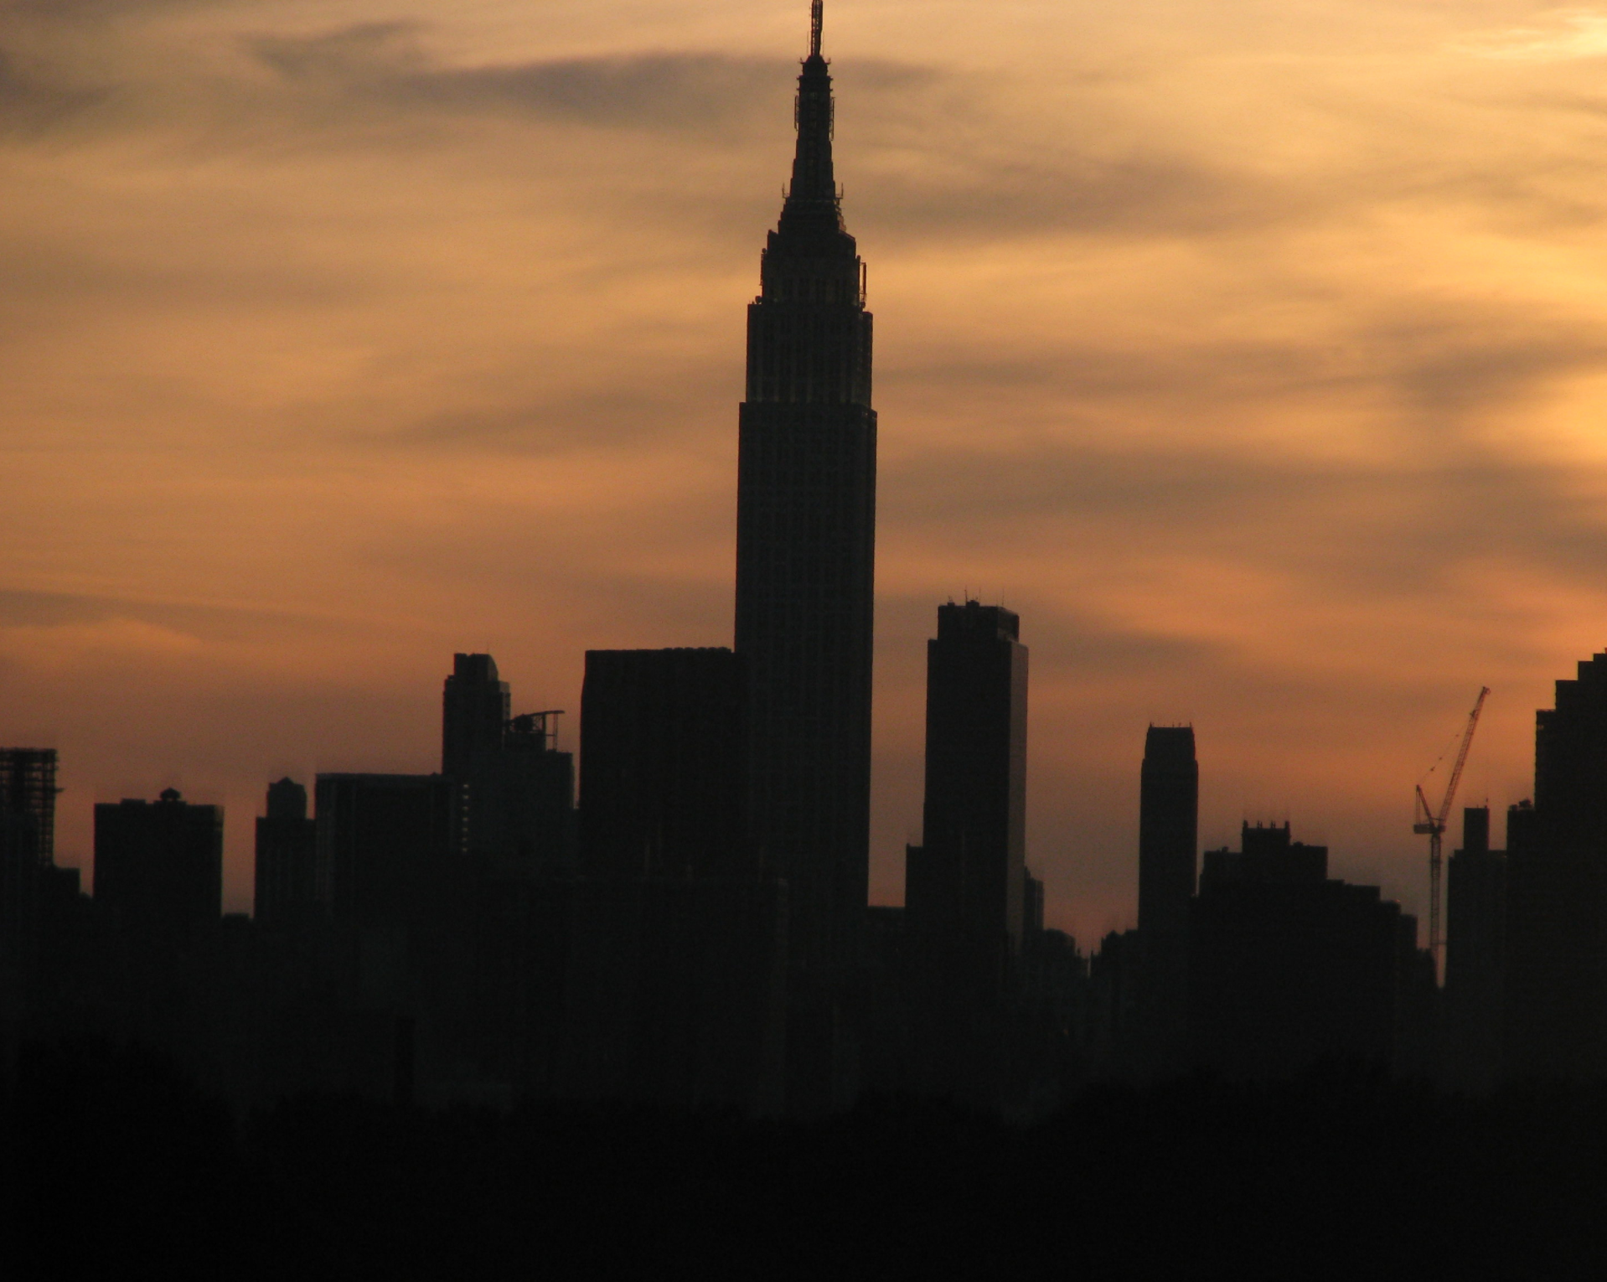
Structure can also be the silhouette, or outline, of a building.
Empire State Building (Manhattan)
© Art Deco Society of New York
© Art Deco Society of New York

Slide 6
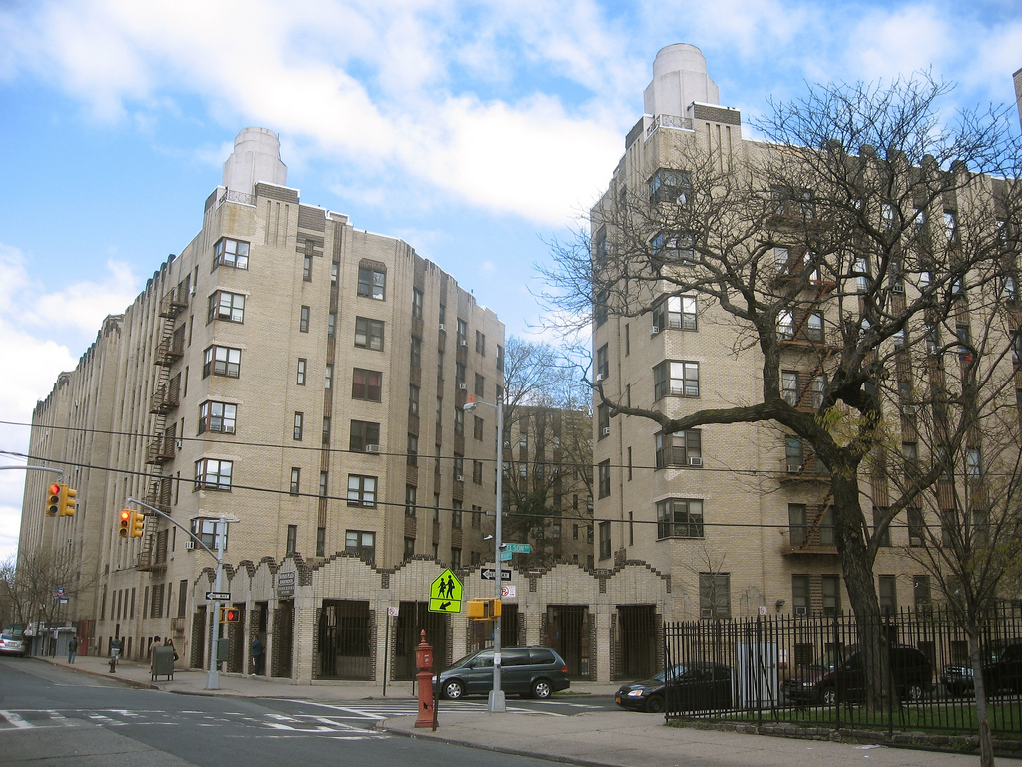
The structure of all buildings includes:
Walls
Windows
Roofs
Entrances
These can be interior
or exterior parts.
Noonan Plaza (The Bronx)
© Art Deco Society of New York
© Art Deco Society of New York

Slide 7
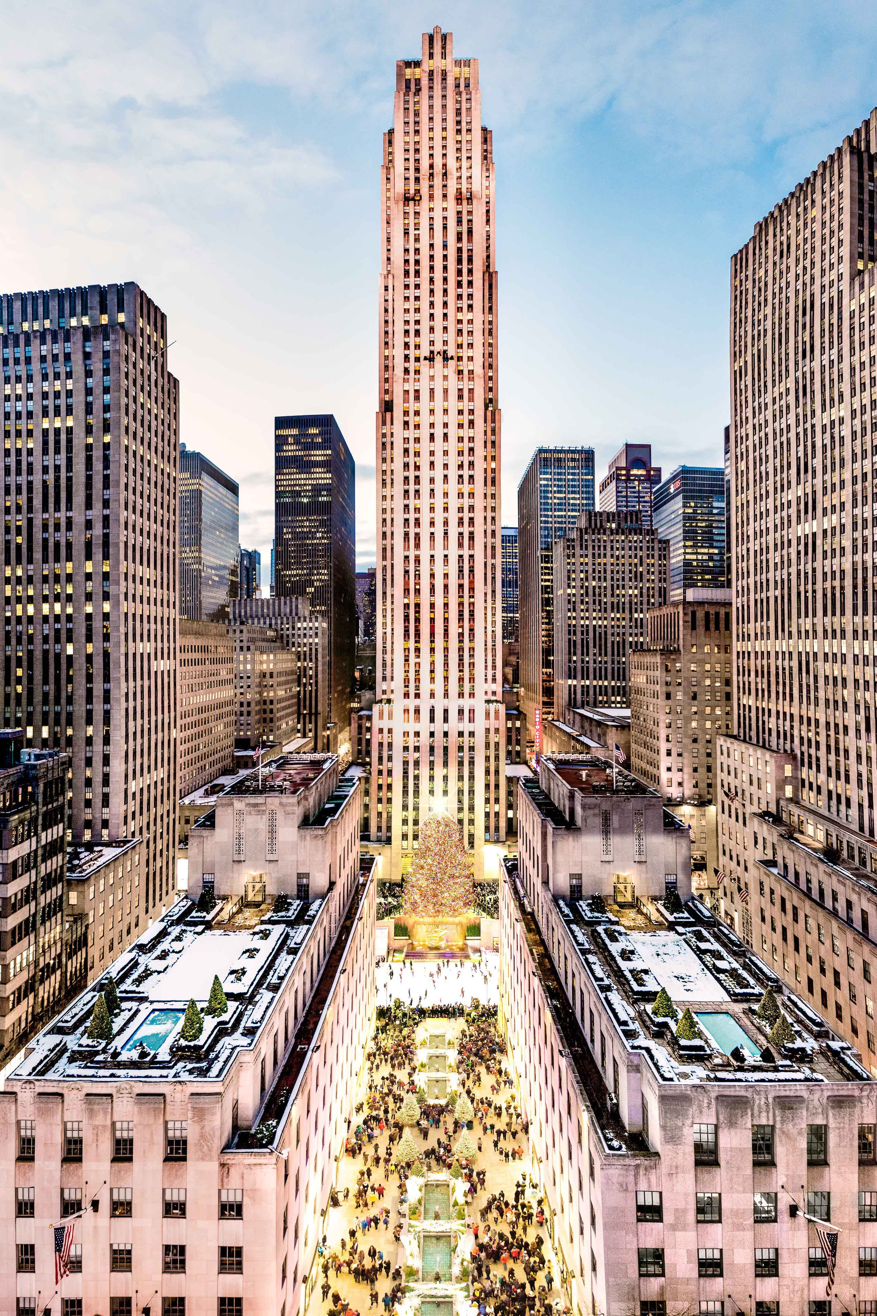
The person who designs a building is called an Architect.
How the architect puts these structural parts together determines the style of a building:
Walls
Windows
Roofs
Entrances
Outdoor spaces
Interior spaces
30 Rockefeller Center (Manhattan)
© Art Deco Society of New York
© Art Deco Society of New York

Slide 8
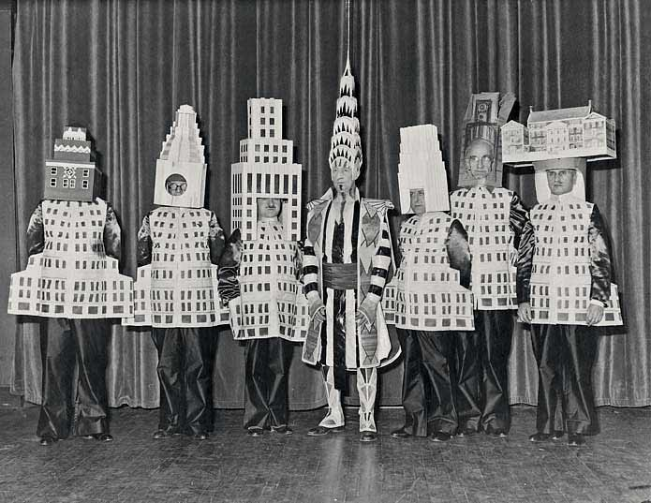
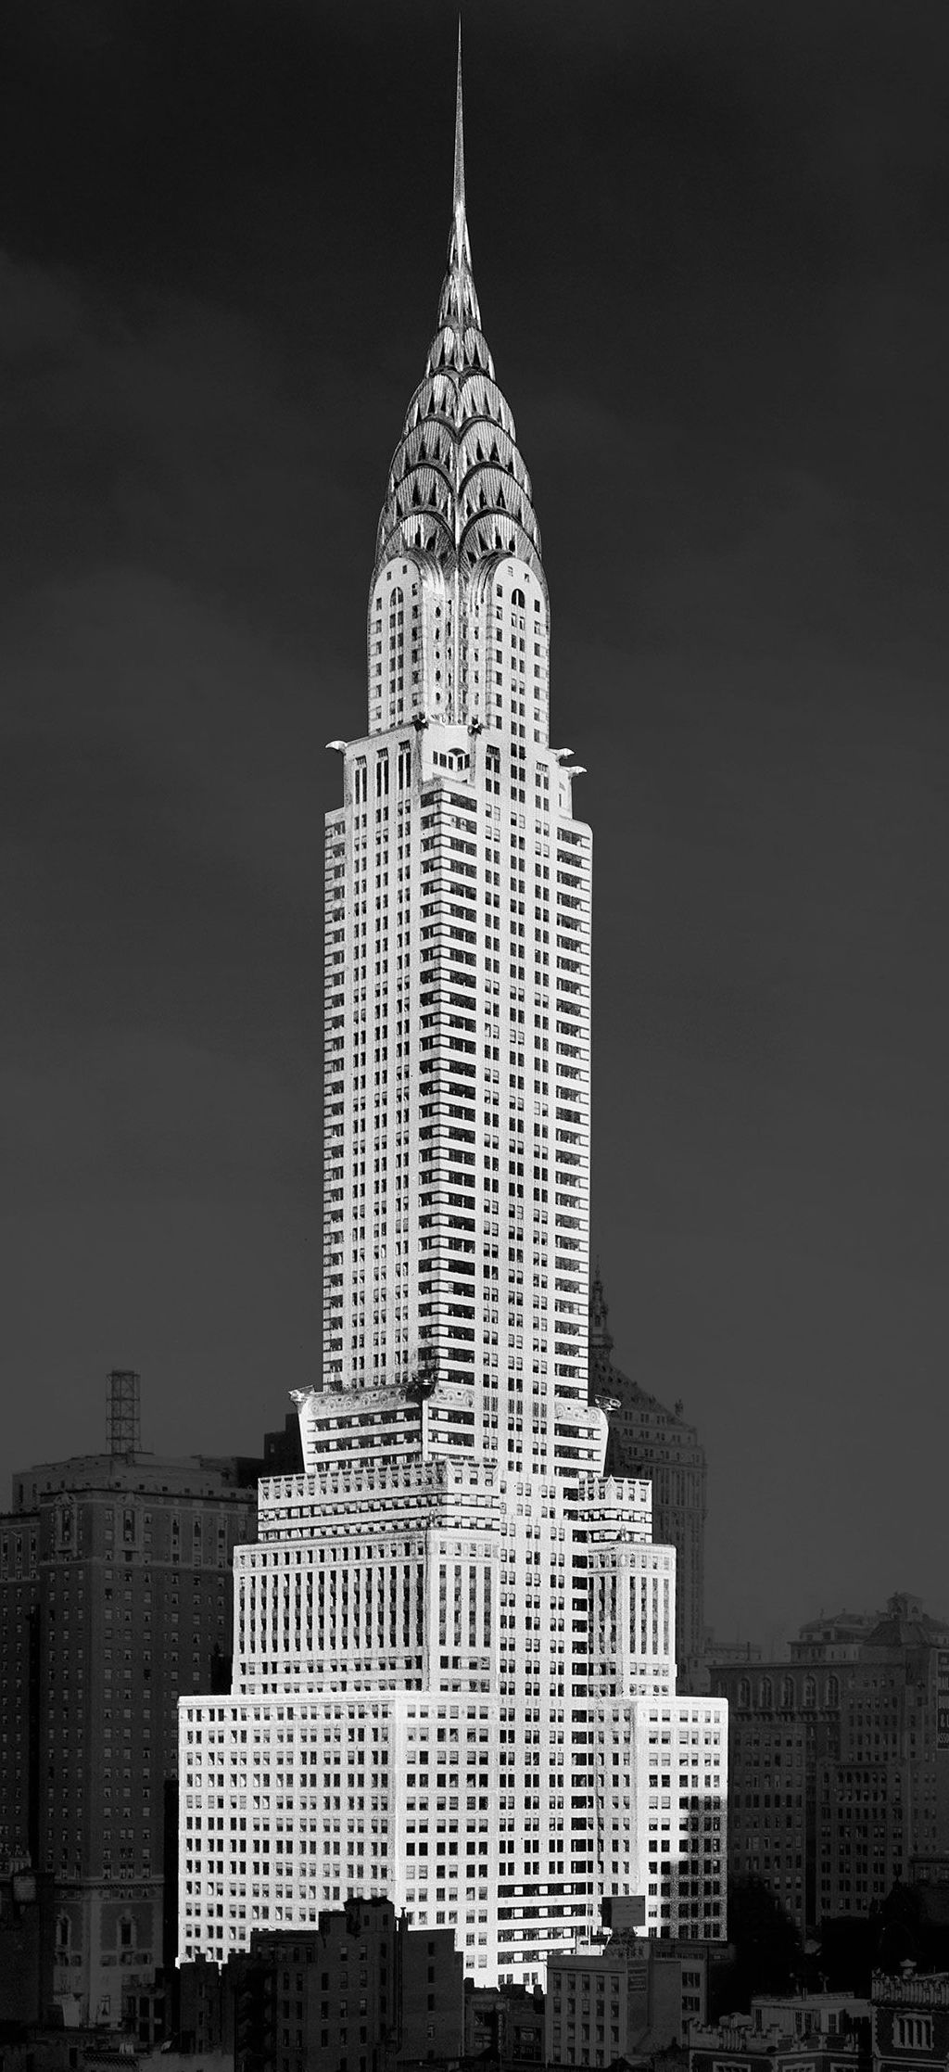
Famous architects dressed like their New York City buildings,
1931 Beaux Arts Ball
© Art Deco Society of New York
© Art Deco Society of New York

Slide 9
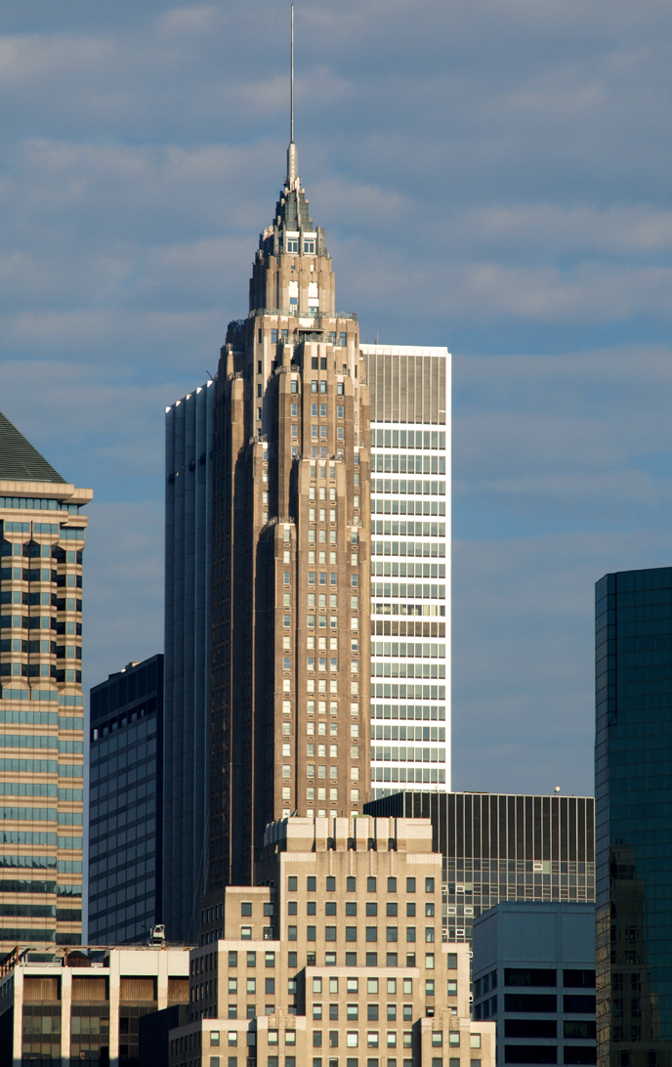
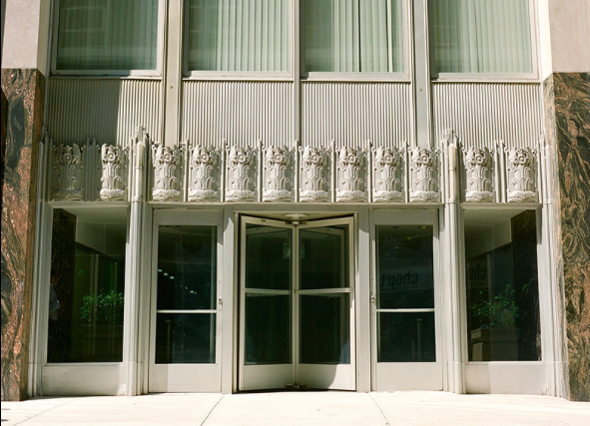
When was art deco popular?
The Art Deco style of architecture became popular in the 1920s and 1930s—about 100 years ago! Terms associated with this era include the Jazz Age and the Interwar Period. Art Deco overlapped with the Roaring Twenties and the Great Depression.
70 Pine Street (Manhattan)
© Art Deco Society of New York
© Art Deco Society of New York

Slide 10
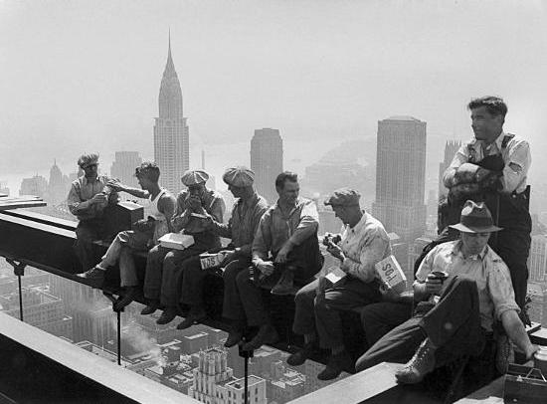
Deco buildings were designed during changing times in America, after World War I (ending in 1918) and before World War II (ending in 1945).
Modern cities were developing.
Construction workers eating lunch up high at Rockefeller Center
© Art Deco Society of New York
© Art Deco Society of New York

Slide 11
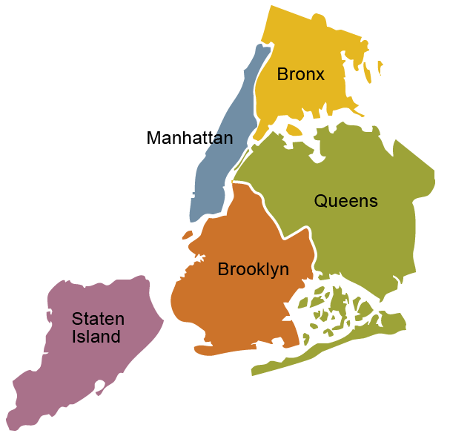
As more people moved to Manhattan, New York grew outwards toward what are now the other boroughs, as well as upwards.
There are 5 boroughs in the City of New York.
© Art Deco Society of New York

Slide 12
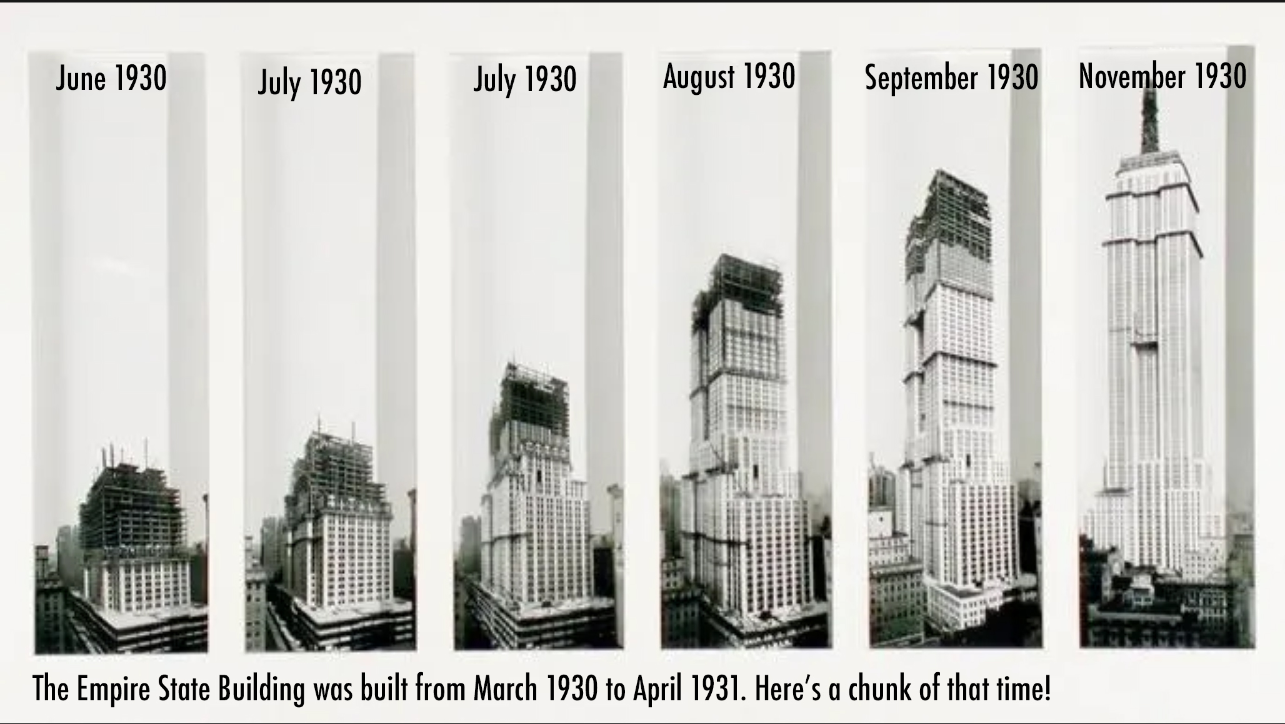
Buildings were being made taller and taller creating the modern skyscraper.
© Art Deco Society of New York

Slide 13
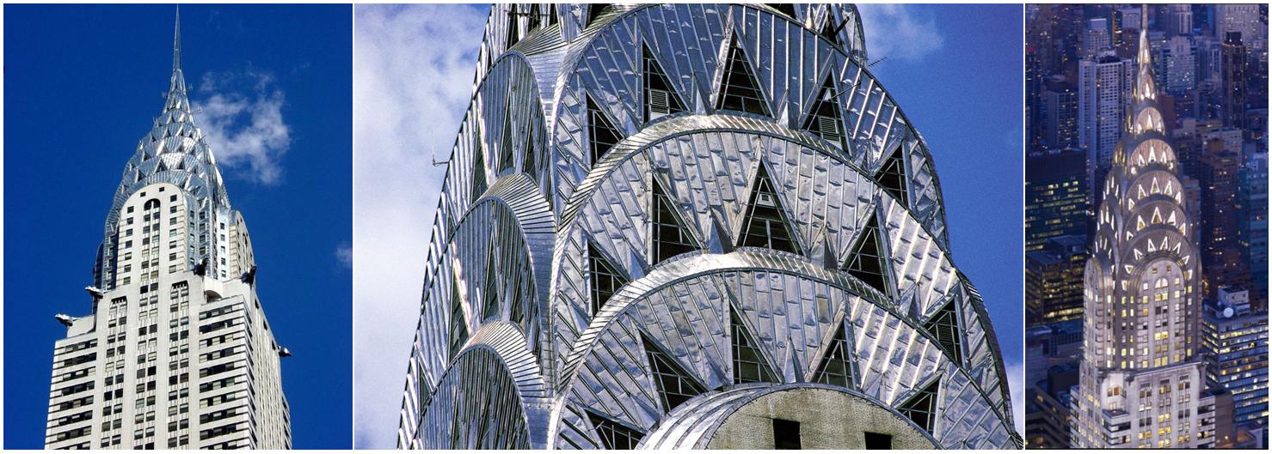
There were many new materials being created, like plastic and special metals. Many of these materials came about because of military innovation that happened during World War I.
Chrysler Building (Manhattan)
© Art Deco Society of New York

Slide 14
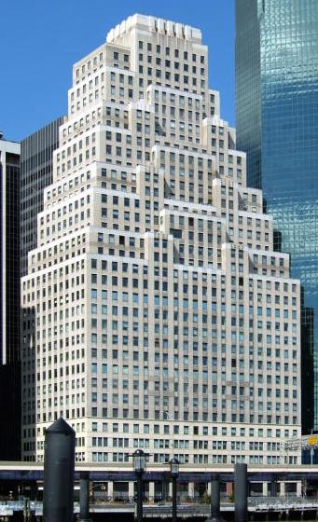
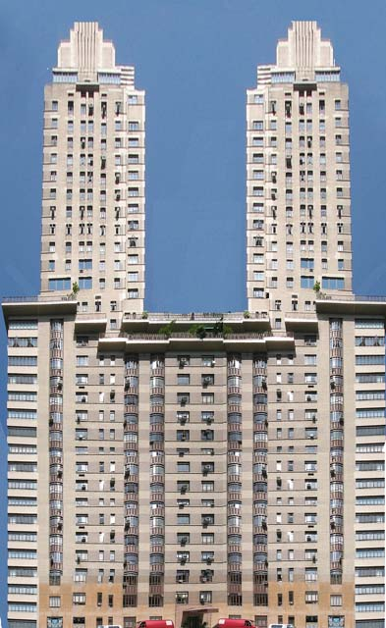
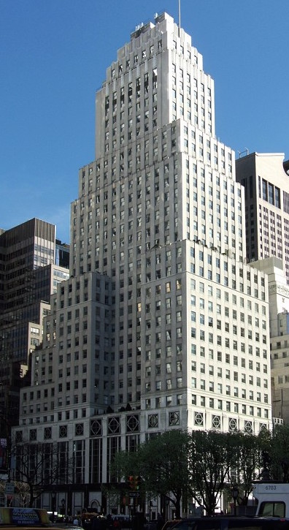
Even though buildings have the same structural parts, each building is unique.
Most Art Deco buildings share features that are similar but not exactly the same. Like people in a family!
120 Wall Street
(Manhattan)
The Century
(Manhattan)
Squibb Building
(Manhattan)
© Art Deco Society of New York
© Art Deco Society of New York

Slide 15
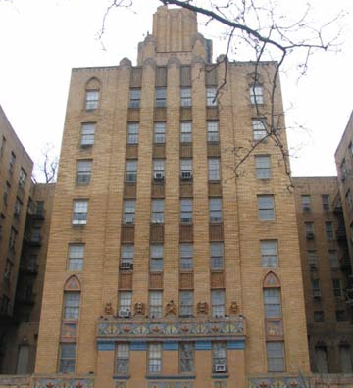
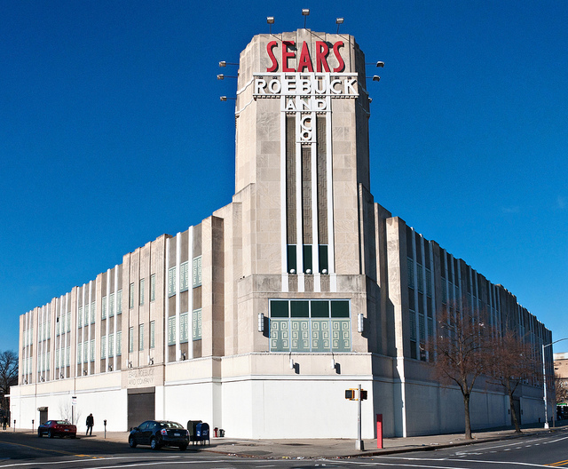
Look at these buildings…
Do you notice any similar features?
1001 Jerome Avenue
(The Bronx)
Sears, Roebuck & Company Building
(Brooklyn)
© Art Deco Society of New York

Slide 16
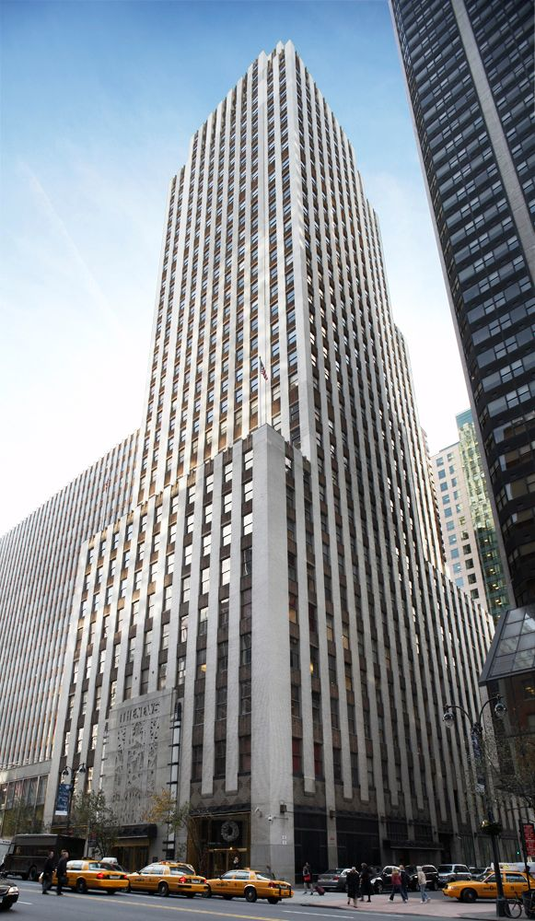
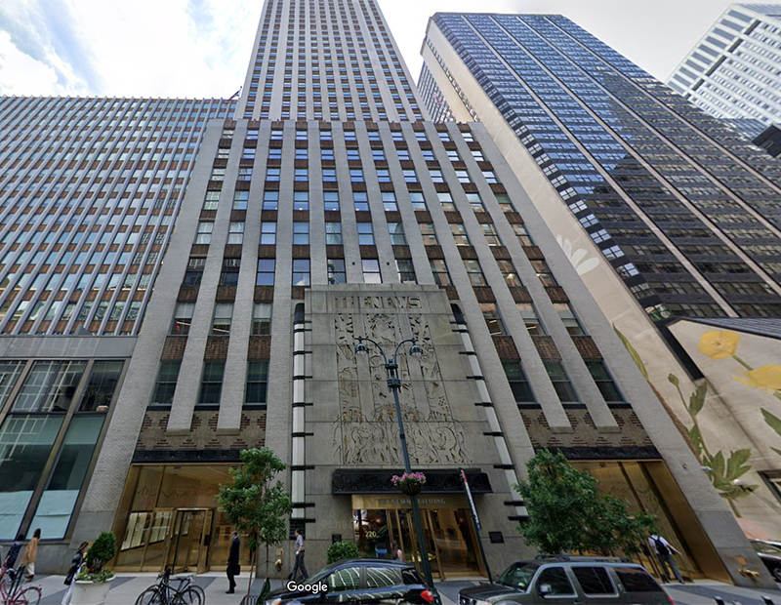
Massing
Every building has a general shape and size that takes up space in three dimensions.
The overall impression of its size and shape is called massing.
Daily News Building (Manhattan)
© Art Deco Society of New York
© Art Deco Society of New York

Slide 17
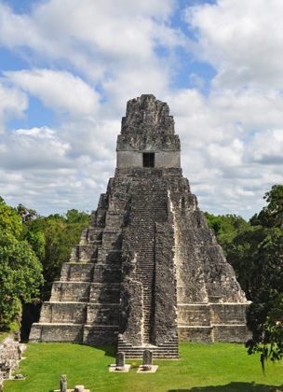
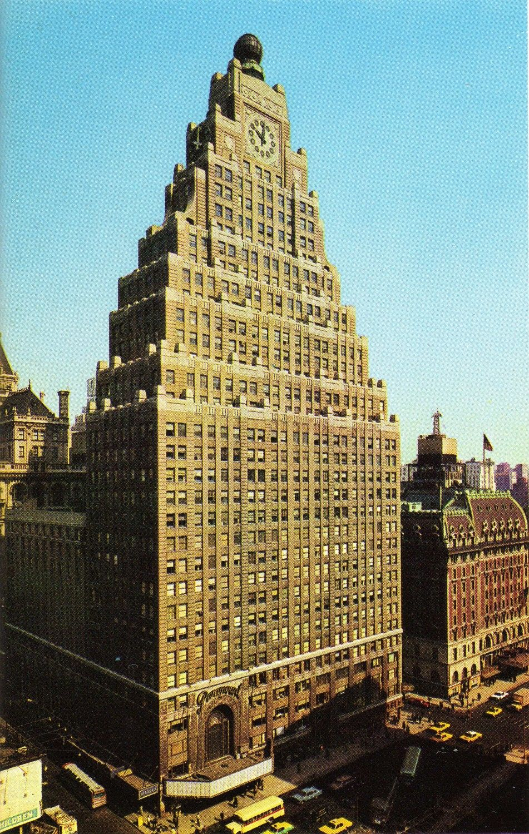
Art Deco skyscrapers normally have different stepped levels.
These steps are similar to the steps in Mayan and Aztecan pyramids (ziggurats).
Tikal, Guatemala
Paramount Building (Manhattan)
© Art Deco Society of New York

Slide 18
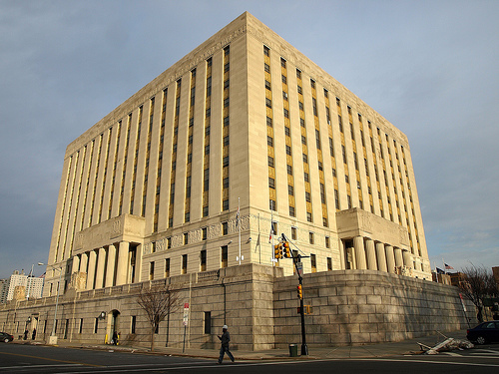
Vertical lines make your eye move all the way from the bottom of a building to the top.
VERTICAL LINES
In Art Deco buildings, windows are often “stacked” in vertical lines.
The Bronx County Building (The Bronx)
© Art Deco Society of New York
© Art Deco Society of New York

Slide 19
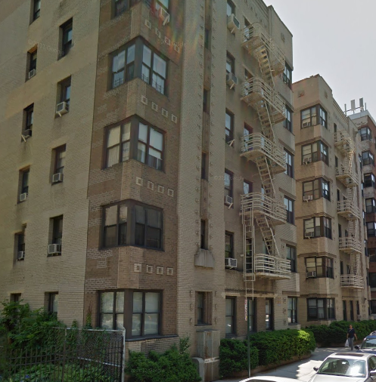
WRAP AROUND WINDOWS
Wrap around windows are windows that wrap around the corner of a building.
This type of window is very common in Art Deco apartment buildings.
265 Cabrini Boulevard (Manhattan)
© Art Deco Society of New York
© Art Deco Society of New York

Slide 20
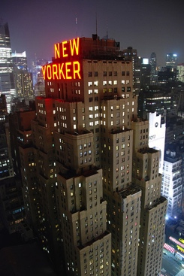
Flat Roofs
Flat roofs are roofs that have no angle or slant.
Some Art Deco buildings have flat roofs, or many layers of flat roofs, that make the top of the building look like it becomes more narrow towards the top.
The New Yorker (Manhattan)
© Art Deco Society of New York
© Art Deco Society of New York

Slide 21
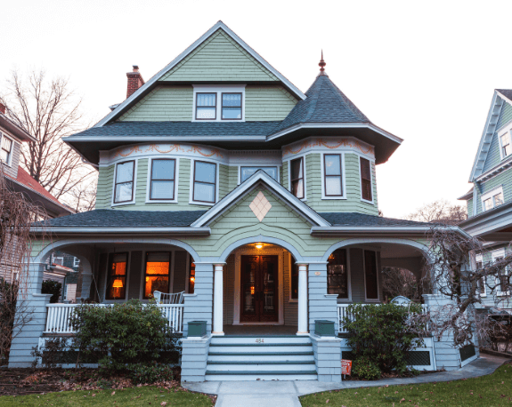
Pitched Roofs
Pitched roofs are roofs with slants.
Pitched roofs were popular before the Art Deco style, but they are not common in Art Deco buildings.
Slanted roofs on a private house in Brooklyn—not Art Deco!
© Art Deco Society of New York
© Art Deco Society of New York

Slide 22
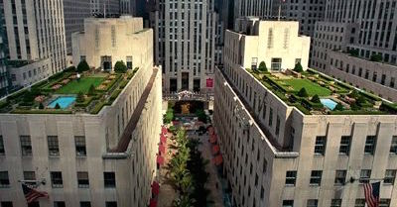
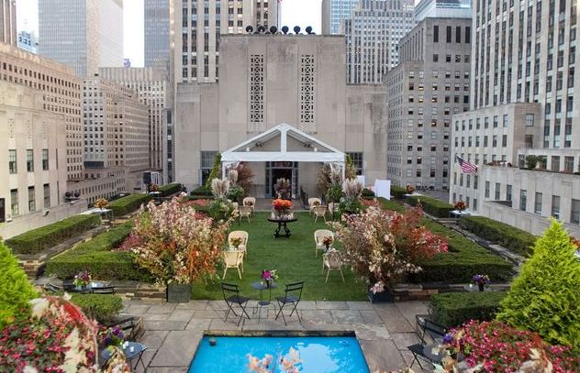
Some flat roofs have rooftop gardens, like the ones at Rockefeller Center (Manhattan).
© Art Deco Society of New York

Slide 23
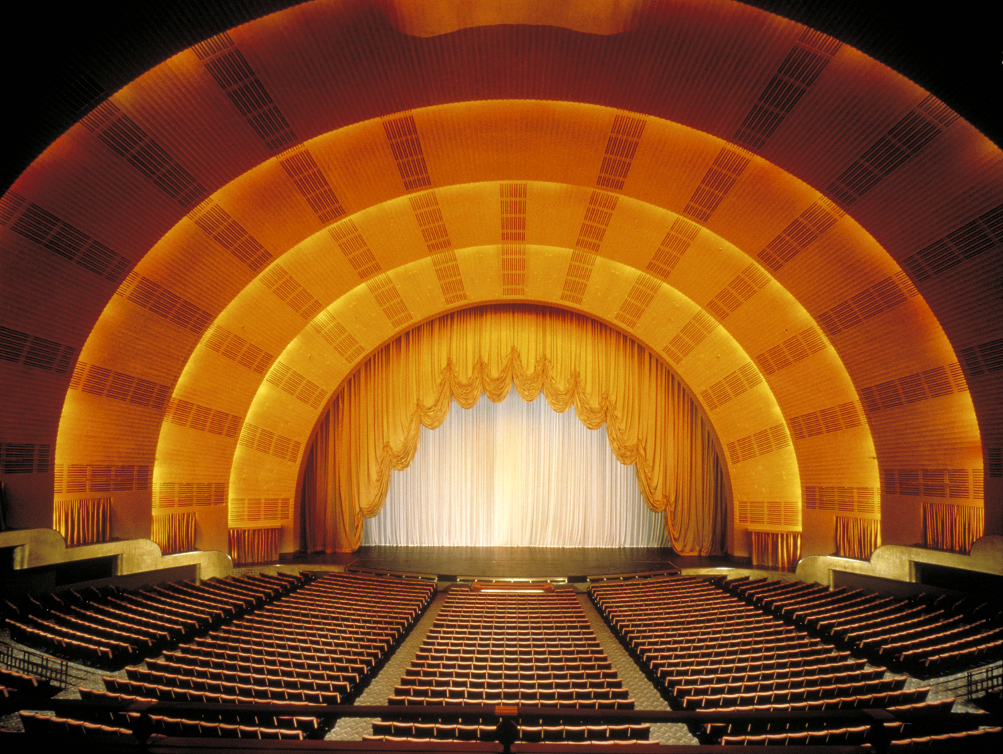
PART II:
DESIGN
Radio City Music Hall (Manhattan)
© Art Deco Society of New York
© Art Deco Society of New York

Slide 24
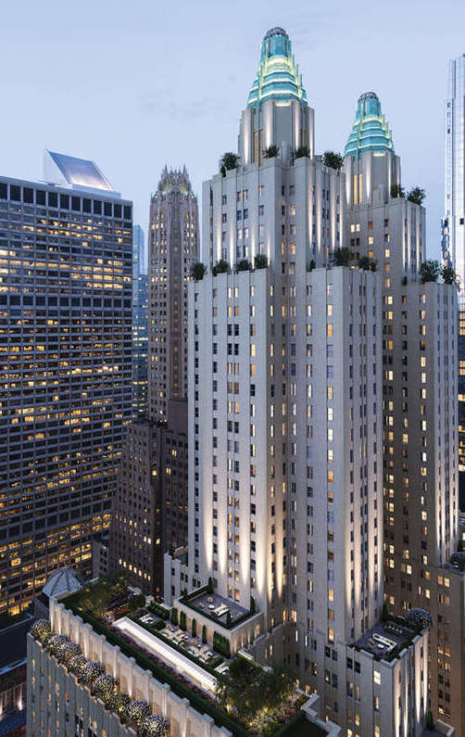
All buildings have both structure and design.
Every building is made of the same structural parts, but they all look different because of how a building is designed or decorated.
When creating a building, architects make artistic choices that change the look of a building.
All of those artistic choices are called “design.”
The Waldorf Astoria (Manhattan)
© Art Deco Society of New York

Slide 25
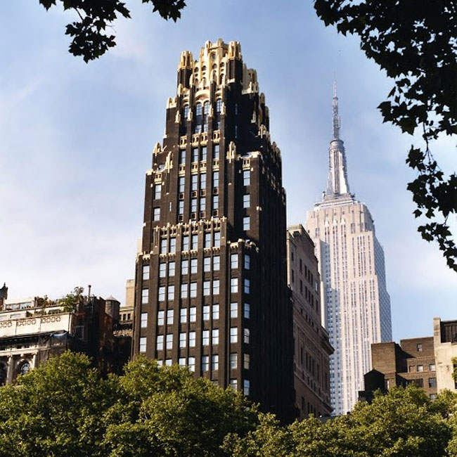
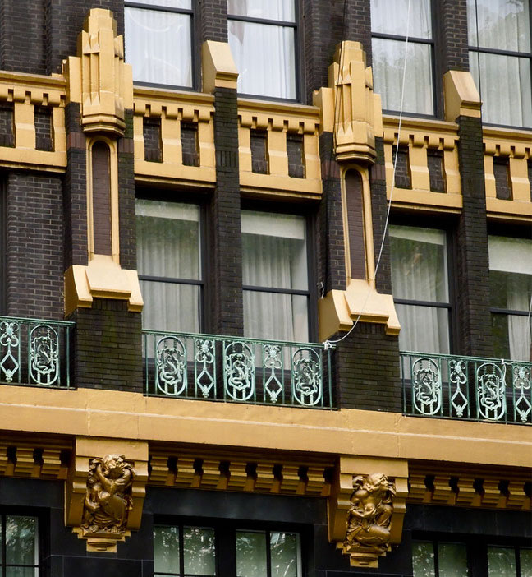
Design of all buildings include:
The colors
Materials on the outside of the building
American Radiator Building (Manhattan)
© Art Deco Society of New York

Slide 26
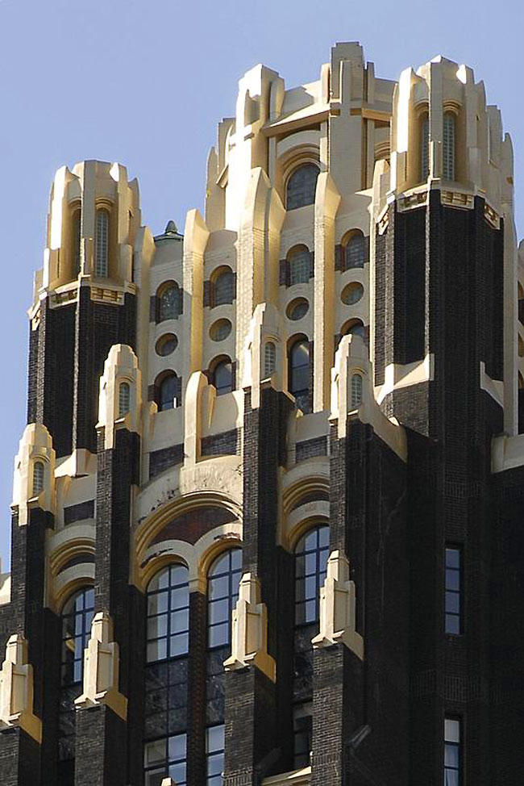
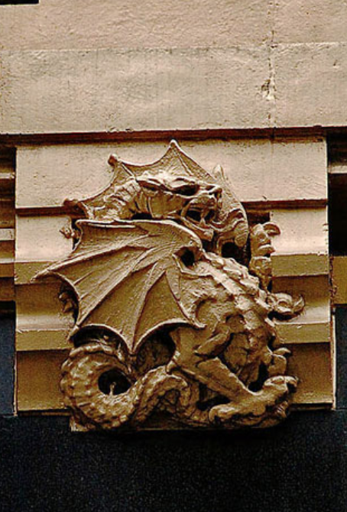
The addition of objects to decorate walls or even the top of a building
American Radiator Building (Manhattan)
© Art Deco Society of New York

Slide 27
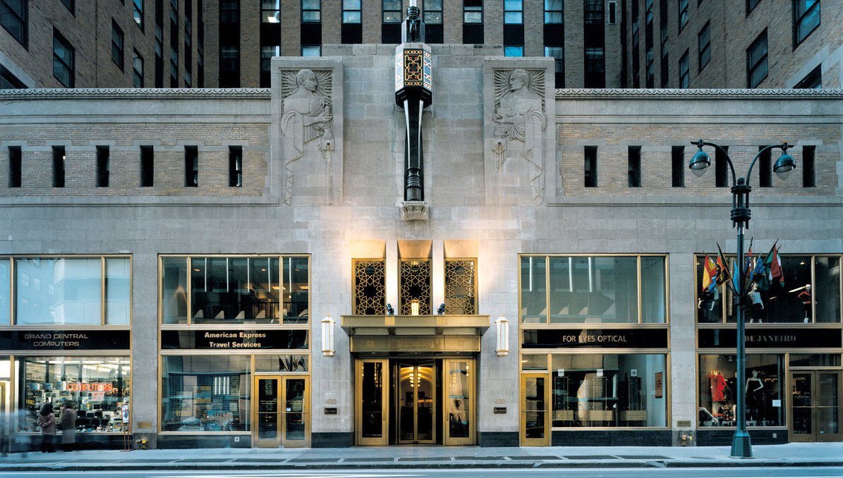
What the entrance looks like
Graybar Building (Manhattan)
© Art Deco Society of New York

Slide 28
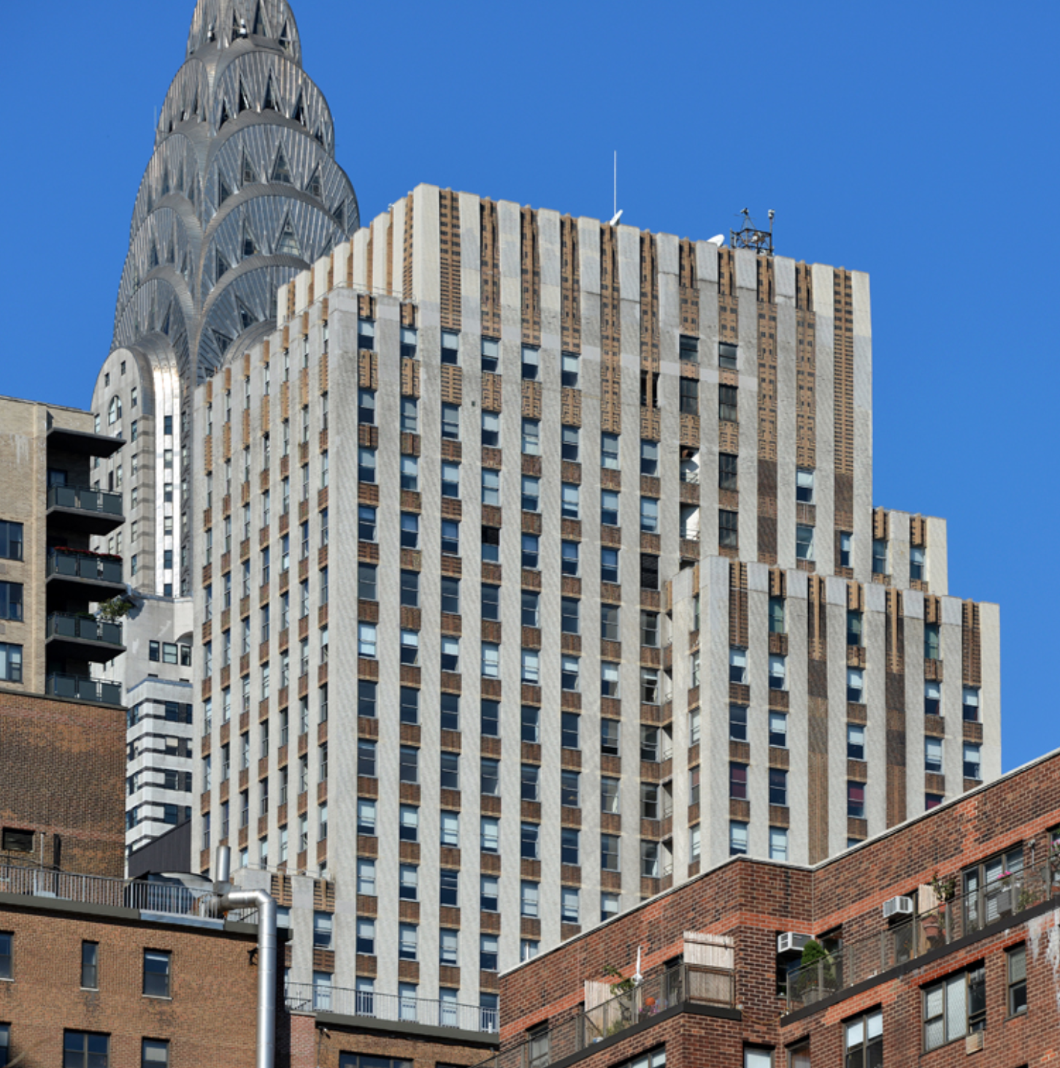
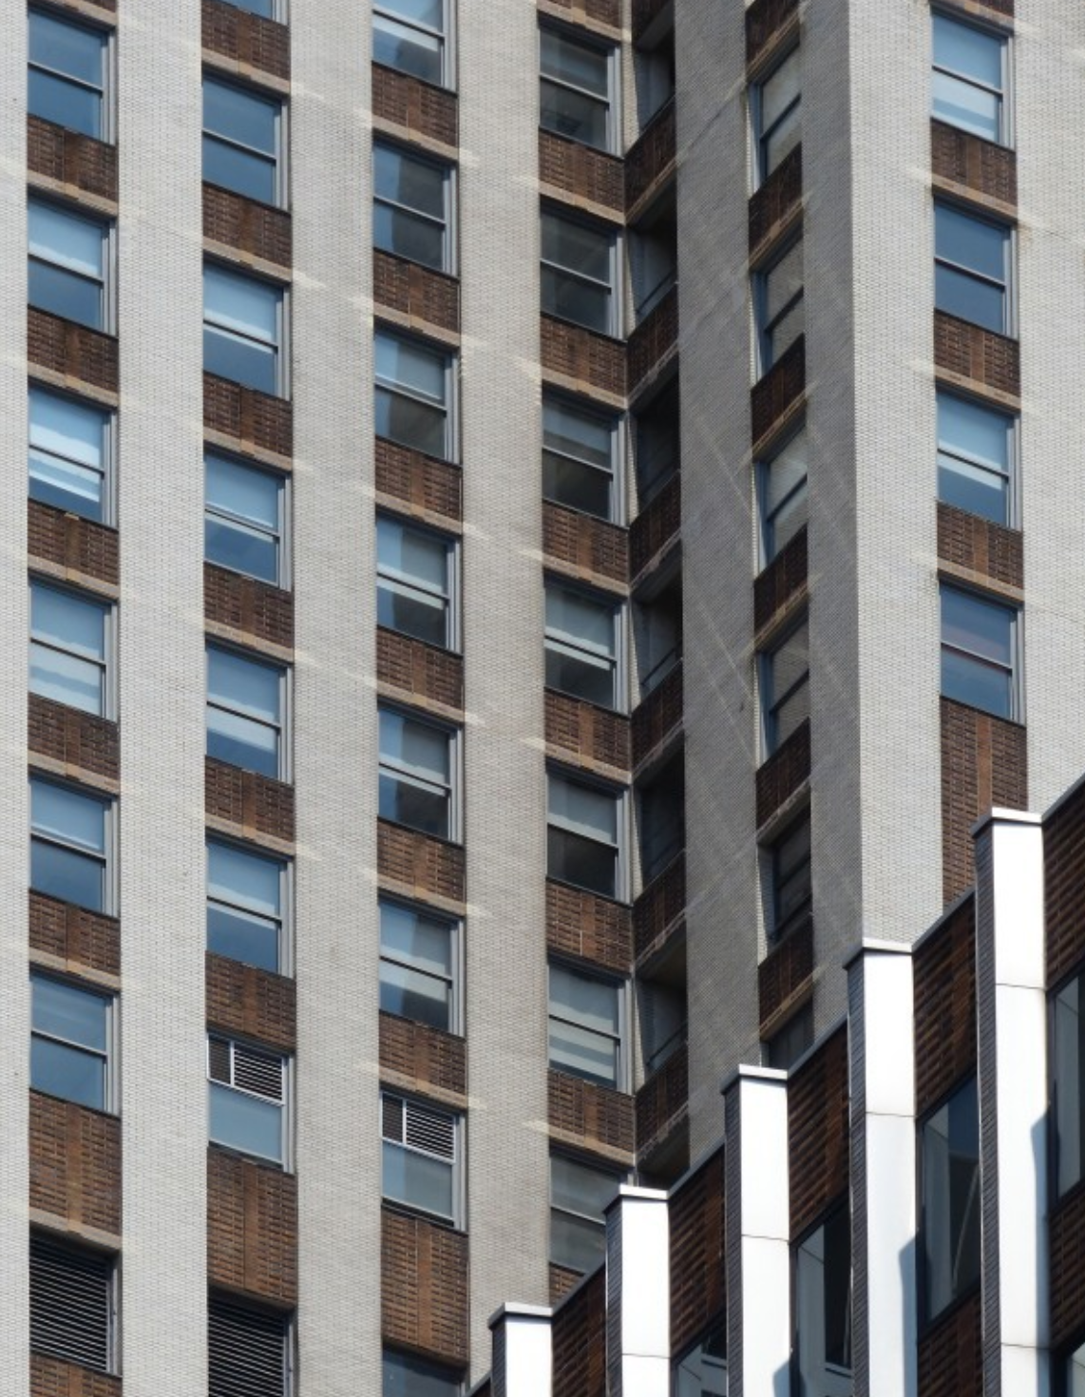
How the windows are shaped, framed, or accented
Daily News Building (Manhattan)
© Art Deco Society of New York

Slide 29
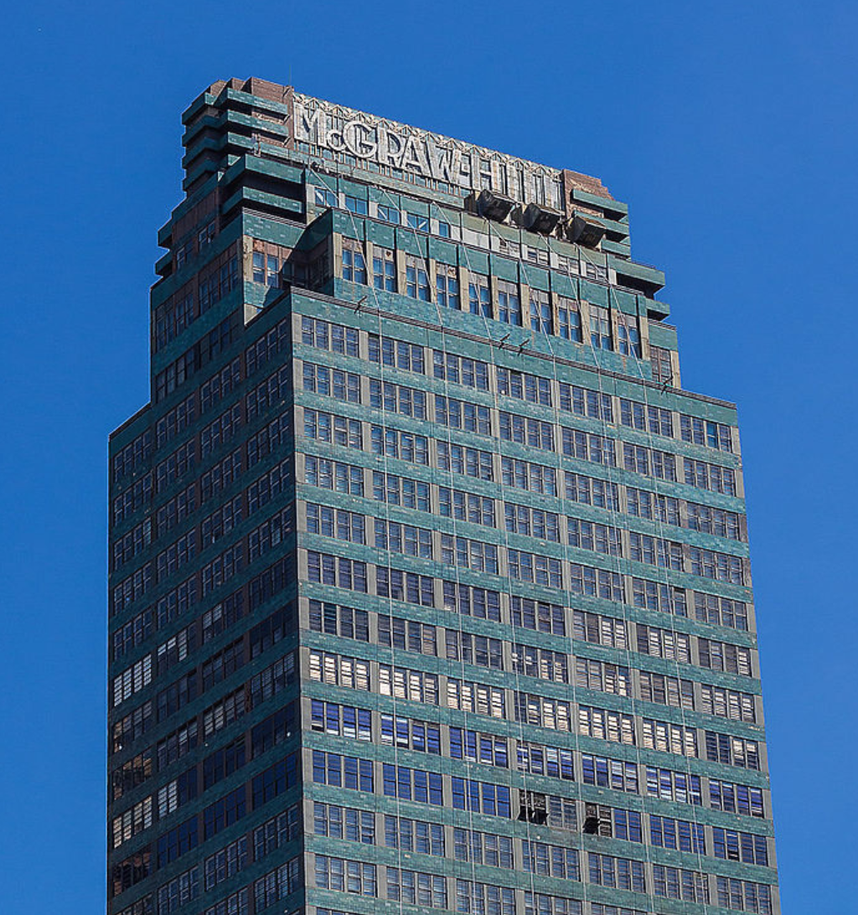
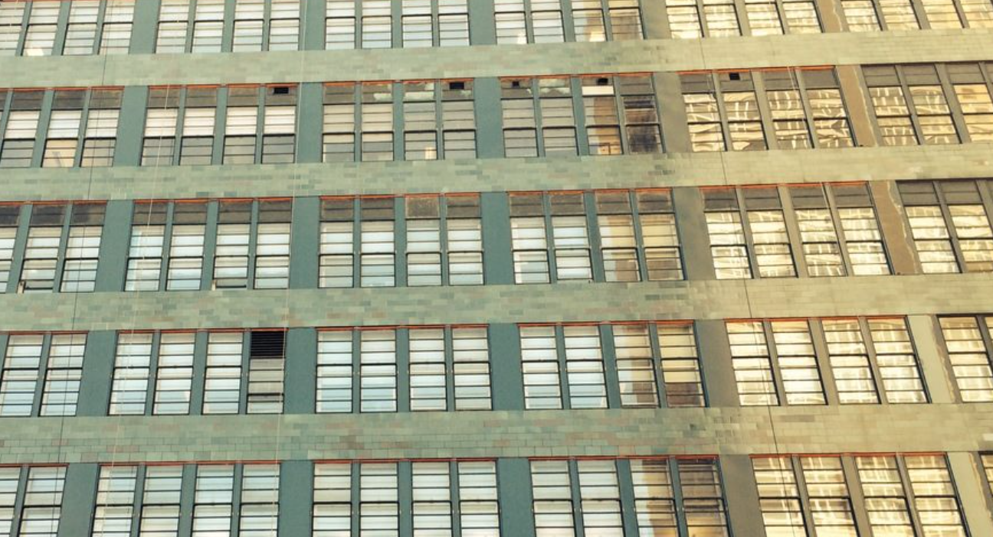
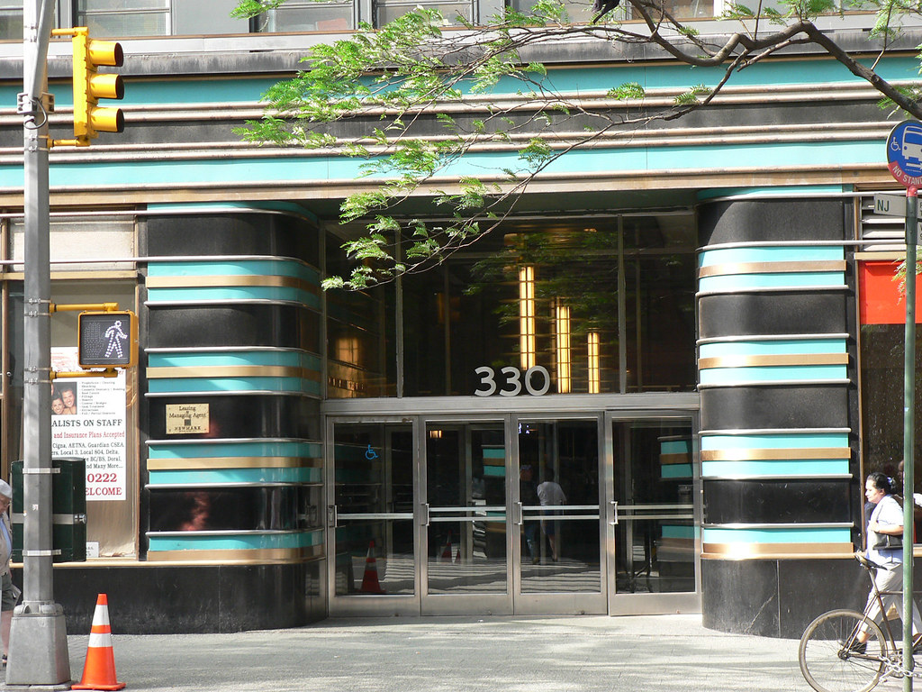
Patterns on the walls (interior or exterior) or around doors
The McGraw Hill Building (Manhattan)
© Art Deco Society of New York

Slide 30
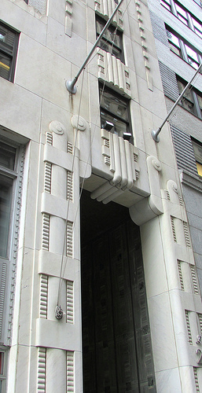
Surface material
The exterior of building can be made of various materials applied to its surface.
Examples include:
Brick
Metal
Stone
Glass
Let’s take a look at these materials…
29 Broadway (Manhattan)
© Art Deco Society of New York

Slide 31
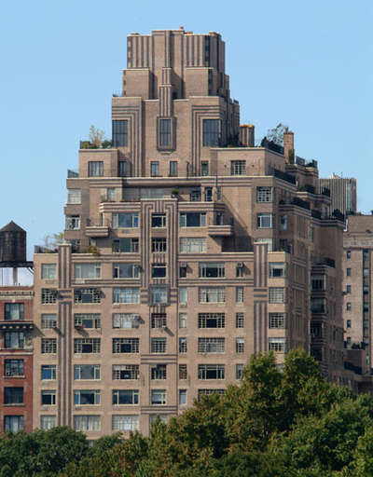
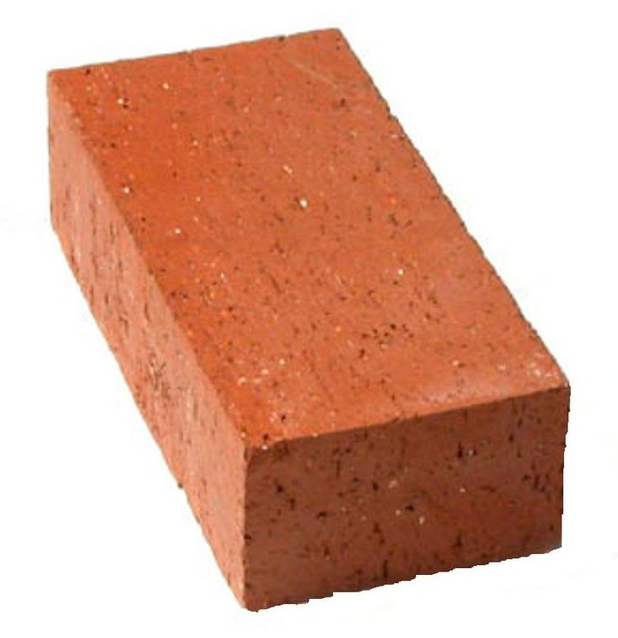
Brick can be a surface material.
The Ardsley (Manhattan)
© Art Deco Society of New York

Slide 32
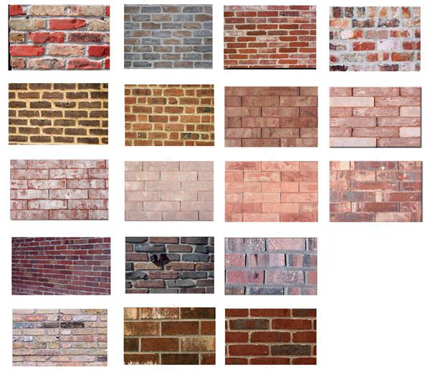
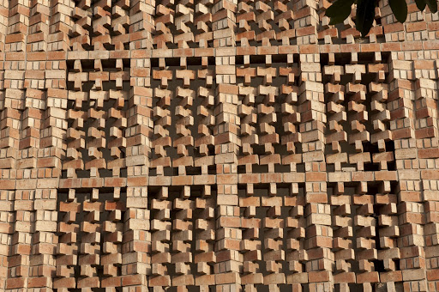
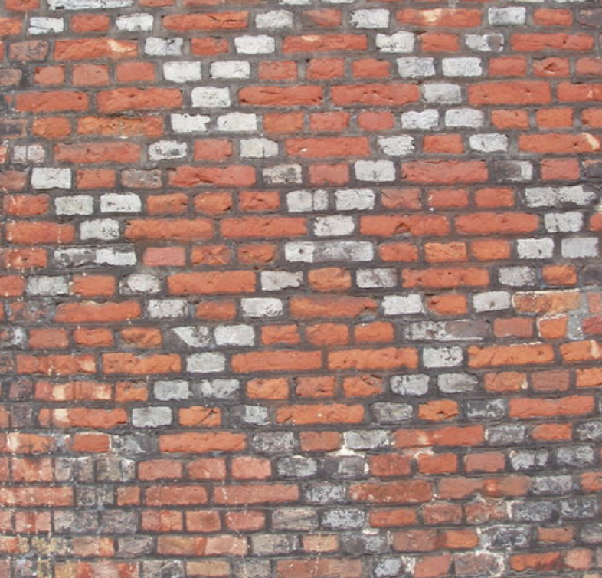
Bricks comes in many different colors.
Bricks can be rotated different ways and make all kinds of patterns.
© Art Deco Society of New York

Slide 33
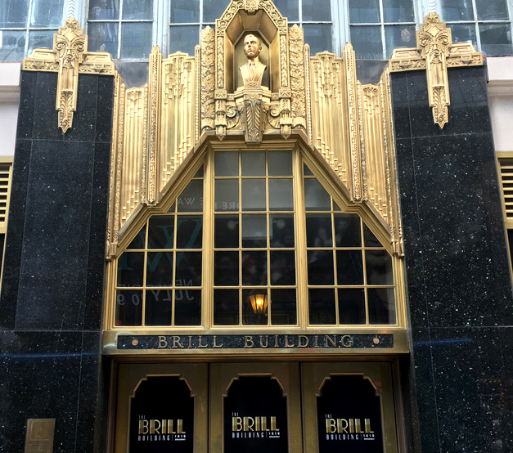

Metal can be a surface material.
The Brill Building (Manhattan)
© Art Deco Society of New York

Slide 34



Stone can be a surface material.
The Eldorado (Manhattan)
© Art Deco Society of New York

Slide 35


Sometimes other materials are made to look like stone (cast stone), but they are not real stone. Concrete is often made to look like stone.
181st St. Subway Station (Manhattan)
© Art Deco Society of New York

Slide 36


Glass can be a surface material and it can come in lots of colors, not just clear!
One Wall Street (Manhattan)
© Art Deco Society of New York

Slide 37

But glass can also be used to make lots of windows that look like walls of glass.
Steiner Studios
(Brooklyn)
© Art Deco Society of New York

Slide 38


Sometimes glass is made into big, thick blocks called glass bricks.
William Lescaze House (Manhattan)
© Art Deco Society of New York

Slide 39


Can you name some of the materials
in this Art Deco building?
Stella Tower (Manhattan)
© Art Deco Society of New York

Slide 40


Common Deco Surface Materials Are:
Limestone – a smooth stone often made into large blocks with a very smooth surface.
Limestone
Brooklyn Public Library (Brooklyn)
© Art Deco Society of New York

Slide 41


Granite – a natural stone that could be highly polished to make a very luxurious surface.
Granite rock
275 Madison Avenue (Manhattan)
© Art Deco Society of New York
© Art Deco Society of New York

Slide 42

DECORATIVE SURFACE MATERIALS
Surface materials like limestone and granite are often used for a large part of a building’s exterior.
30 Rockefeller Plaza (Manhattan)
© Art Deco Society of New York

Slide 43


While designing a building architects will add smaller sections of decoration out of other, different surface materials.
30 Rockefeller Plaza (Manhattan)
© Art Deco Society of New York

Slide 44

DECORATIVE SURFACE MATERIALS
Decorative surface materials are often used to add decoration to the outside of a building.
In the 1920s and 1930s, there were many new materials added to Art Deco buildings to make them look different and more modern, or newer.
Chrysler Building (Manhattan)
© Art Deco Society of New York
© Art Deco Society of New York

Slide 45


Mosaics - a picture or design made from small pieces of colored glass or ceramic tiles.
Mosaic tiles
The Fish Building (The Bronx)
© Art Deco Society of New York

Slide 46


Slide 47


Slide 48


Slide 49


Terracotta - a red clay often used for ceramic bowls, vases, or artistic works was used in the decoration of a building.
Terracotta - Red clay
Gramercy House (Manhattan)
Terracotta can bring bright colors to the surface of a building.
© Art Deco Society of New York

Slide 50


Sculptural Relief
Relief is a form of sculpture (3-D art) where the figure or design is raised from the background, similar to a coin.
Relief sculptures were often used to enhance entrances, make borders around windows, and along roof edges.
The Daily News Building (Manhattan)
© Art Deco Society of New York

Slide 51

SPANDREL
Spandrel panels are decorative pieces that fit between windows of different floors that are aligned right above one another.
In Art Deco, these often have a decorative pattern and are made of metals, terracotta, or stone.
1500 Grand Concourse (The Bronx)
© Art Deco Society of New York
© Art Deco Society of New York

Slide 52

GEOMETRIC SHAPES
Many architects in the 1920s and 1930s used geometric shapes and lines to make patterns such as zigzags (right) and chevrons (below).
265 Cabrini Boulevard (Manhattan)
© Art Deco Society of New York
© Art Deco Society of New York

Slide 53

Geometric shapes became so popular that architects and designers began to simplify other natural shapes into geometric forms—like fountains and leaves!
Art Deco fountain at 181 Madison (Manhattan)
© Art Deco Society of New York
© Art Deco Society of New York

Slide 54



Chanin Building (Manhattan)
© Art Deco Society of New York

Slide 55

PARAPET
A parapet is a low wall along the edge of a roof, bridge, or balcony.
In Art Deco buildings, a parapet can sometimes go far above the roof to make the building more decorative (pretty, fancy, or interesting to the eye.)
This is why many Art Deco buildings look like they are wearing a crown.
55 Central Park West (Manhattan)
© Art Deco Society of New York

Slide 56


Presented by:
Teachers & Parents: This presentation was designed to offer a basic understanding of New York Art Deco architecture. There is much more to discover about 1920s and 1930s New York at ArtDeco.org.
The New York Art Deco Registry at ArtDeco.org is a great resource for finding Deco Buildings in your area.
© Art Deco Society of New York
© Art Deco Society of New York

