Slide 1
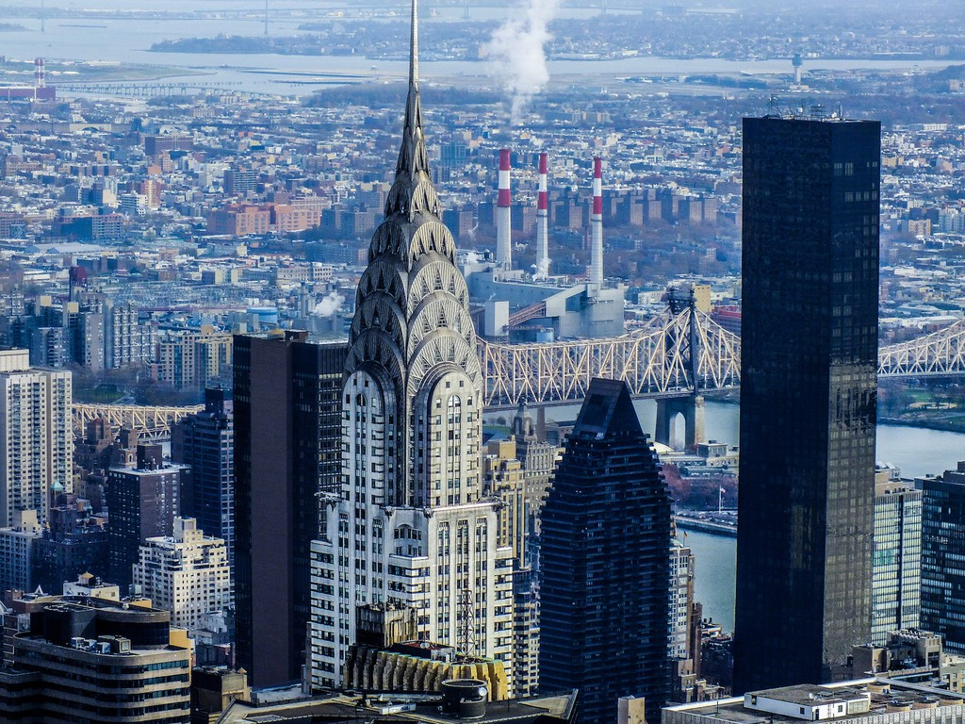
WHAT MAKES A NEW YORK BUILDING ART DECO?
Chrysler Building, Midtown East (Manhattan)
© Art Deco Society of New York

Slide 2
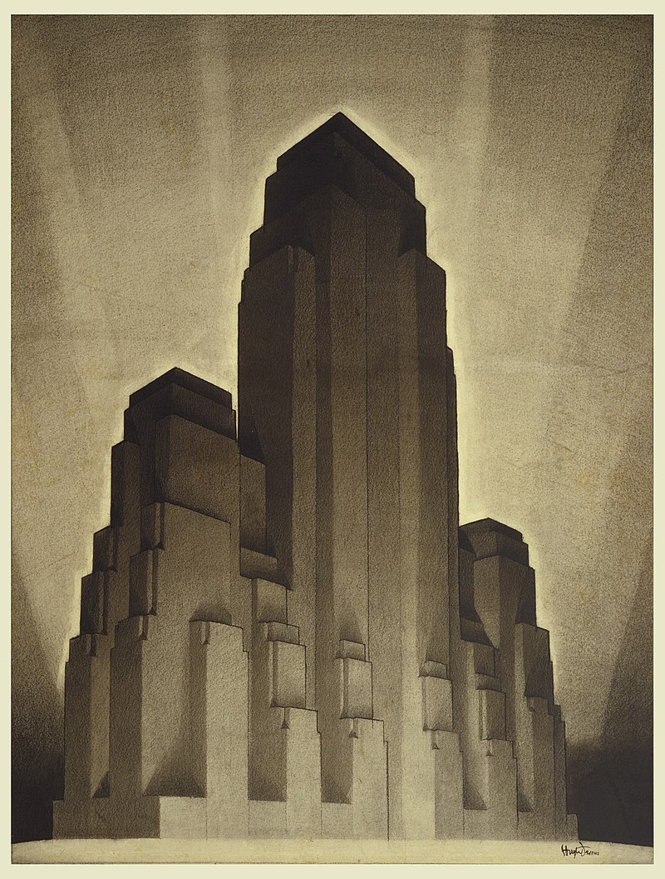
PART I:
STRUCTURE
Hugh Ferriss,
1916
© Art Deco Society of New York
© Art Deco Society of New York

Slide 3
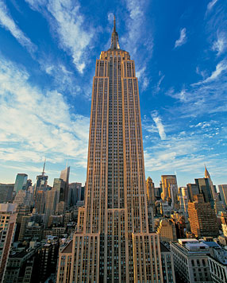
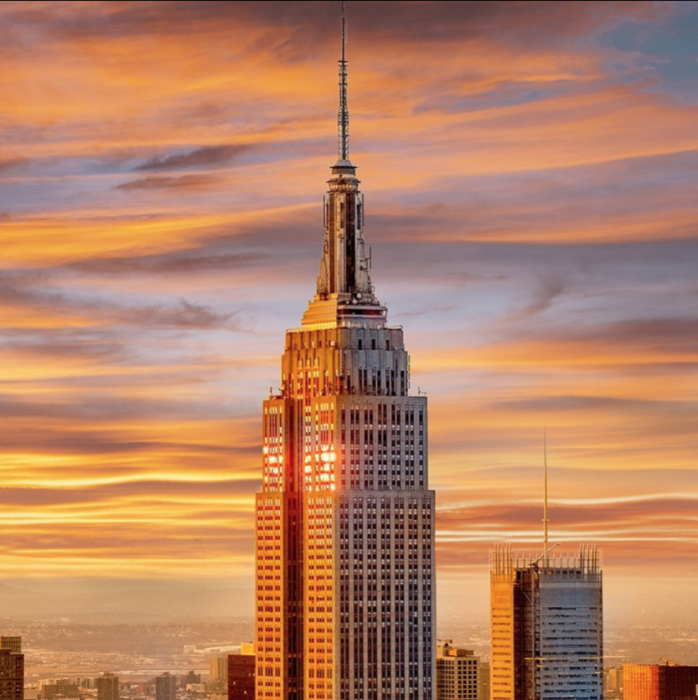
All buildings have STRUCTURE and design.
Empire State Building (Manhattan)
© Art Deco Society of New York
© Art Deco Society of New York

Slide 4
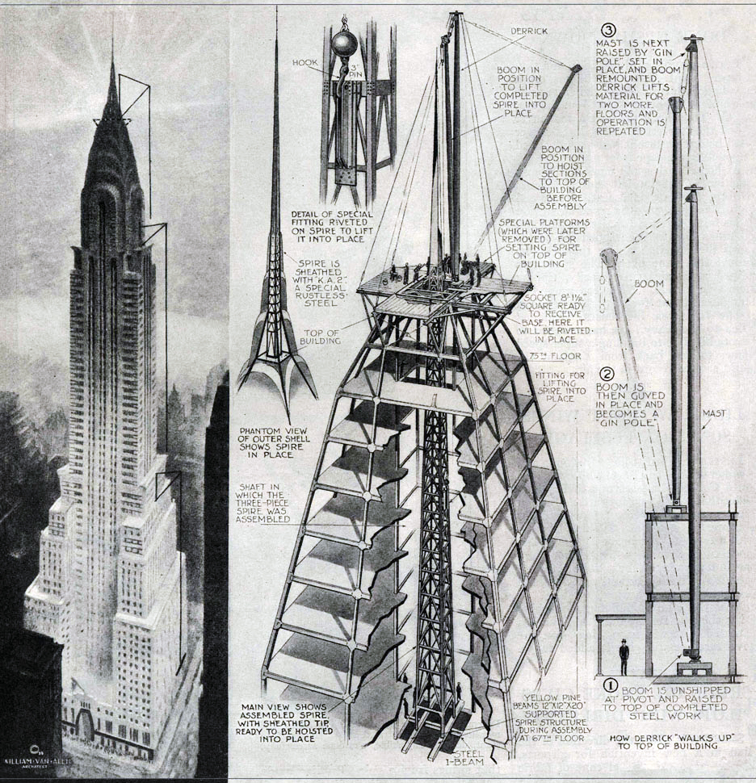
Internal structure includes the parts of a building that:
give it support
keep it standing
make it function
(work for us!)
Chrysler Building (Manhattan)
© Art Deco Society of New York
© Art Deco Society of New York

Slide 5
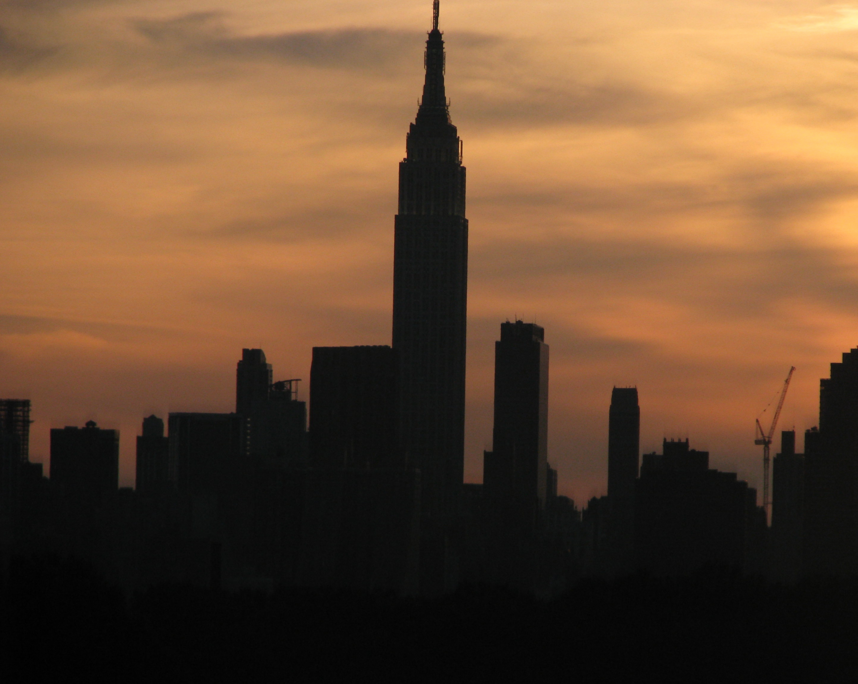
Structure can also be the silhouette, or outline, of a building.
Empire State Building (Manhattan)
© Art Deco Society of New York
© Art Deco Society of New York

Slide 6
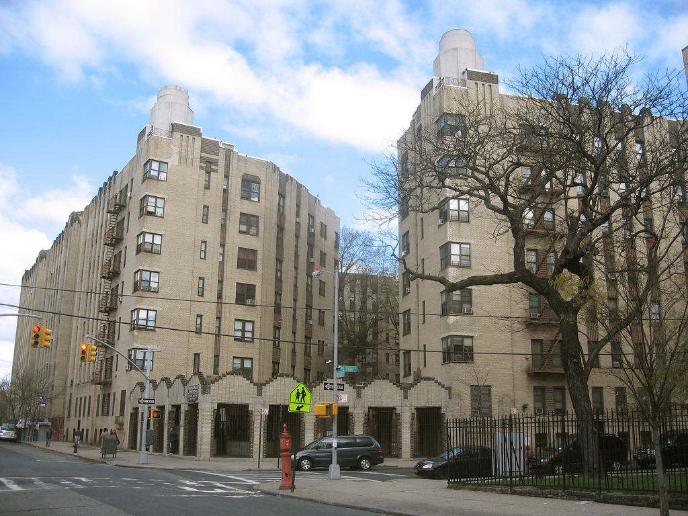
The structure of all buildings includes:
Walls
Windows
Roofs
Entrances
These can be interior
or exterior parts.
Noonan Plaza (The Bronx)
© Art Deco Society of New York
© Art Deco Society of New York

Slide 7
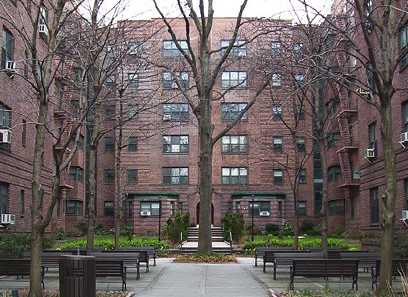
Which parts of The structure do you see in this Art Deco building?
Structure Key
Walls
Windows
Roofs
Entrances
Dunolly Gardens (Queens)
© Art Deco Society of New York
© Art Deco Society of New York

Slide 8
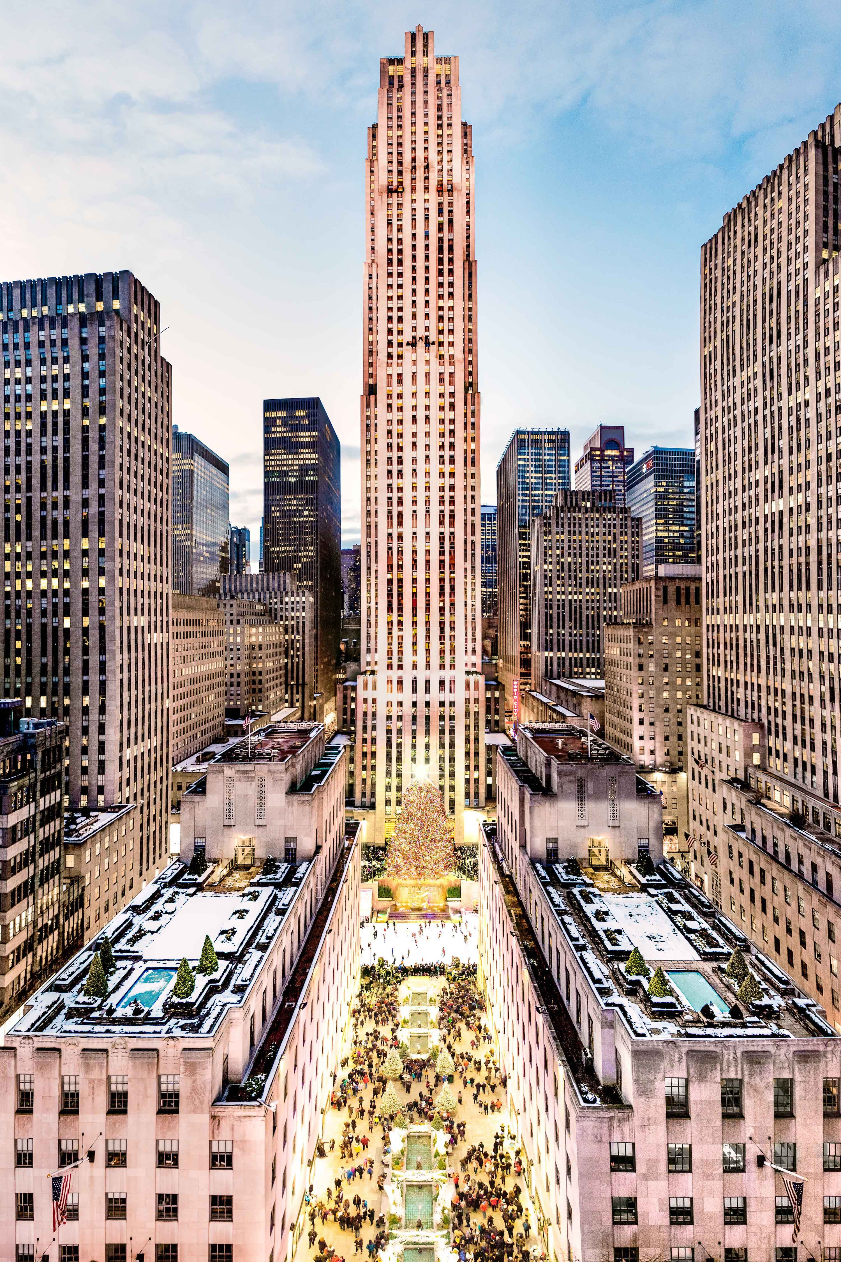
The person who designs a building is called an Architect.
How the architect puts these structural parts together determines the style of a building:
Walls
Windows
Roofs
Entrances
Outdoor spaces
Interior spaces
30 Rockefeller Center (Manhattan)
© Art Deco Society of New York
© Art Deco Society of New York

Slide 9
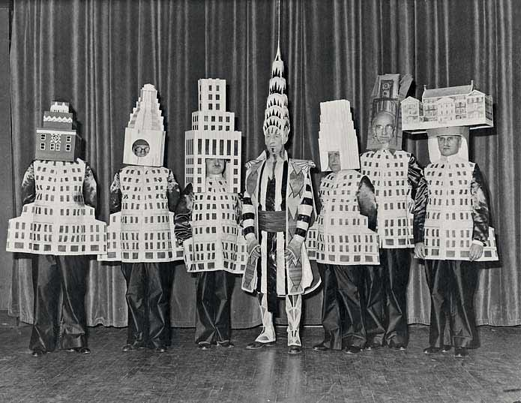
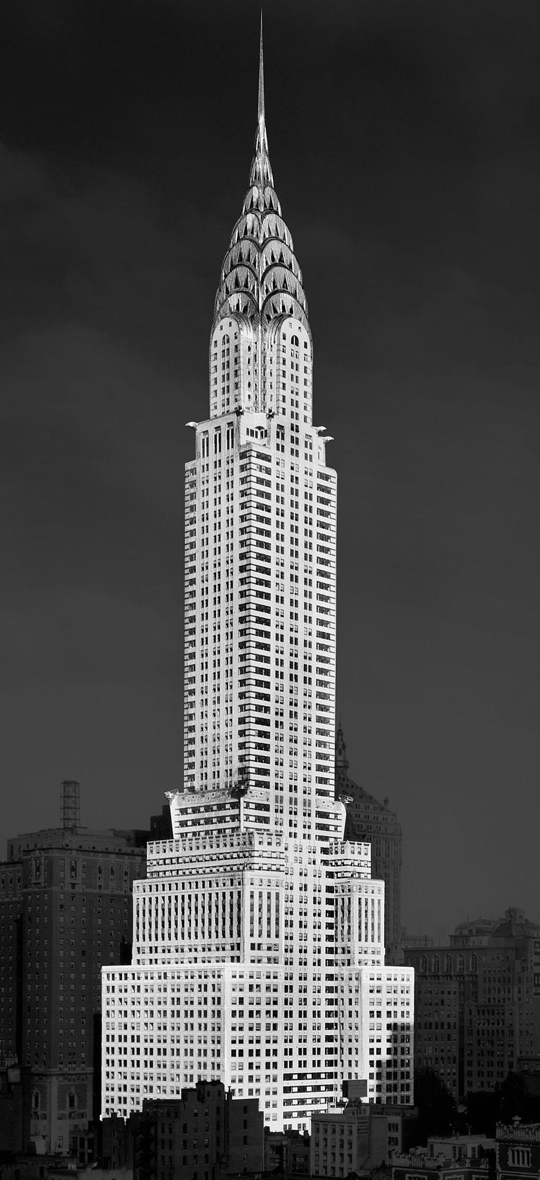
Famous architects dressed like their New York City buildings
© Art Deco Society of New York
© Art Deco Society of New York

Slide 10
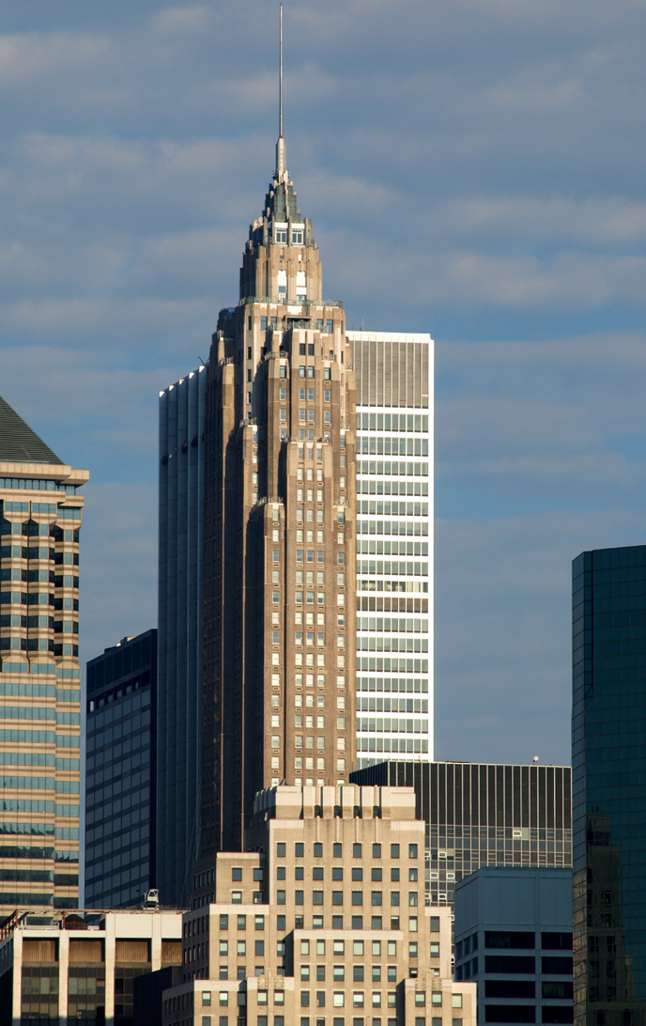
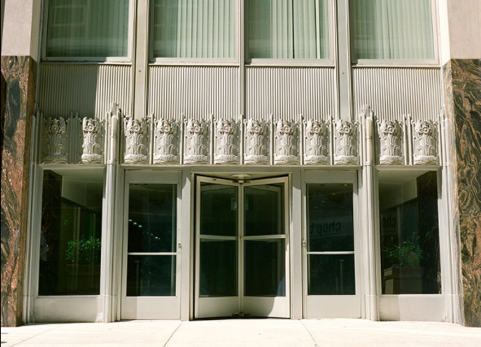
When was art deco popular?
The Art Deco style of architecture became popular in the 1920s and 1930s—about 100 years ago!
70 Pine Street (Manhattan)
© Art Deco Society of New York
© Art Deco Society of New York

Slide 11
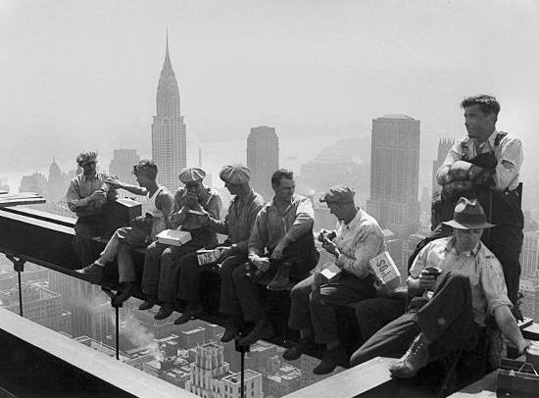
Deco buildings were designed during changing times in America, after World War I and before World War II.
Modern cities were developing.
Construction workers eating lunch up high at Rockefeller Center
© Art Deco Society of New York
© Art Deco Society of New York

Slide 12
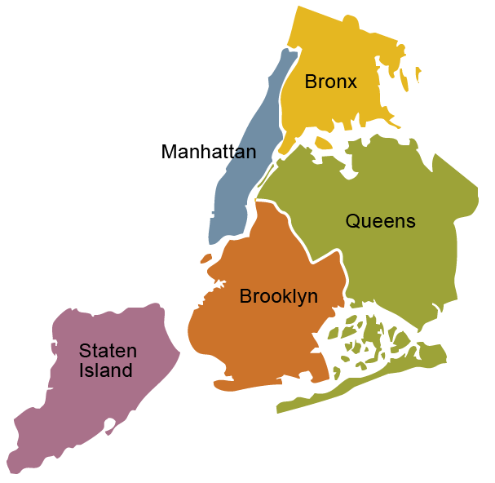
As more people moved to Manhattan, New York grew outwards toward what are now the other boroughs, as well as upwards.
© Art Deco Society of New York

Slide 13
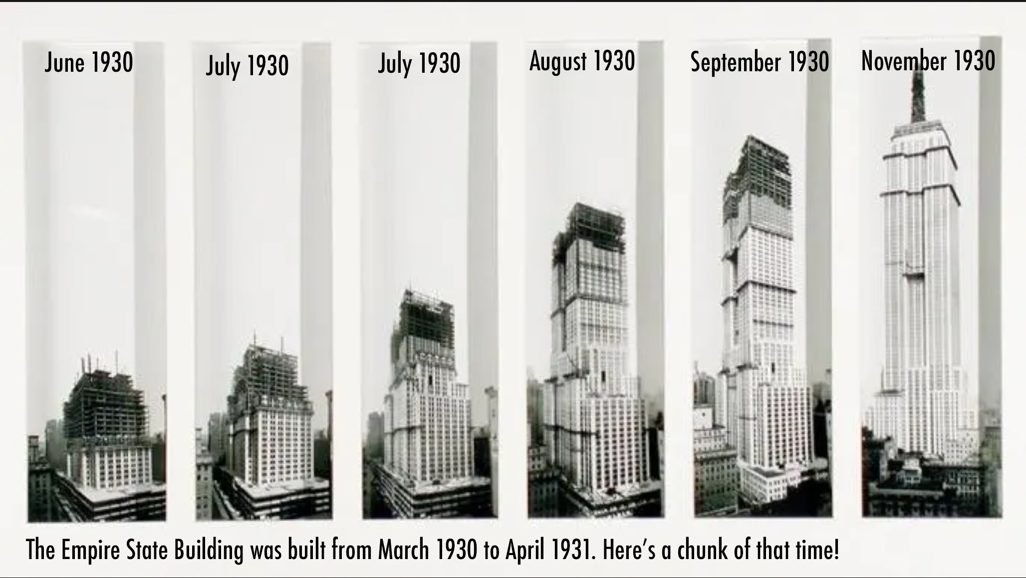
Buildings were being made taller and taller creating the modern skyscraper.
© Art Deco Society of New York

Slide 14
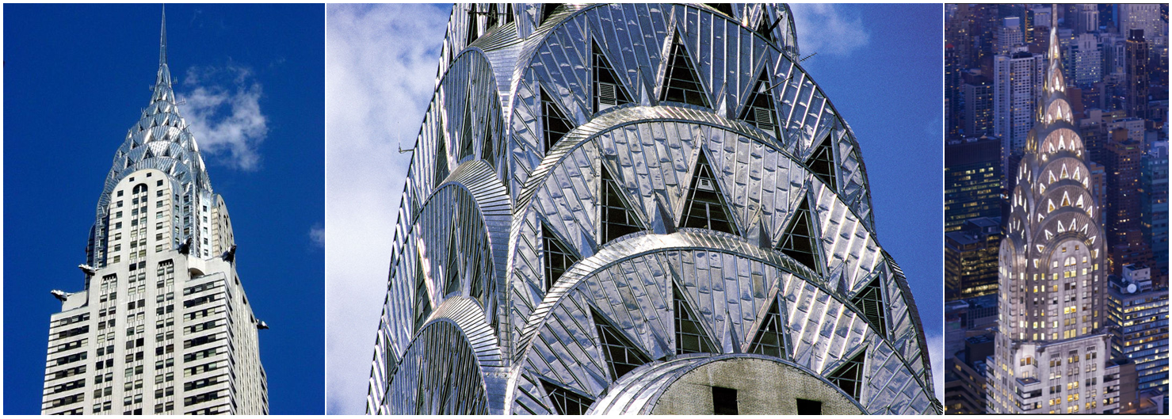
There were many new materials being created, like plastic and special metals.
Chrysler Building (Manhattan)
© Art Deco Society of New York

Slide 15
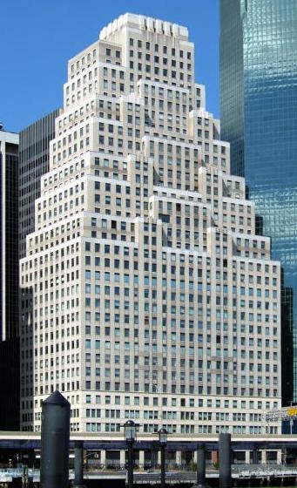
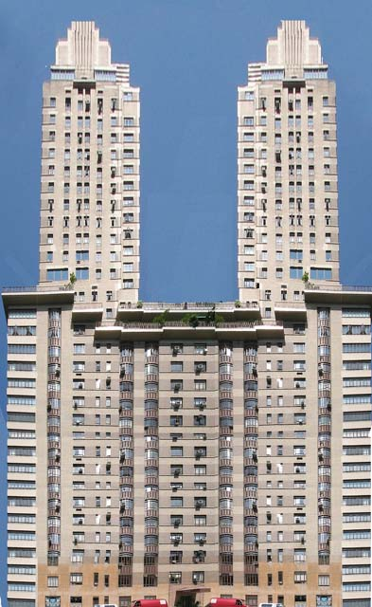
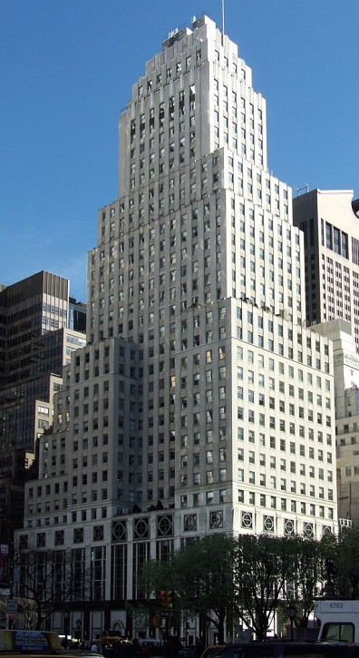
Even though buildings have the same structural parts, each building is unique.
Most Art Deco buildings share features that are similar but not exactly the same. Like people in a family!
120 Wall Street
(Manhattan)
The Century
(Manhattan)
Squibb Building
(Manhattan)
© Art Deco Society of New York
© Art Deco Society of New York

Slide 16
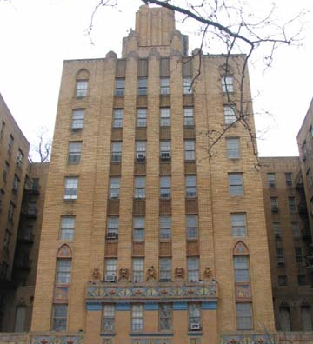
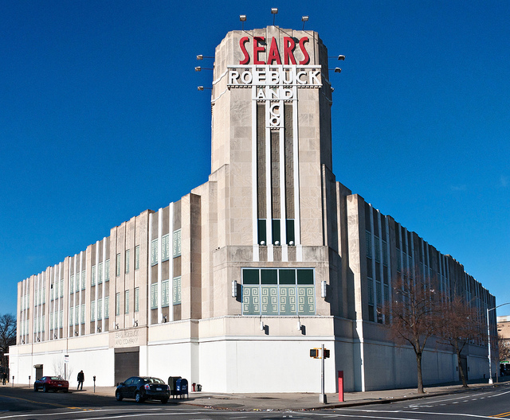
Look at these buildings… Do you notice any similar features?
1001 Jerome Avenue
(The Bronx)
Sears, Roebuck & Company Building
(Brooklyn)
© Art Deco Society of New York

Slide 17
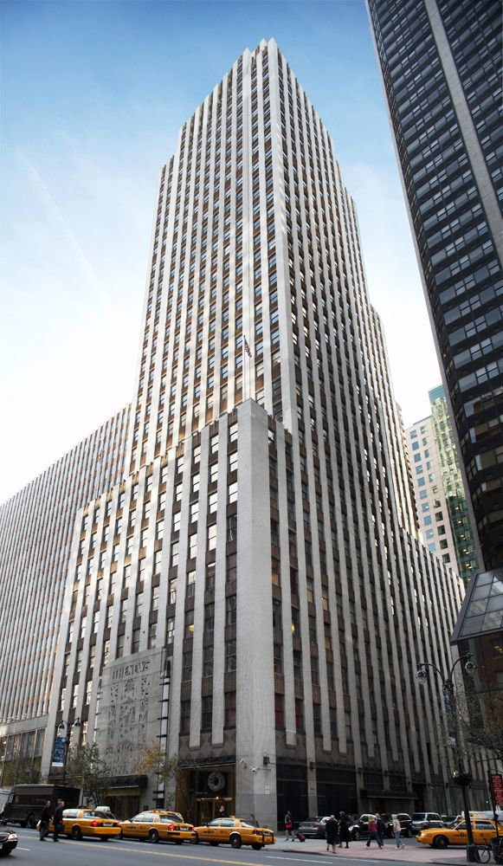
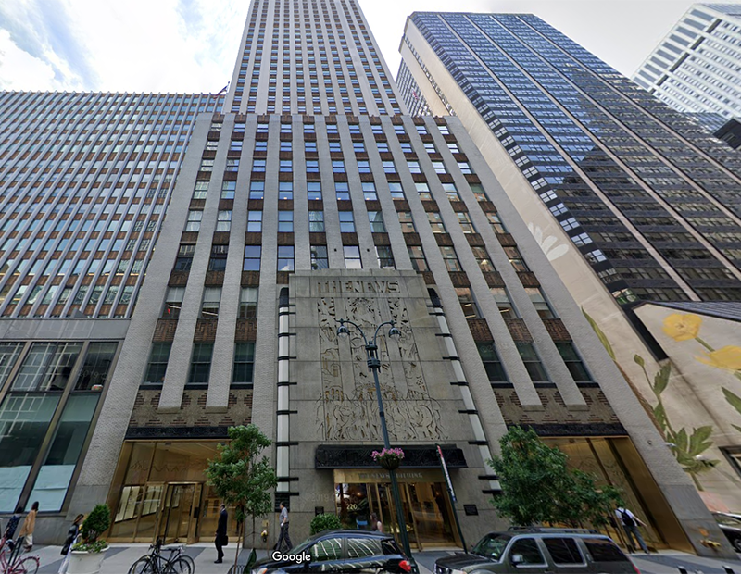
Shape and size
Buildings are 3-D, like a Playdough sculpture, not 2-D, or flat like a drawing.
Every building has a general shape and size that takes up space.
Daily News Building (Manhattan)
© Art Deco Society of New York
© Art Deco Society of New York

Slide 18
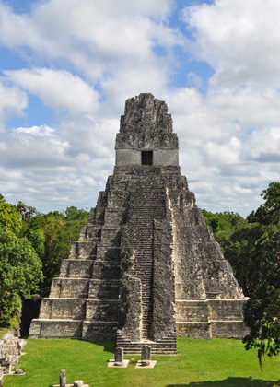
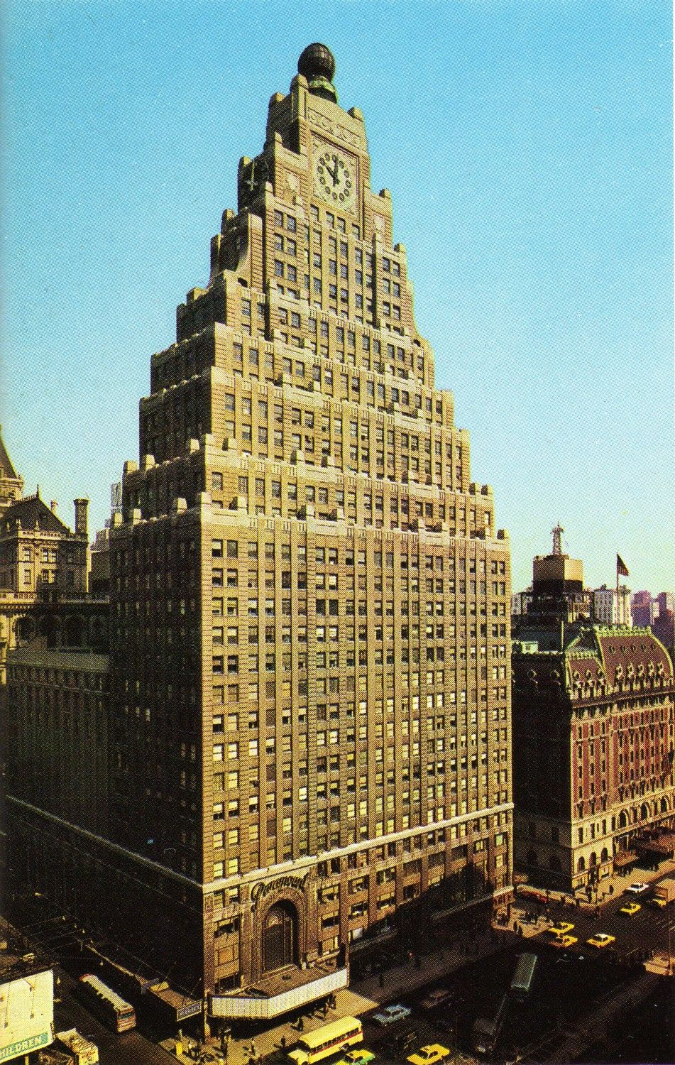
Art Deco skyscrapers normally have different stepped levels.
These steps are similar to the steps in Mayan and Aztecan pyramids (ziggurats).
Tikal, Guatemala
Paramount Building (Manhattan)
© Art Deco Society of New York

Slide 19
Vertical lines make your eye move all the way from the bottom of a building to the top.
VERTICAL LINES
In Art Deco buildings, windows are often “stacked” in vertical lines.
The Bronx County Building (The Bronx)
© Art Deco Society of New York
© Art Deco Society of New York

Slide 20
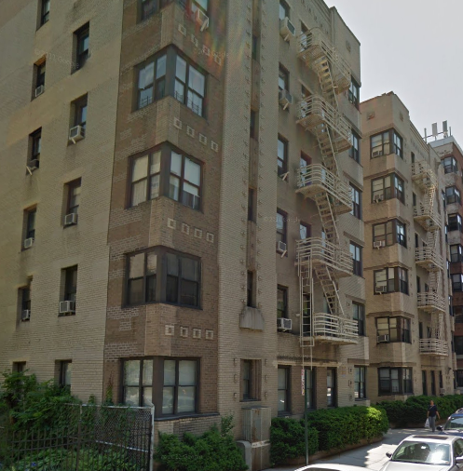
WRAP AROUND WINDOWS
Wrap around windows are windows that wrap around the corner of a building.
This type of window is very common in Art Deco apartment buildings.
265 Cabrini Boulevard (Manhattan)
© Art Deco Society of New York
© Art Deco Society of New York

Slide 21
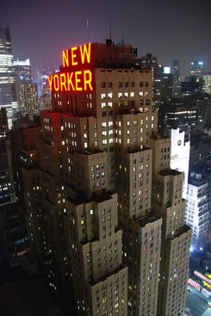
Flat Roofs
Flat roofs are roofs that have no angle or slant.
Some Art Deco buildings have flat roofs, or many layers of flat roofs, that make the top of the building look smaller.
The New Yorker (Manhattan)
© Art Deco Society of New York
© Art Deco Society of New York

Slide 22
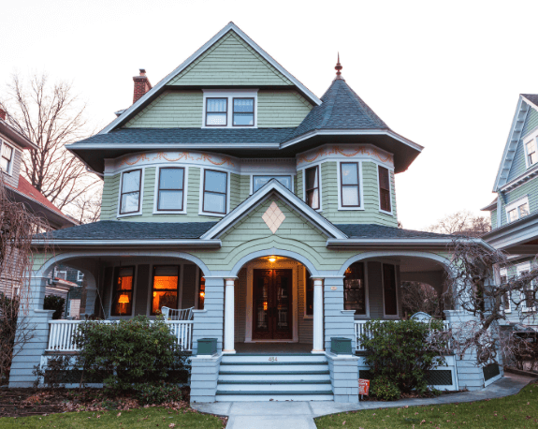
Pitched Roofs
Pitched roofs are roofs with slants.
Pitched roofs were popular before the Art Deco style, they are not common in Art Deco buildings.
Slanted roofs on a private house in Brooklyn—not Art Deco!
© Art Deco Society of New York
© Art Deco Society of New York

Slide 23
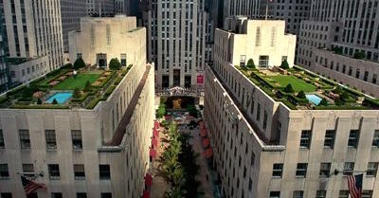
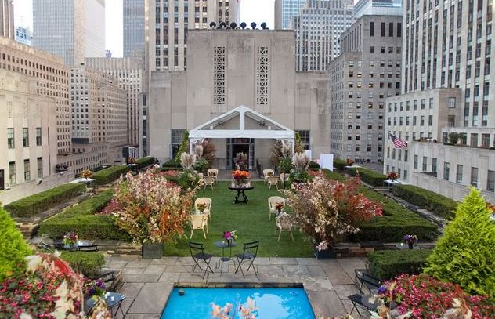
Some flat roofs have rooftop gardens, like the ones at Rockefeller Center (Manhattan).
© Art Deco Society of New York

Slide 24
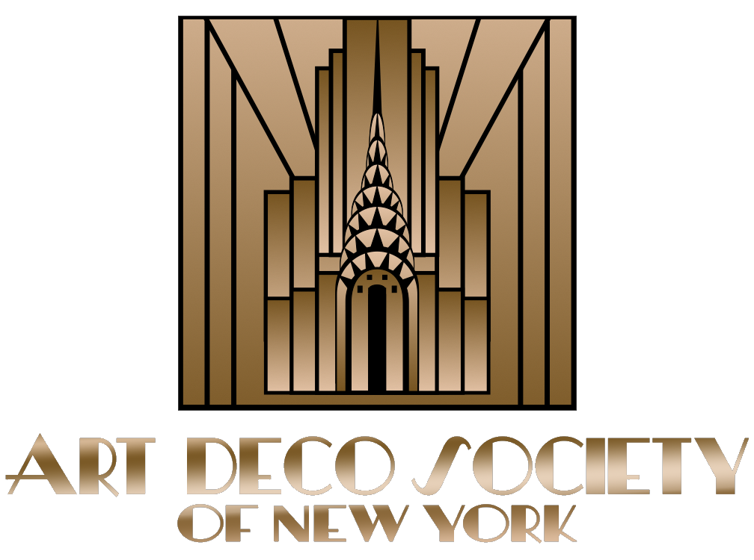
Presented by:
Teachers & Parents: This presentation was designed to offer a basic understanding of New York Art Deco architecture. There is much more to discover about 1920s and 1930s New York at ArtDeco.org.
The New York Art Deco Registry at ArtDeco.org is a great resource for finding Deco Buildings in your area.
© Art Deco Society of New York
© Art Deco Society of New York

