Slide 1

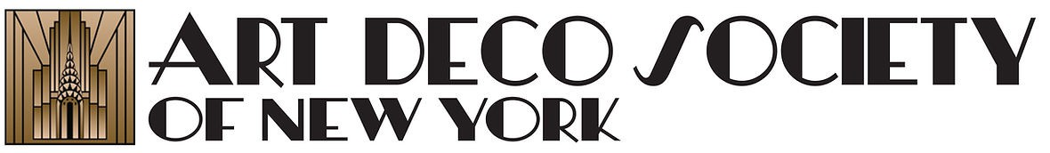
Describing Deco

Slide 2
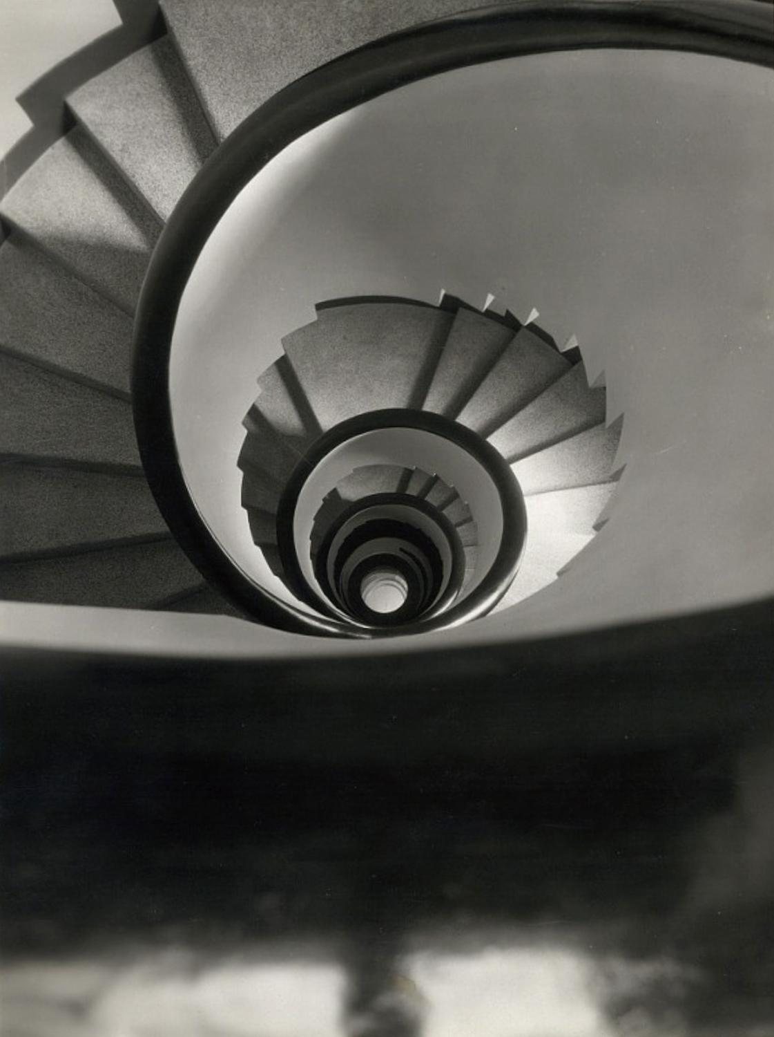
What is
Art Deco?
Photo: Thérèse Bonney, Paris 1925

Slide 3
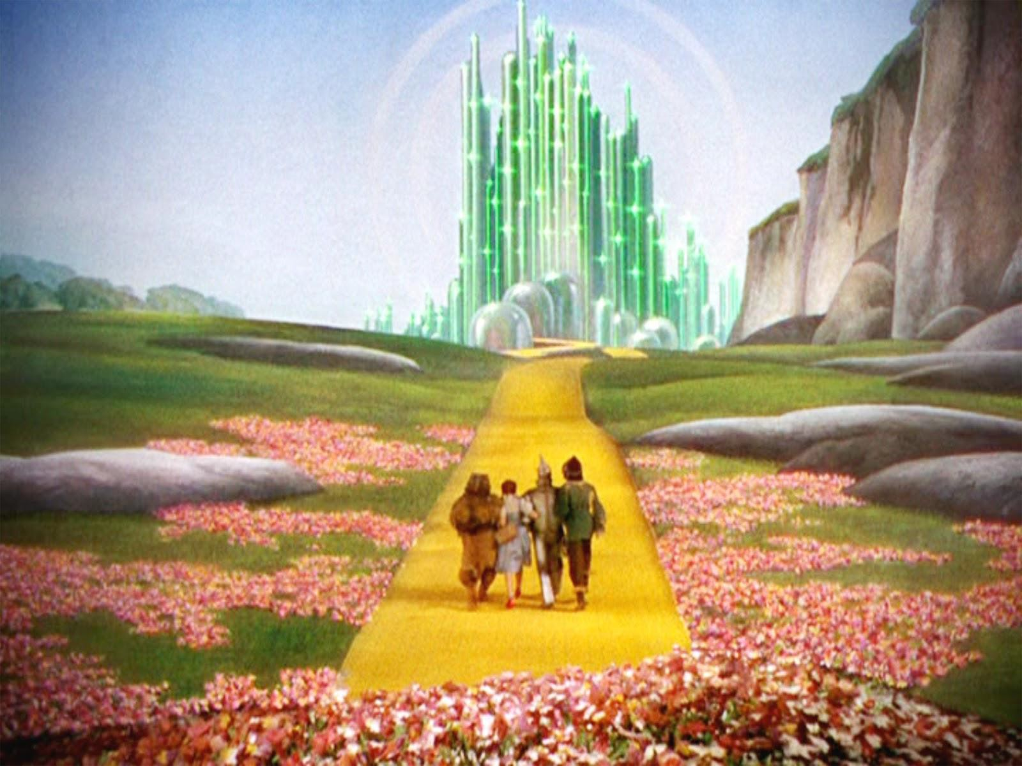
You’ve likely encountered Art Deco before - without even realizing it!
Notes:
How many of you recognize the Emerald City from what famous film?

Slide 4
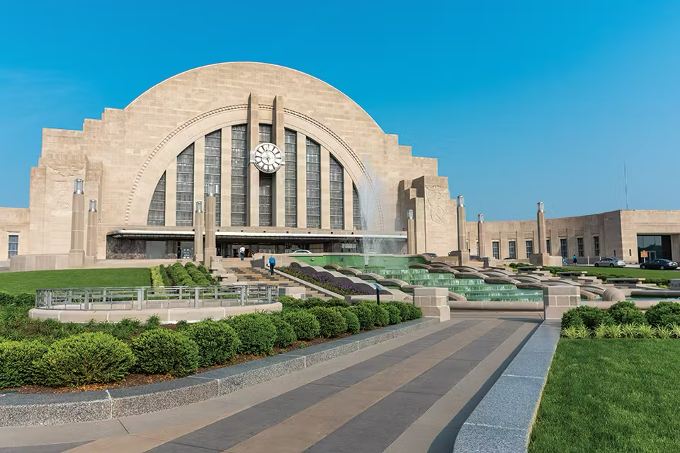
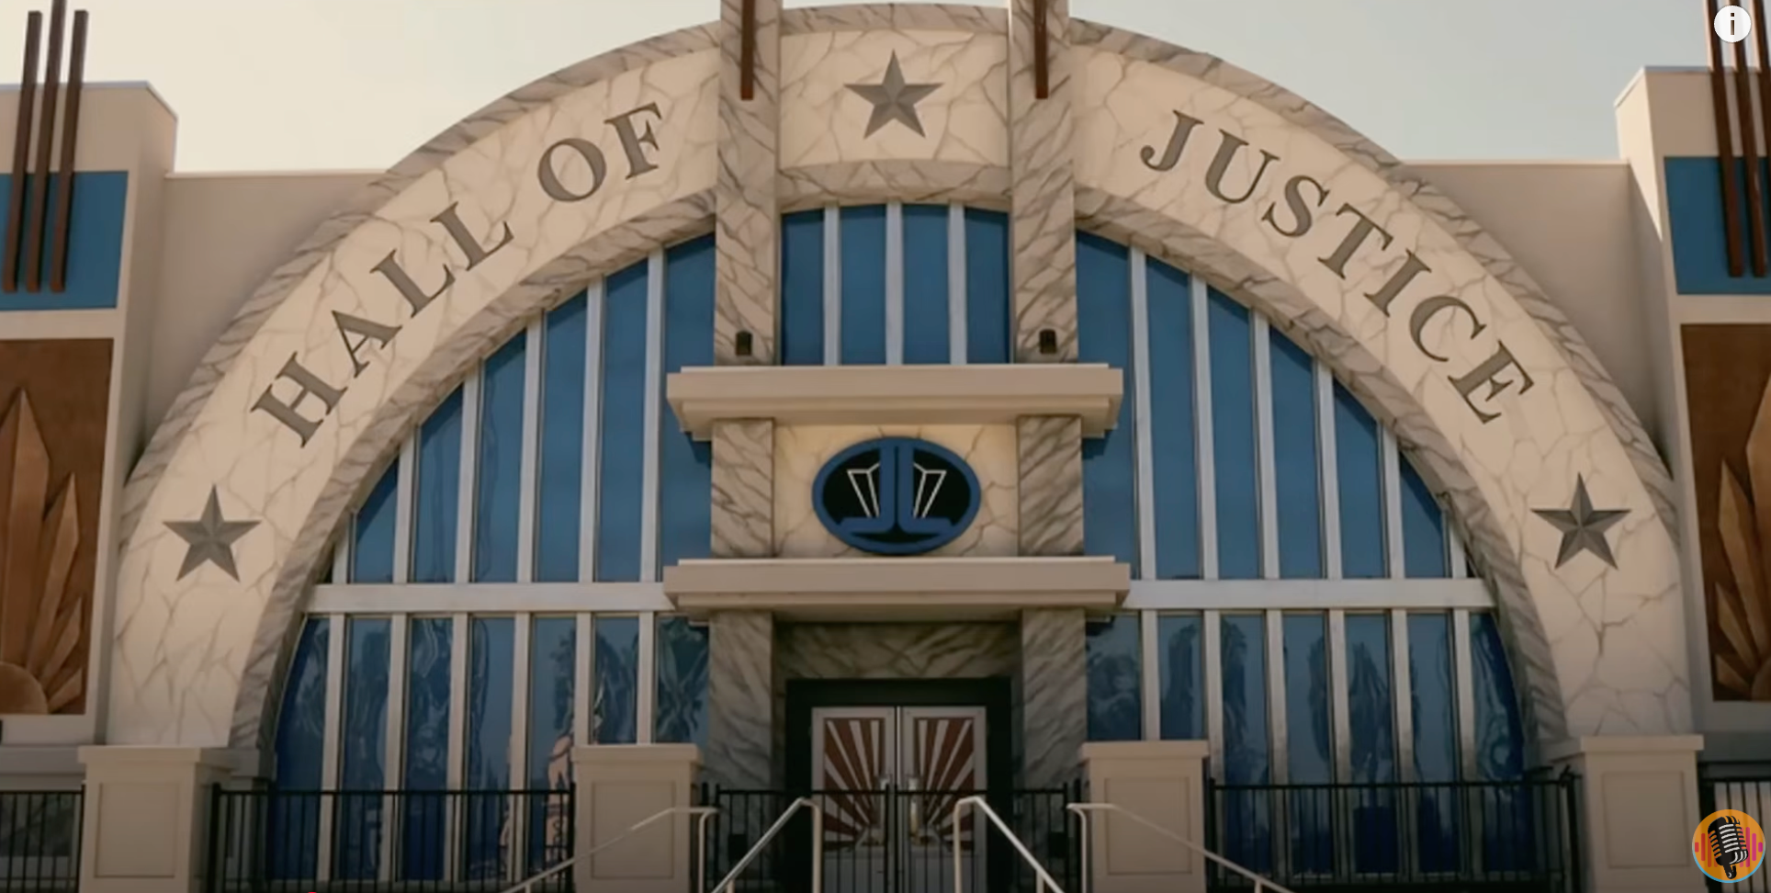
Cincinnati Union Terminal, 1933
Notes:
The new Superman movie filmed extensively in Cincinnati, Ohio, utilizing several iconic locations that are transformed into settings for the film. The Cincinnati Museum Center (at Union Terminal) serves as the Hall of Justice, the headquarters of the Super Friends and later the Justice League.

Slide 5
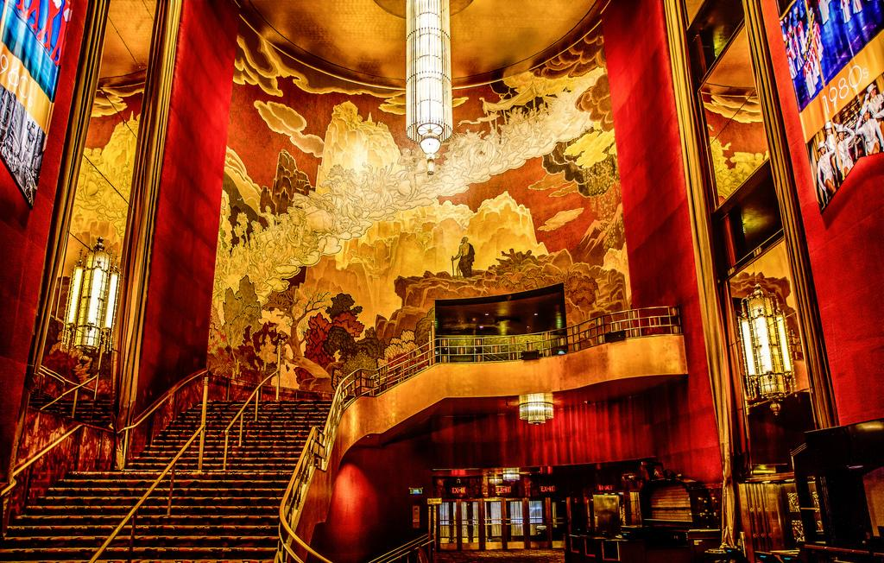
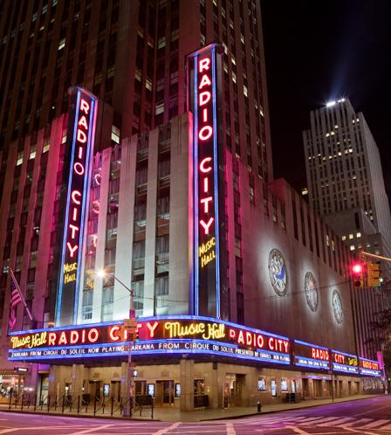
Radio City Music Hall, 1932
Notes:
Radio City Music Hall opened in 1932 and was designed in the Art Deco style by Donald Deskey. Inside, you’ll see bold shapes, shiny metals, colorful murals, and a huge golden curtain that make the theater feel modern and glamorous.

Slide 6
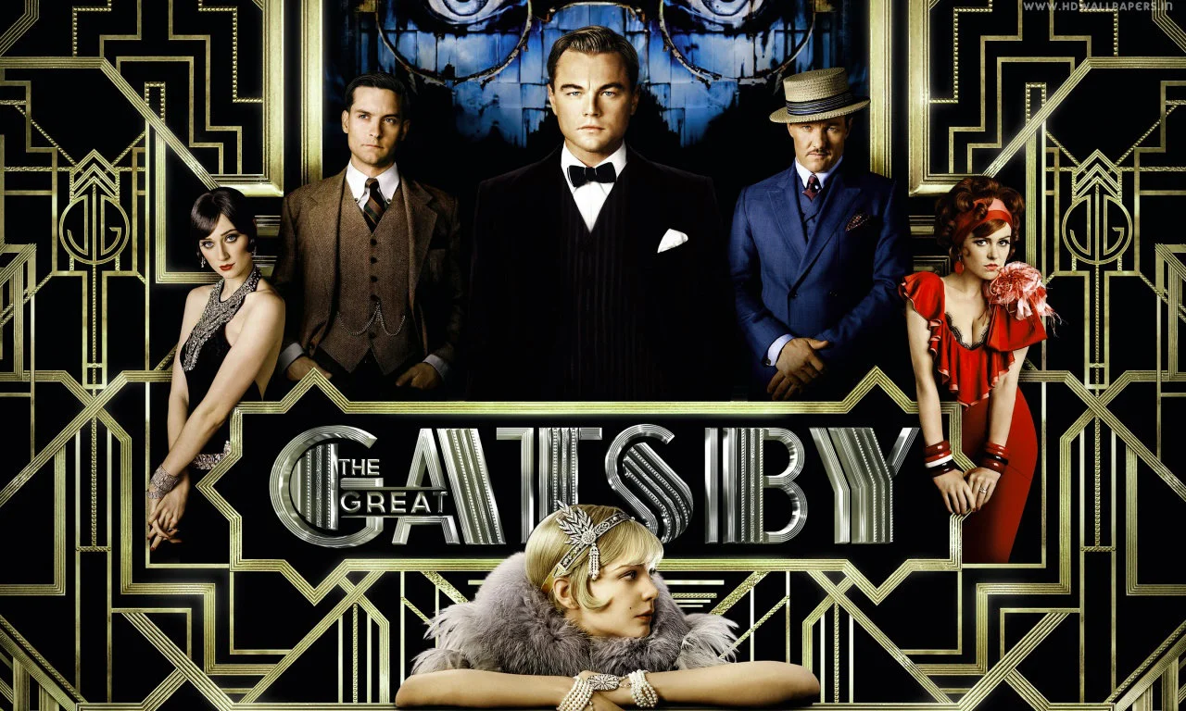
The Great Gatsby
,
Notes:
Although this image is from a film adaptation, The Great Gatsby began as F. Scott Fitzgerald’s 1925 novel, a work that captures the glamour of the Roaring Twenties — the same era that fueled the rise of Art Deco architecture, fashion, and design.

Slide 7

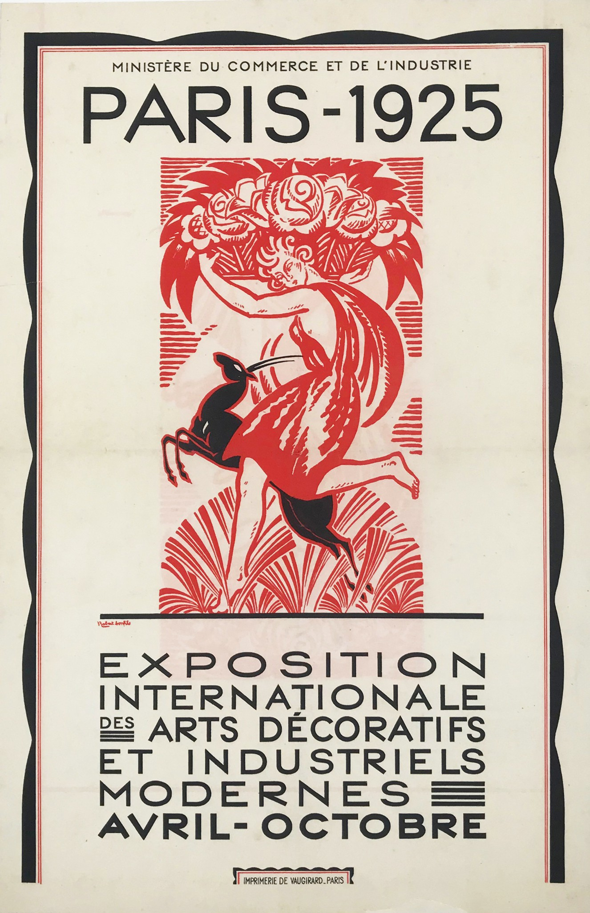
Art Deco was first introduced to the world at the 1925 Paris World’s Fair, which showcased new technologies, designs, and ideas to an international audience. The style took its name from the event itself:
The Exposition Internationale des Arts Decoratifs

Slide 8
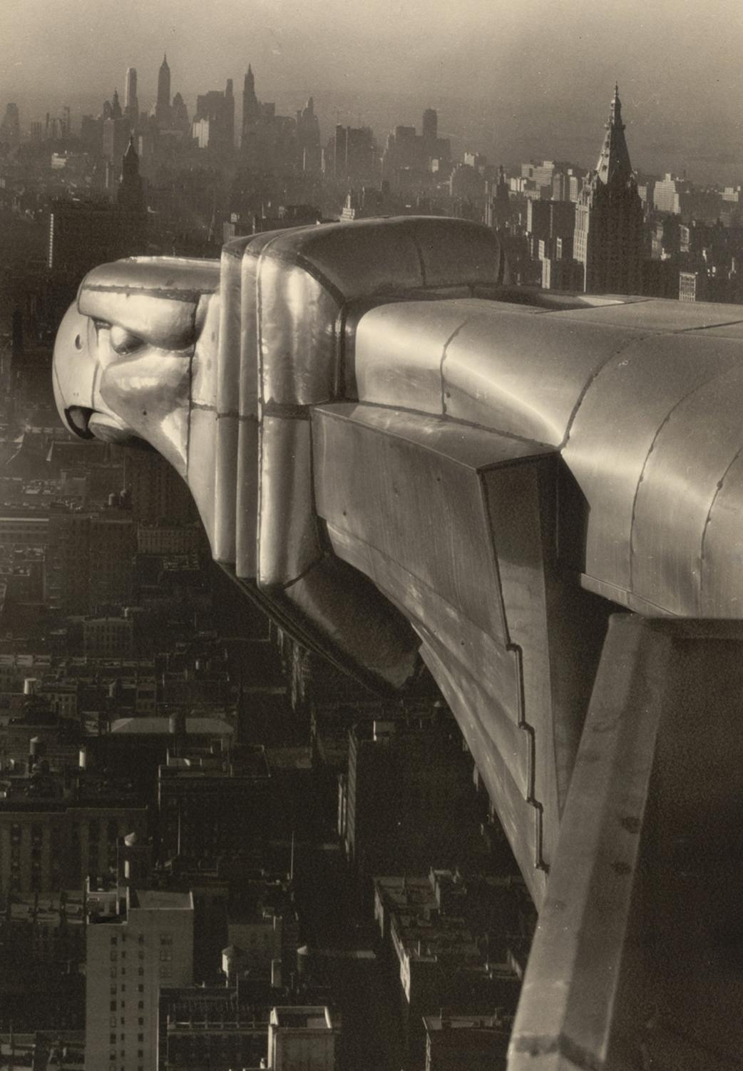
Art Deco is an aesthetic and architectural style that flourished between World War I and World War II, a period now known as the Modern era.
Photo: Margaret Bourke White, 1934

Slide 9
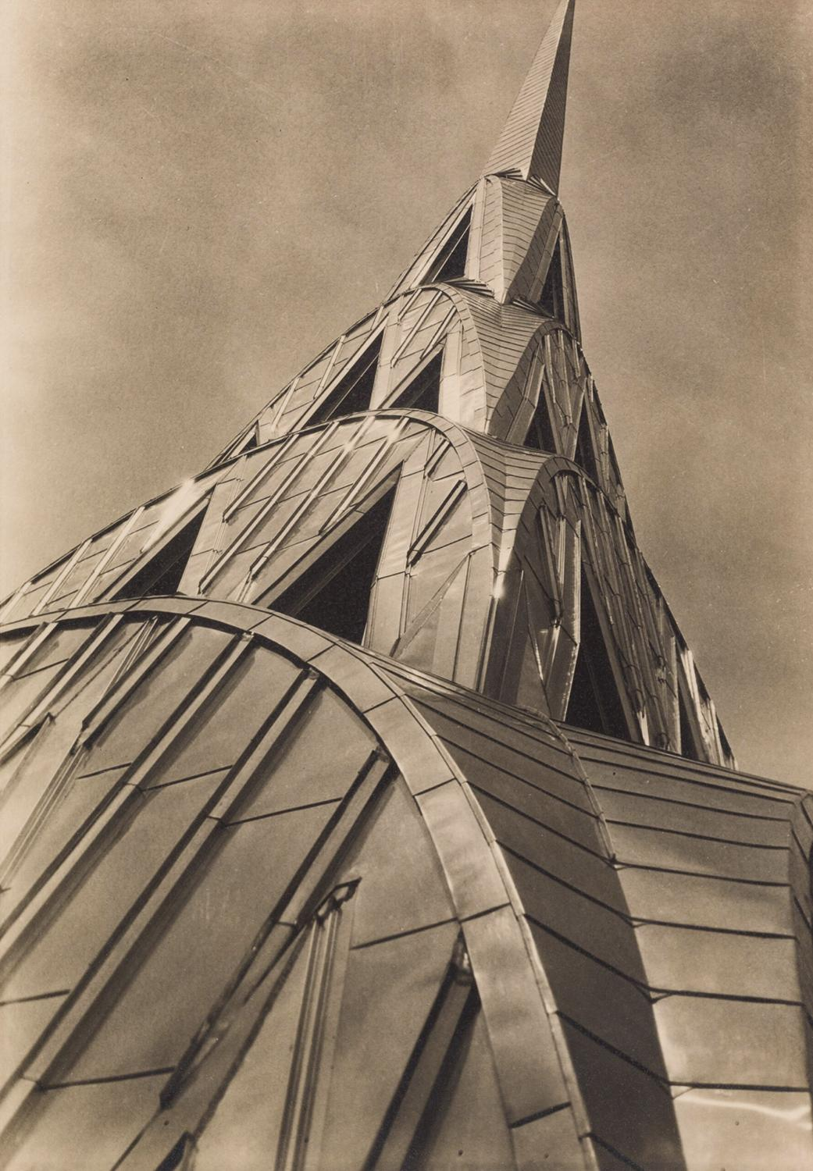
Reflecting a time of ambition and originality, Art Deco emerged during the machine age, blending new technologies with artistic expression and drawing inspiration from diverse eras and cultures around the world.
Photo: Margaret Bourke White, 1934

Slide 10

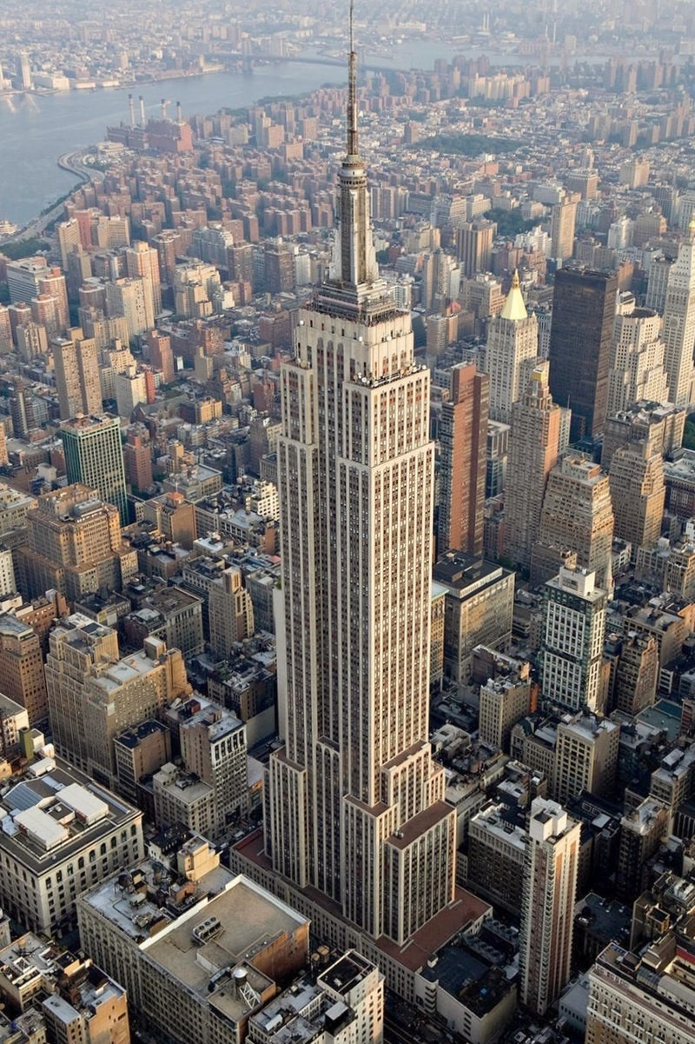
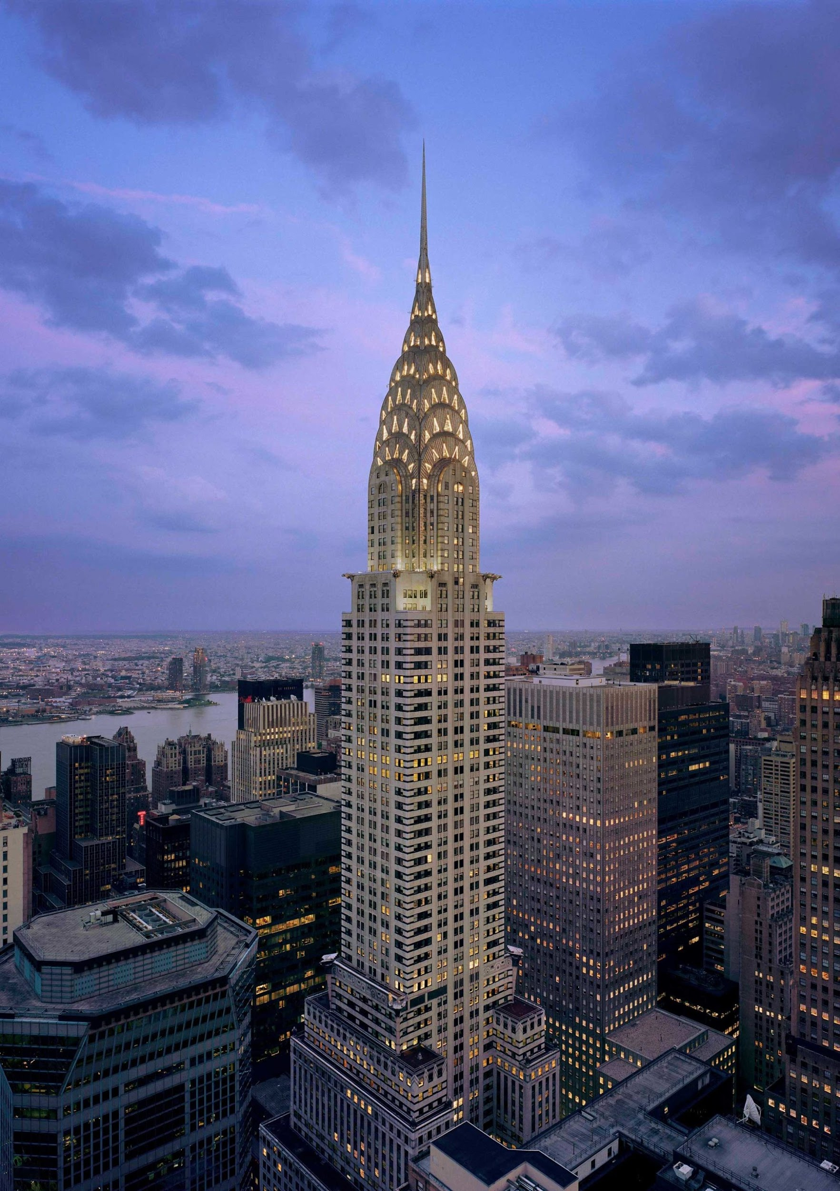
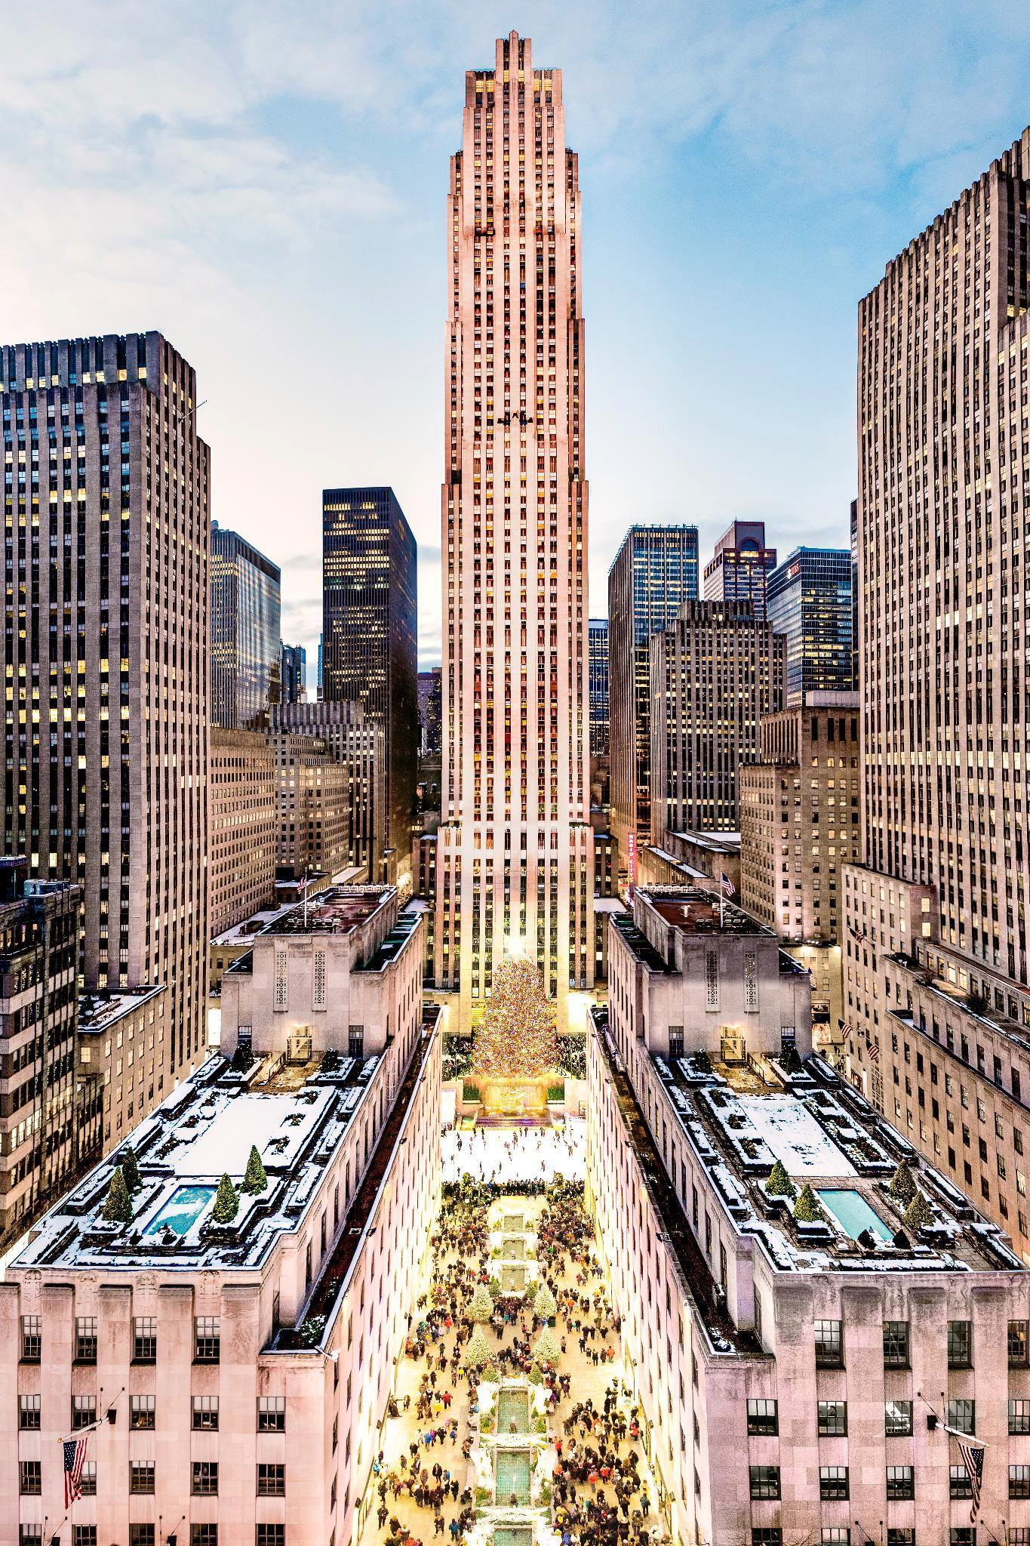
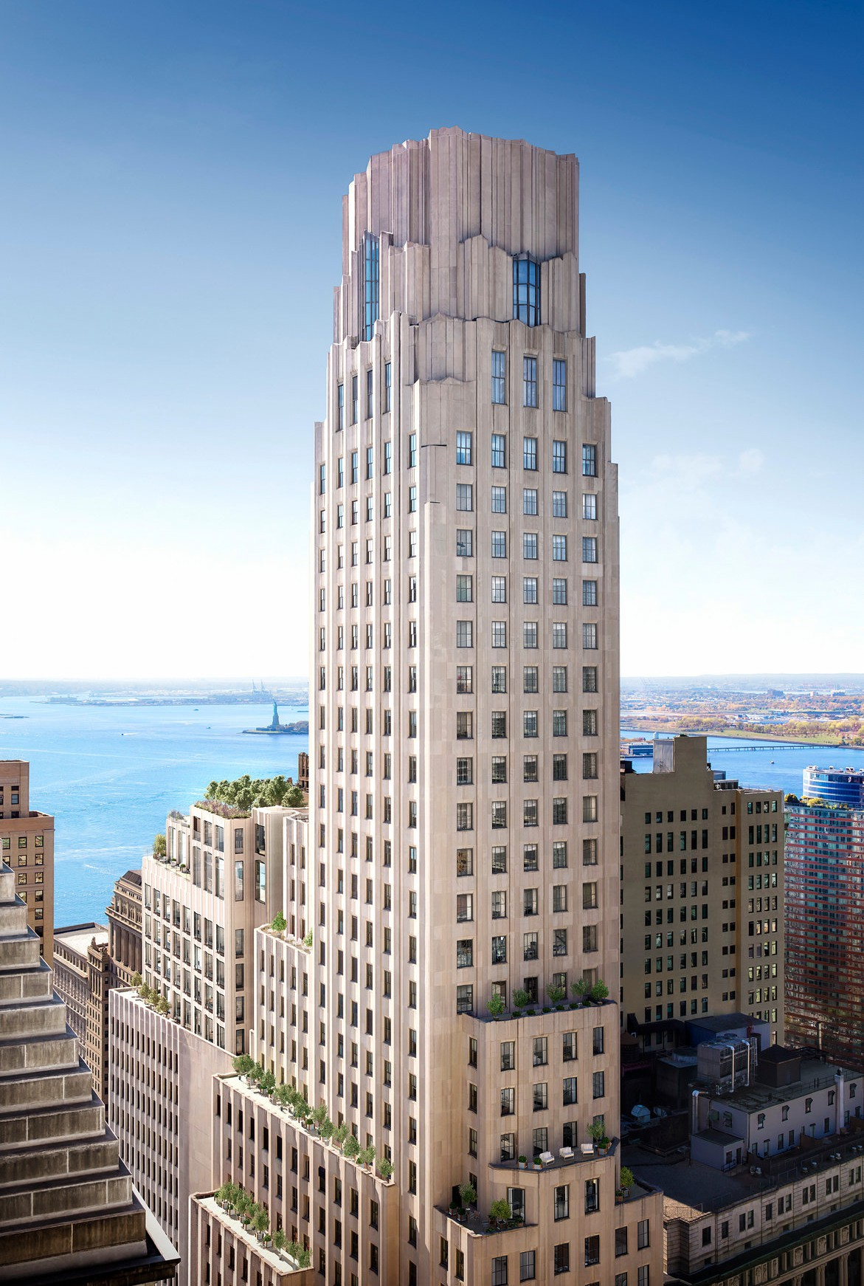
Architects began designing skyscrapers that embodied the spirit of this new era.
Empire State Building
Rockefeller Center
Chrysler Building
One Wall Street
1931
1930
1931-1939
1931
Notes:
These famous buildings transformed New York City into the most celebrated city in the world.

Slide 11
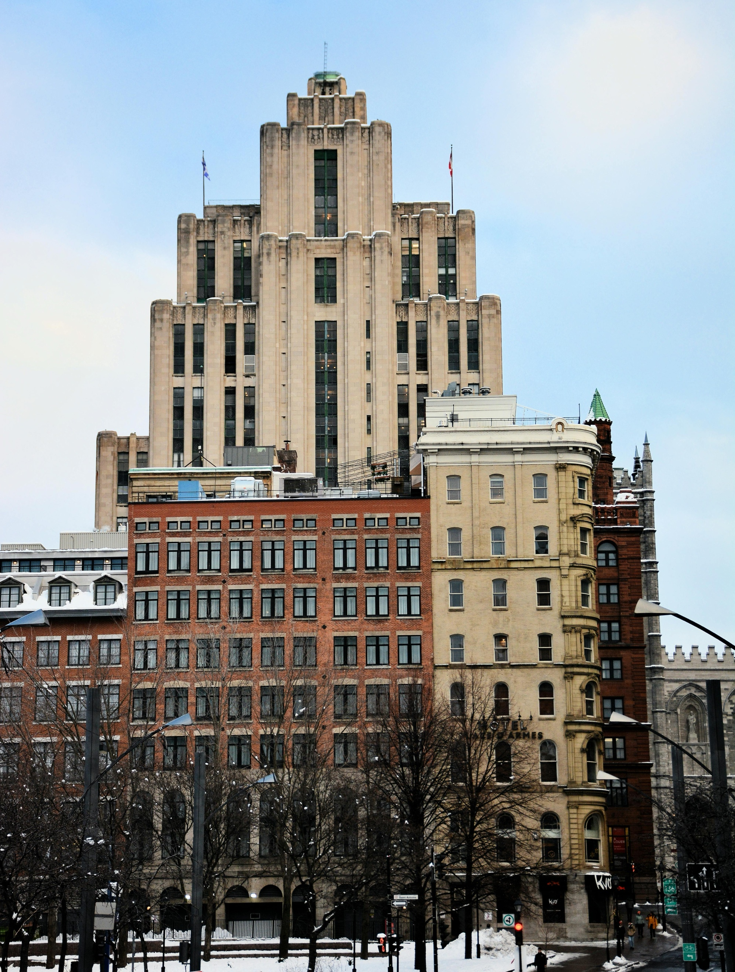
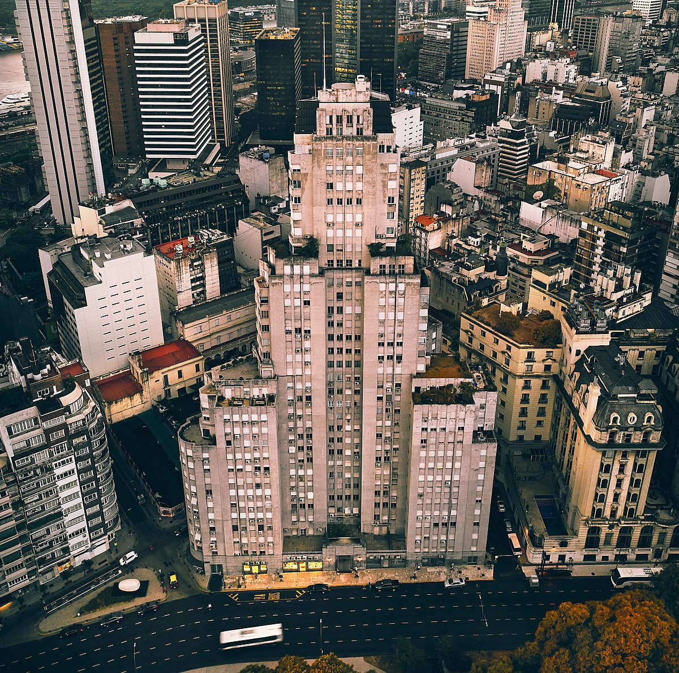
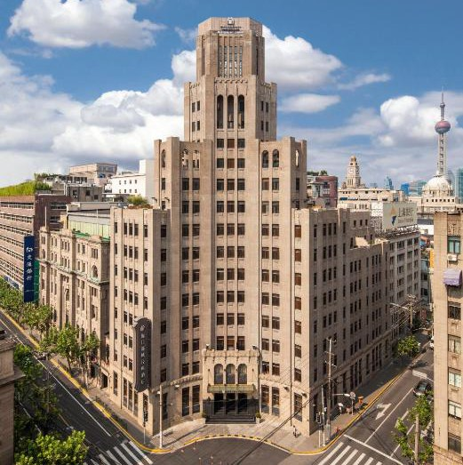
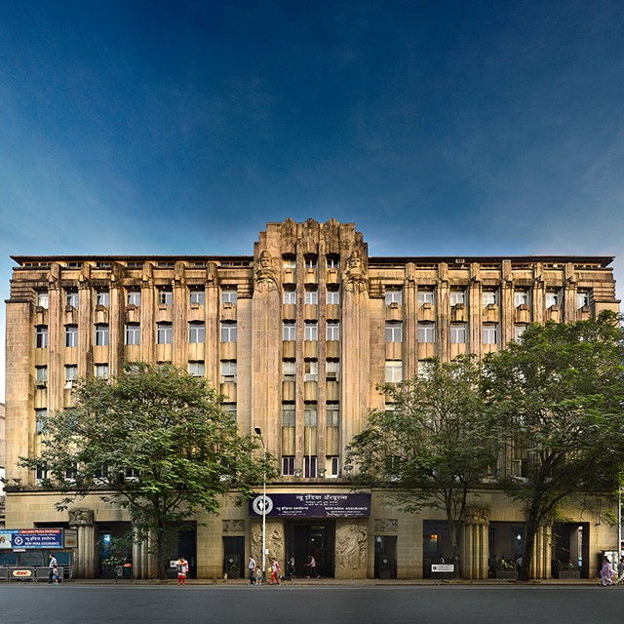
Art Deco Around the World
Aldred Building
Montreal, Canada 1930
Edificio Kavanagh
Buenos Aires, Argentina 1936
The Metropole Hotel
Shanghai, China 1930
India Assurance Building
Mumbai, India 1937
Notes:
Emphasize to students that, while Art Deco was hugely influential in NYC, it also has a strong global presence.

Slide 12

Aside from their height, what do these buildings have in common?
Notes:
The following vocabulary terms track with the students’ worksheets. As you go through these slides, allow relevant time for students to write down definitions or ask questions.

Slide 13
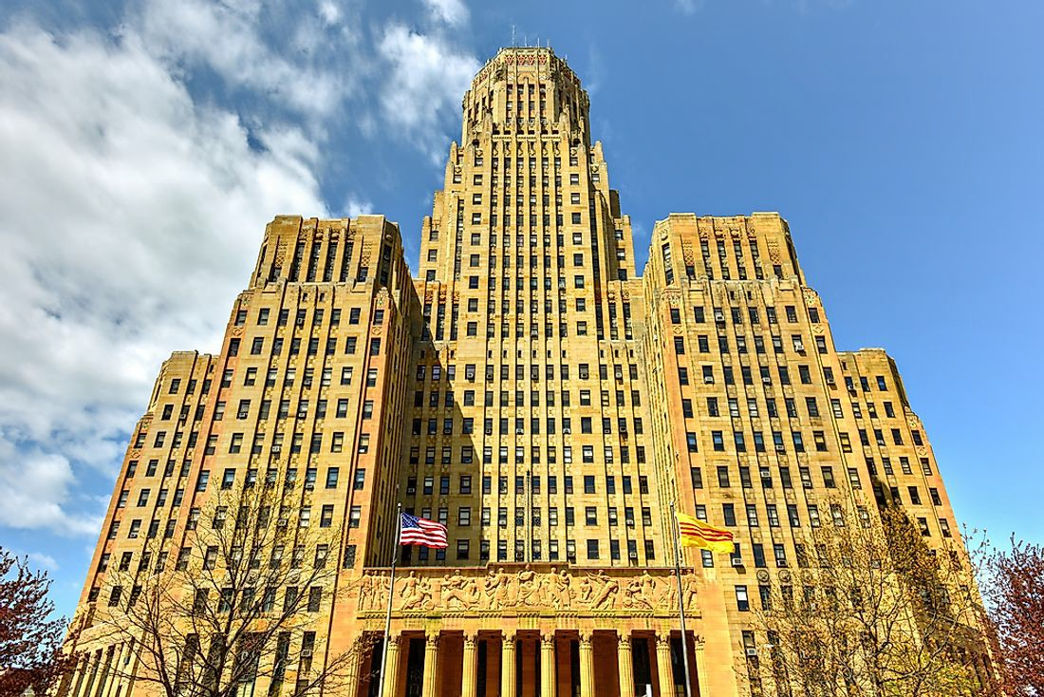
Massing:
the three dimensional or overall shape and size of a building.

Slide 14
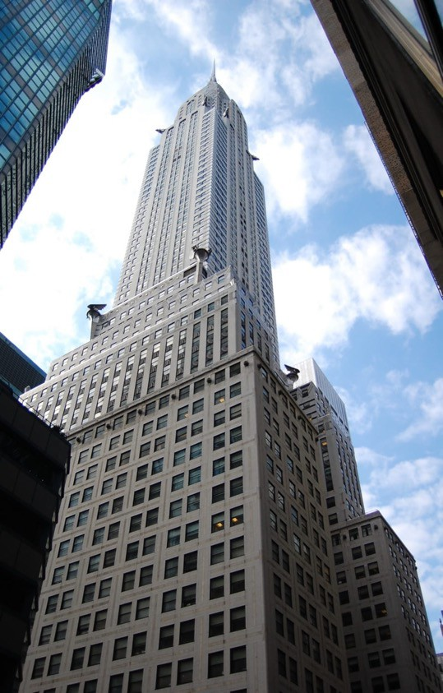
Wide bases + narrow tops
The Chrysler Building, 1930
Notes:
This popular kind of shape was created in response to a NYC zoning law. In 1916, the city passed a law which regulated the shape of skyscrapers to make sure that light and air would reach the sidewalk below. Tall buildings blocked sunlight and cast shadows and made neighboring buildings dark. Before skyscrapers, this wasn’t a huge problem for the city, as buildings could only be built so high anyway.
The law stated that once the building reached a certain height, the overall mass had to be reduced, thus creating setbacks, or the stepped pyramid look.

Slide 15
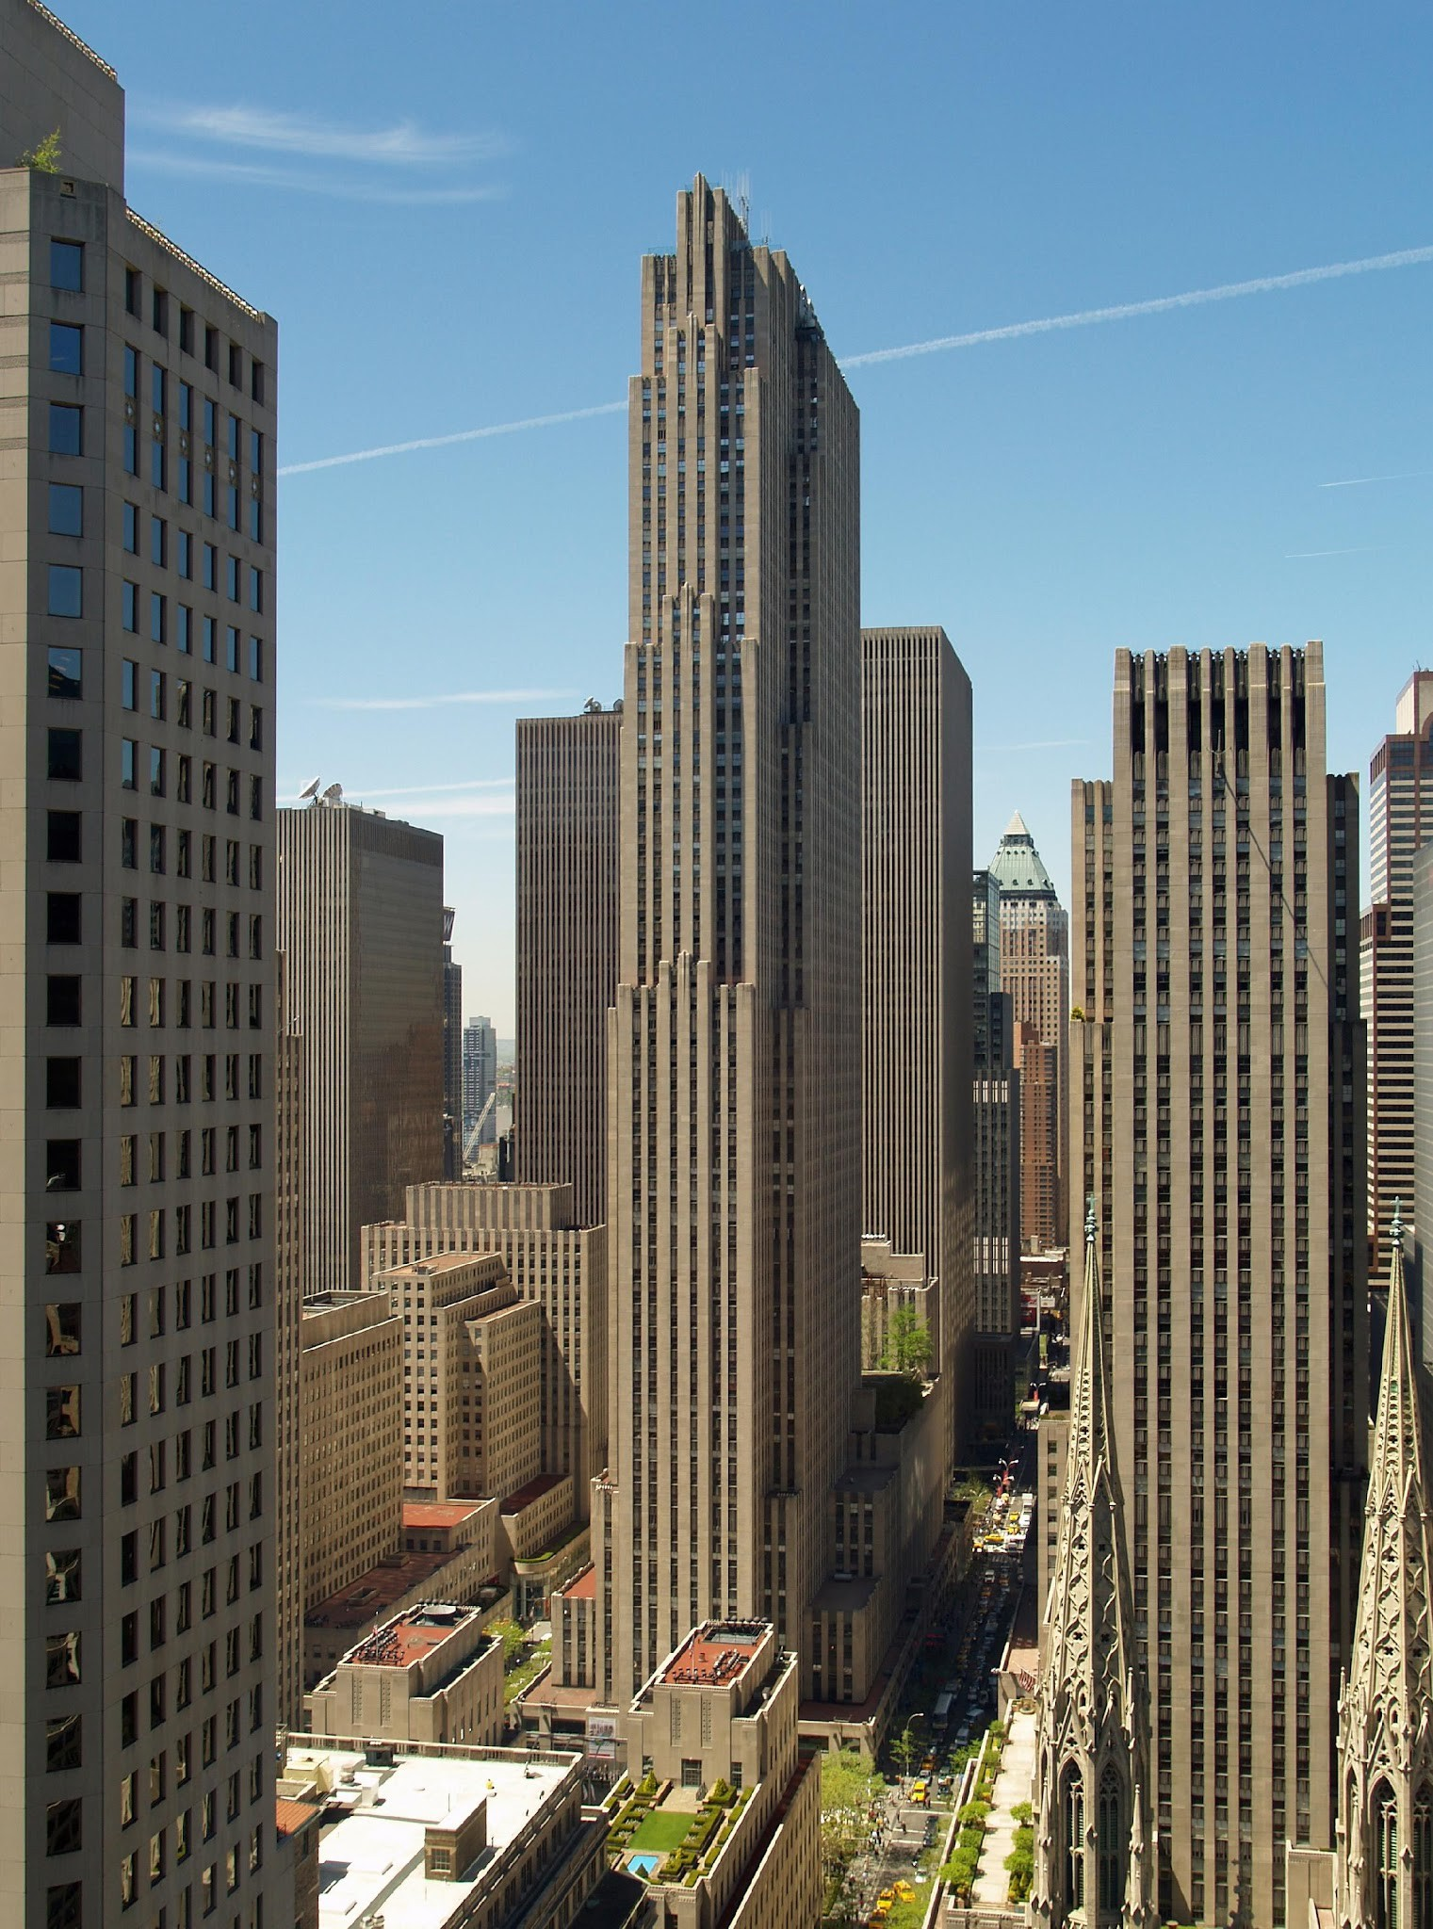
Vertical Accentuation
Notes:
Art Deco buildings often use vertical shapes and lines to emphasize, or accentuate, the vertical height of the building.
The phrase Art Deco didn’t exist until 1966. So, until then, architects called this style the “vertical style!” It was all about emphasizing the buildings height. Recessed windows helped with this effect, as did uninterrupted brick columns on either side of those windows. See: spandrels!

Slide 16
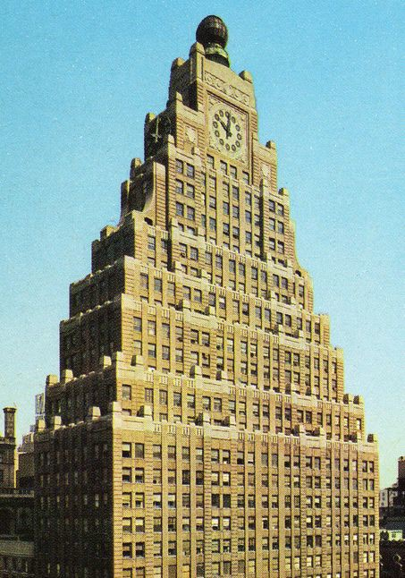
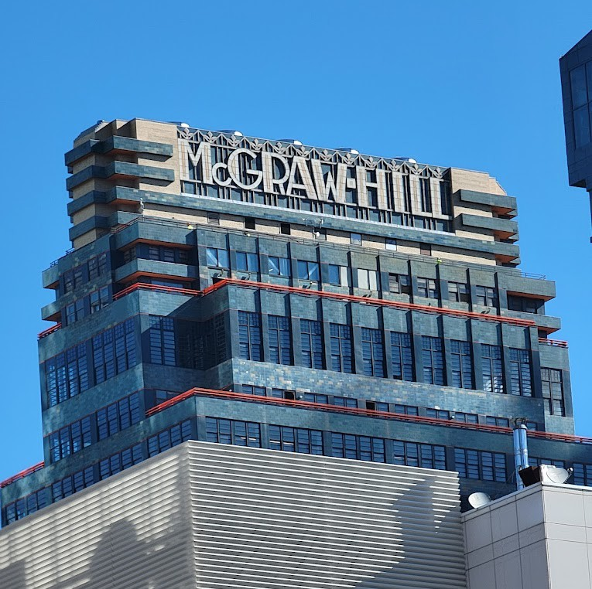
Unique Roofs
Stepped Levels
Notes:
These stepped levels tie into the common shape of a wide base and narrow top, so these pyramid-like levels also tie into the zoning restrictions created at the time.

Slide 17
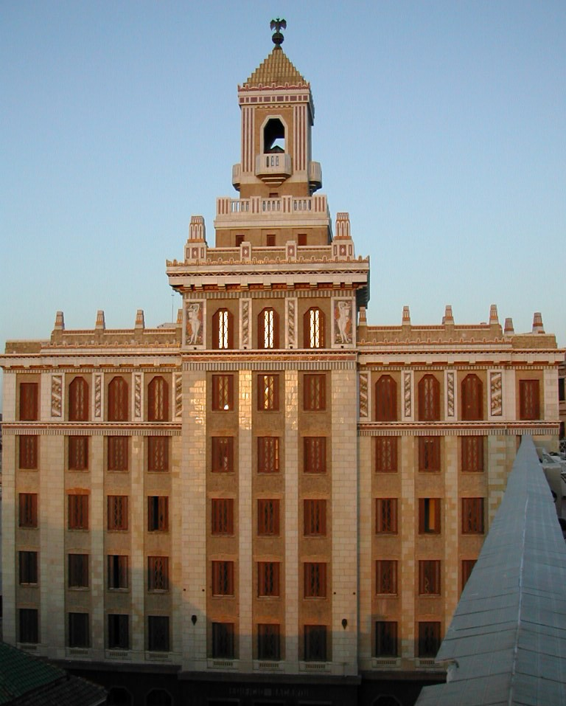
Parapets: a low wall or railing along the edge of a roof, balcony, terrace, or bridge, often serving as a safety barrier or decorative element.
Notes:
Parapets are a low wall along the roof of a building. Originally protective or defensive, the parapets of Art Deco architecture are largely decorative.

Slide 18
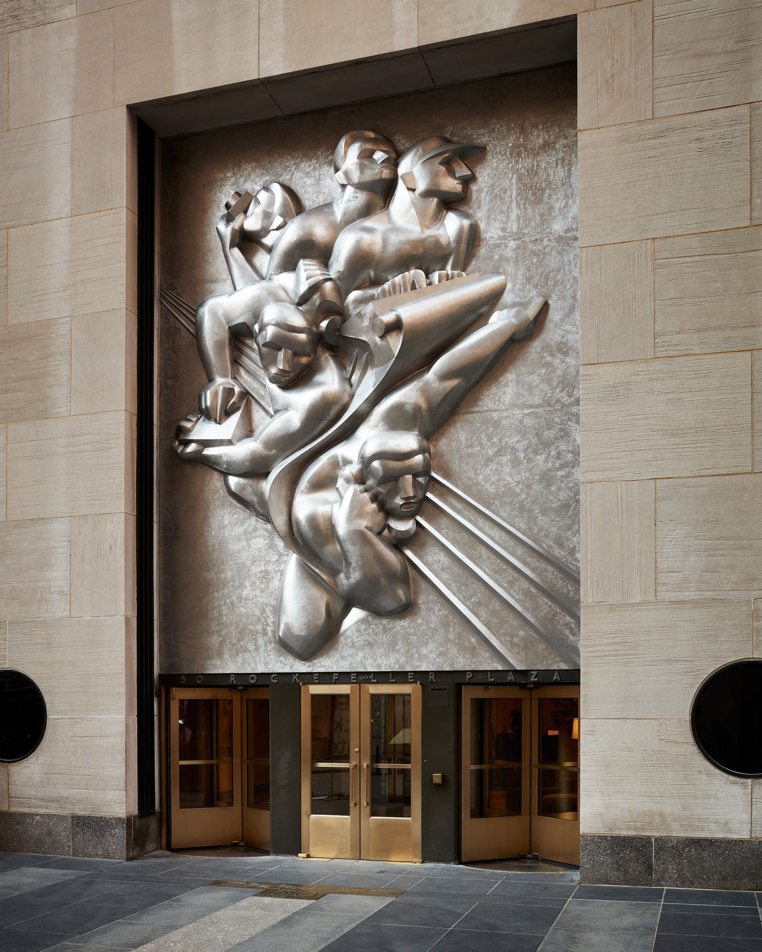
Sculptural Relief
Notes:
Sculptural relief features sculptures that project from their backing material, instead of being carved into the stone or metal itself.
Many ornaments like these were meant to explain what the building’s purpose was! This is the Associated Press building, so the sculpture references the newspaper business at the time.

Slide 19
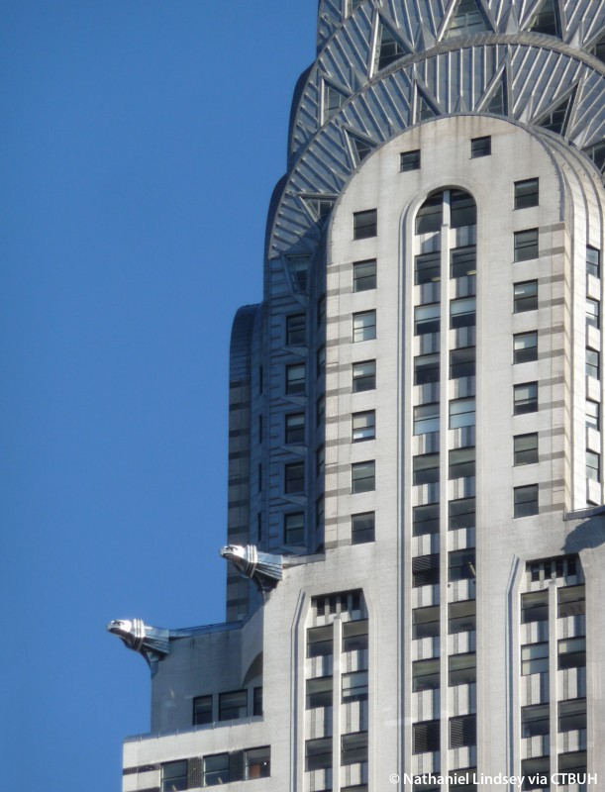
Spandrels: refer to the area between the windows. They can be purely structural or decorative for visual effect.
Notes:
Spandrels refer both to the triangular space found in the upper corners of arches, and to a rectangular space between windows of adjacent floors. They also help accentuate a building’s verticality, as they help emphasize those vertical lines. See: vertical accentuation!

Slide 20
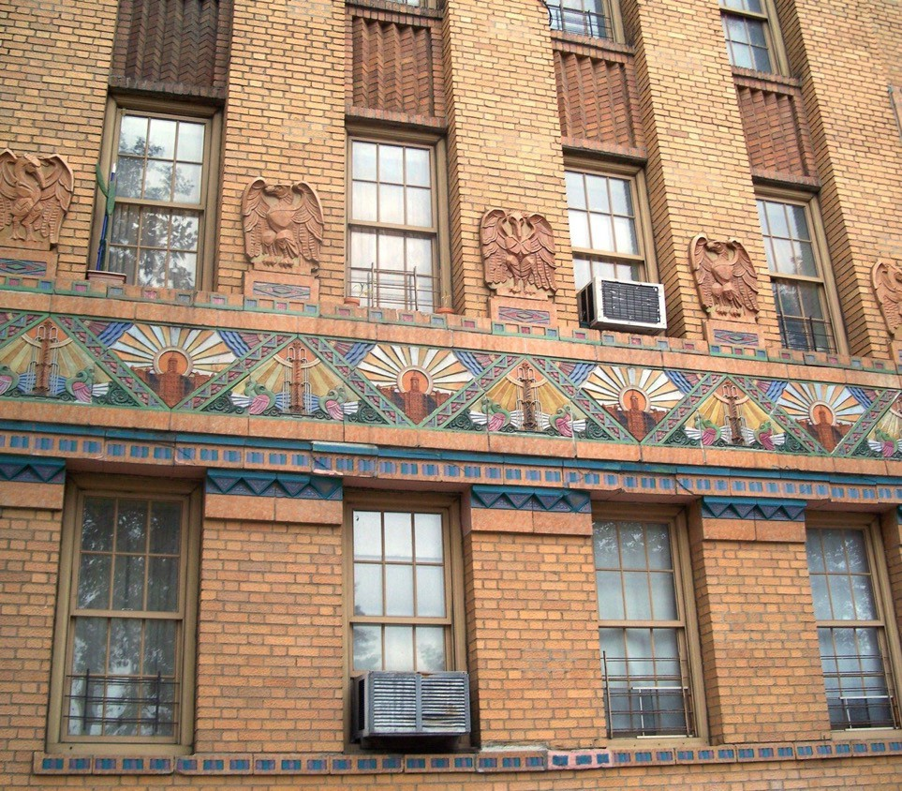
Geometric Patterns
Notes:
GEOMETERIC patterns found their way into decorations like these as well.

Slide 21
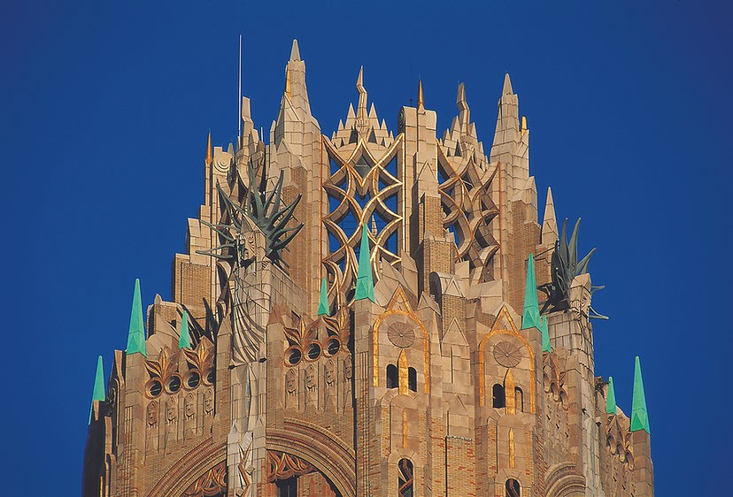
Terracotta
Notes:
Terracotta is a clay-based ceramic material. Along with new kinds of metal alloys and different colors of brick, the frequent use of this material in decoration was part of a common Deco phenomenon to use bright colors whenever possible.

Slide 22
As New York City’s subway system expanded from Manhattan into the outer boroughs during the 1920s and 1930s, building owners embraced the new Art Deco style to attract residents to this modern way of living. These buildings featured bold colors, striking details, and elegant lobbies—many of which still endure today.

Slide 23
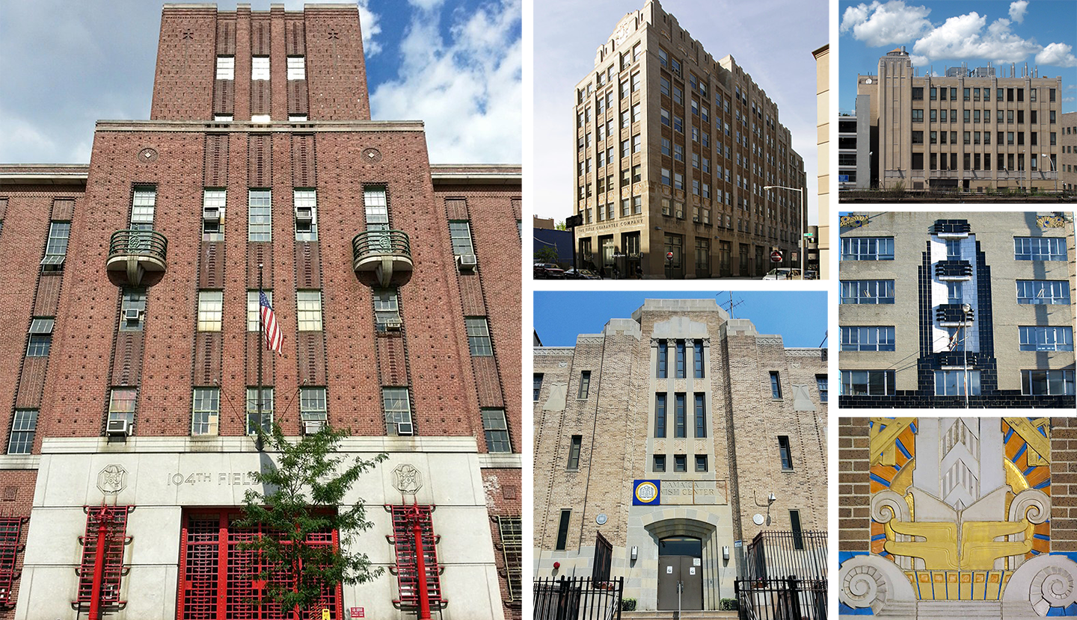
Jamaica, Queens
Notes:
Jamaica, Queens
In the 1930s, Jamaica’s shopping district grew with sleek Art Deco storefronts and movie theaters. These designs brought a modern flair to a busy commercial hub, blending bold signage, glass, and geometric detail.

Slide 24
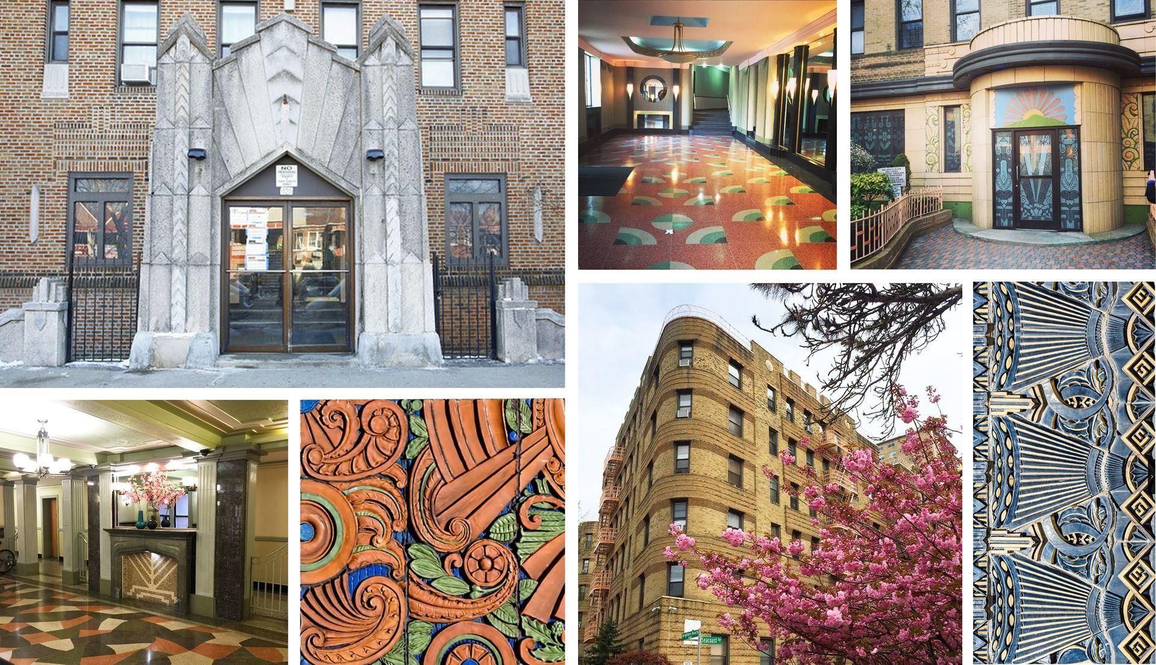
Brighton Beach
Notes:
Brighton Beach, Brooklyn
Alongside the boardwalk, Brighton Beach boasted streamlined Art Deco apartment houses and oceanfront theaters. These buildings reflected the glamour of seaside leisure, with curved facades, nautical motifs, and sunburst patterns.

Slide 25
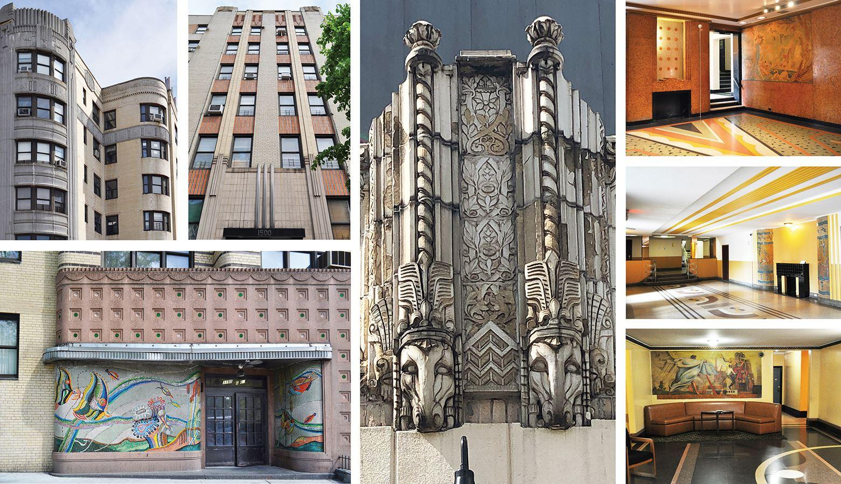
The Grand Concourse
Notes:
The Grand Concourse, Bronx
Often called the “Champs-Élysées of the Bronx,” the Grand Concourse is lined with Art Deco apartment buildings built in the 1920s–30s. Their colorful lobbies, terrazzo floors, and stylized motifs showcased modern living for middle-class New Yorkers.

Slide 26
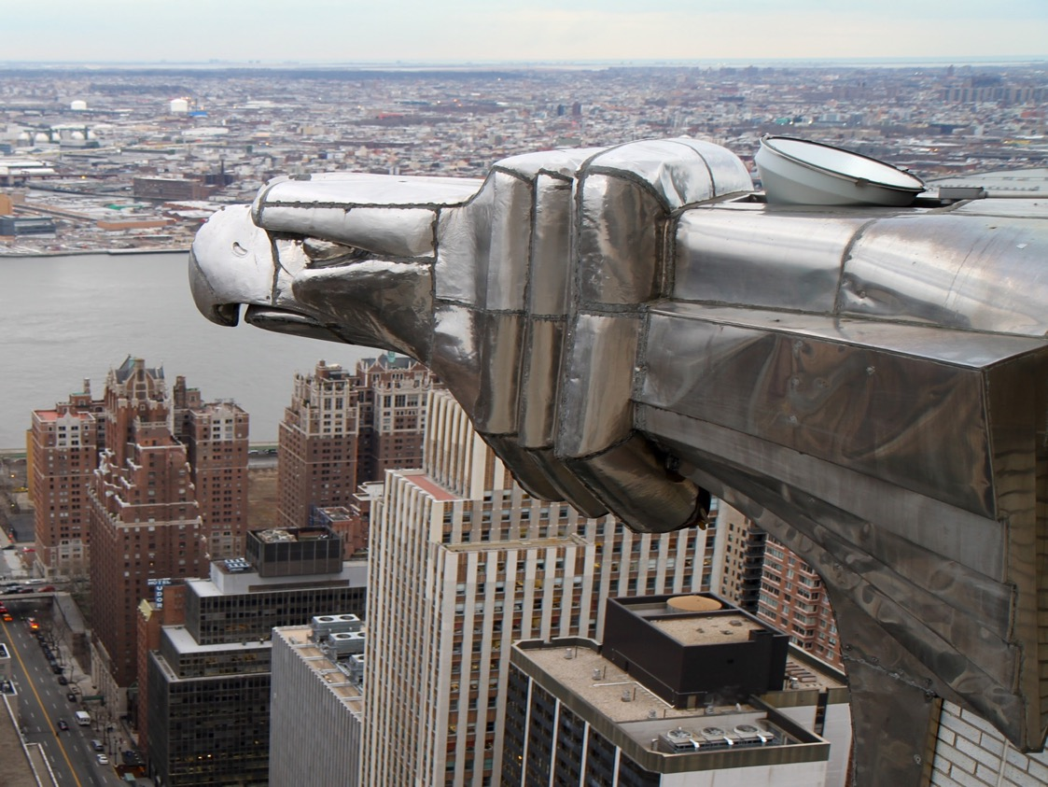
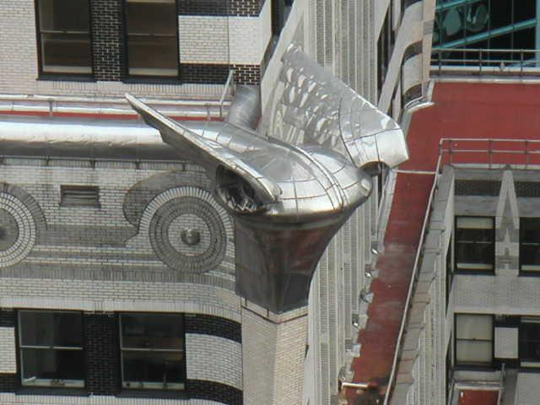
Sculptures highlighting new technology
Notes:
These metal gargoyles decorate the Chrysler building. Note the hood ornament and car wheels in the designs. Like many Deco decorations, these ornaments are a clear indication of the auto company that the building was made for and uses new types of enduring metal materials.
-After WWI, metal production could now be shifted towards peaceful purposes. Better technological innovations that developed ruing wartime could now be put to use to make taller and stronger buildings.
-Metal alloys (combinations of two or more metals, or a metal and a non-metal), were very important in architecture, as they were often stronger, more weather resistant, and less likely to rust than their pure-metal equivalents. Bronze, for example, is an alloy of copper and tin, with other components sometimes mixed in. This new technology allowed for metal accents like the decoration on top of the Chrysler Building. Metalwork is an important feature of NY Deco buildings.

Slide 27
Something to remember: Art Deco draws inspiration from a wide range of cultures and historical periods. Even in New York City, its designs feature motifs and elements from across the globe.

Slide 28
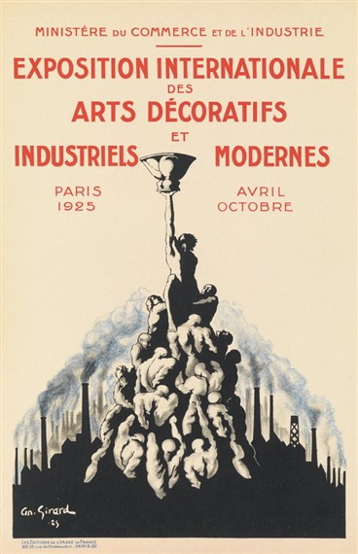
African tribal patterns
Ancient Egyptian art
Asian motifs
Ancient Greek and Roman design
Mayan and Aztec forms
Avant-garde art (new, unusual, or experimental art from the early 20th Century)
Notes:
In the following slides, instructors should note the visual similarities and influences found between the two photos to highlight the influences.

Slide 29

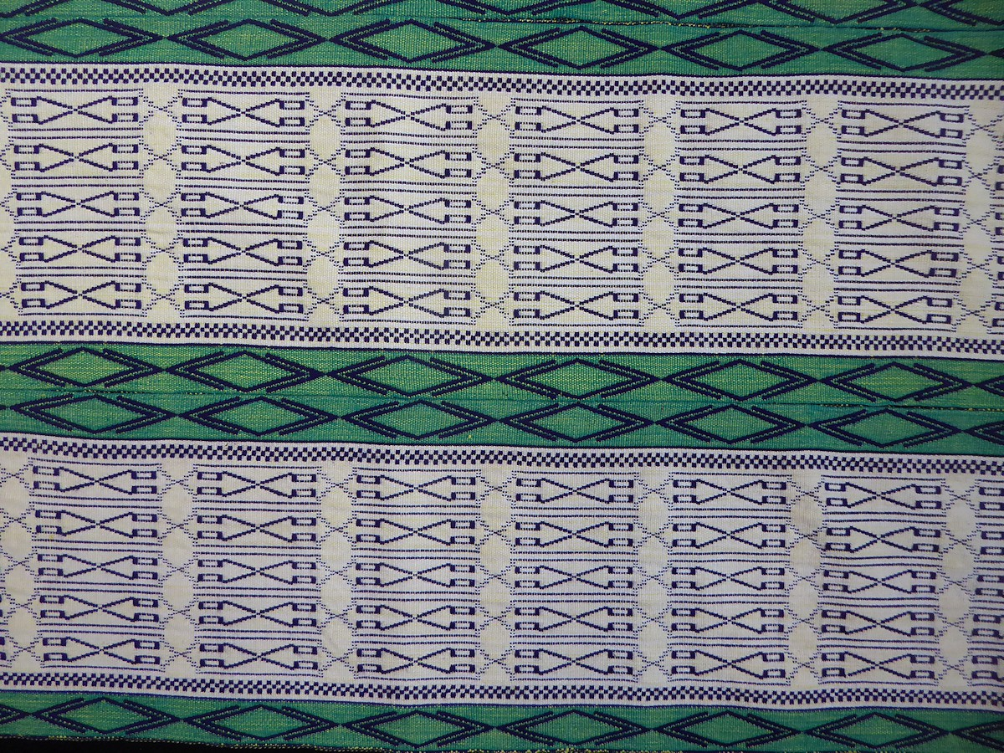
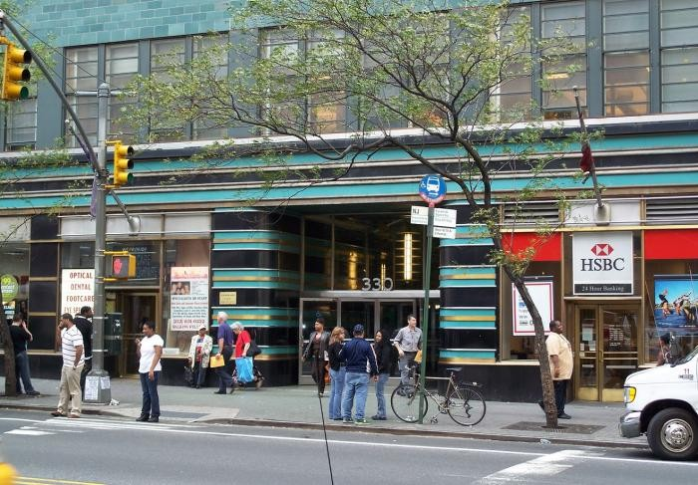
African Designs
Manjak fabric, woven in Senegal
McGraw Hill Building entrance

Slide 30
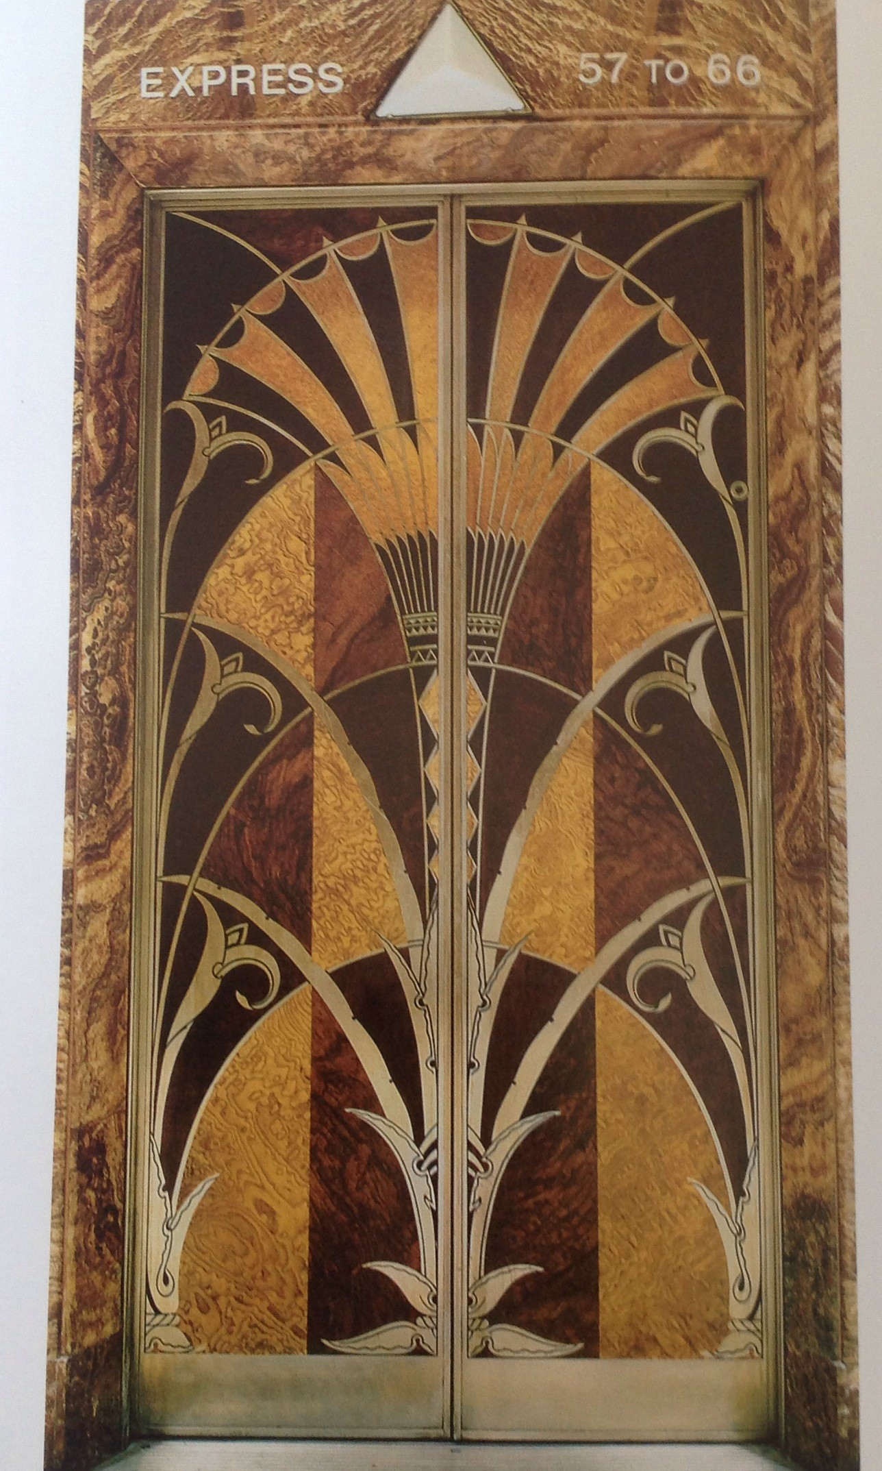
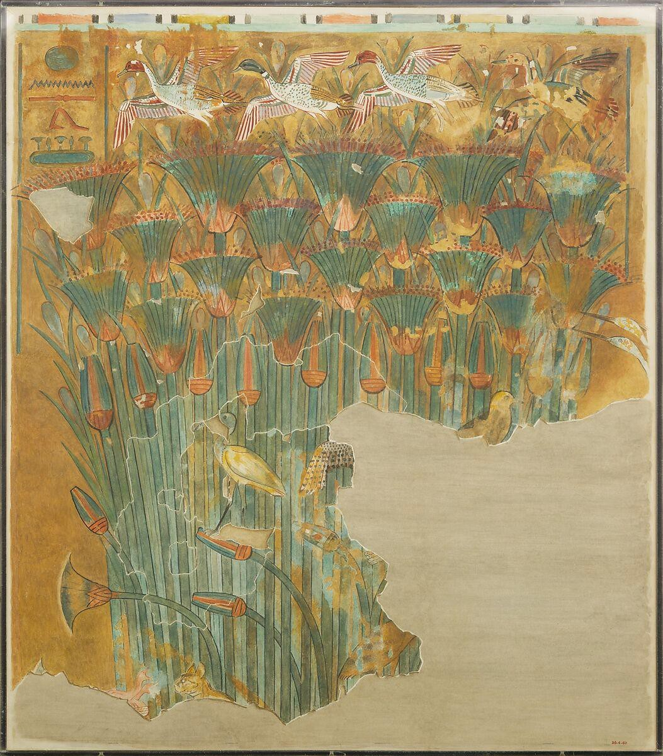
Ancient Egyptian Art
Chrysler Building elevator
Papyrus marsh, New Kingdom
Notes:
-Alternate image: https://www.metmuseum.org/art/collection/search/548437
-Instructors can point out the marshes and the distinct bell-like shape in the ancient art, drawing a clear visual comparison to the Chrysler building elevator

Slide 31
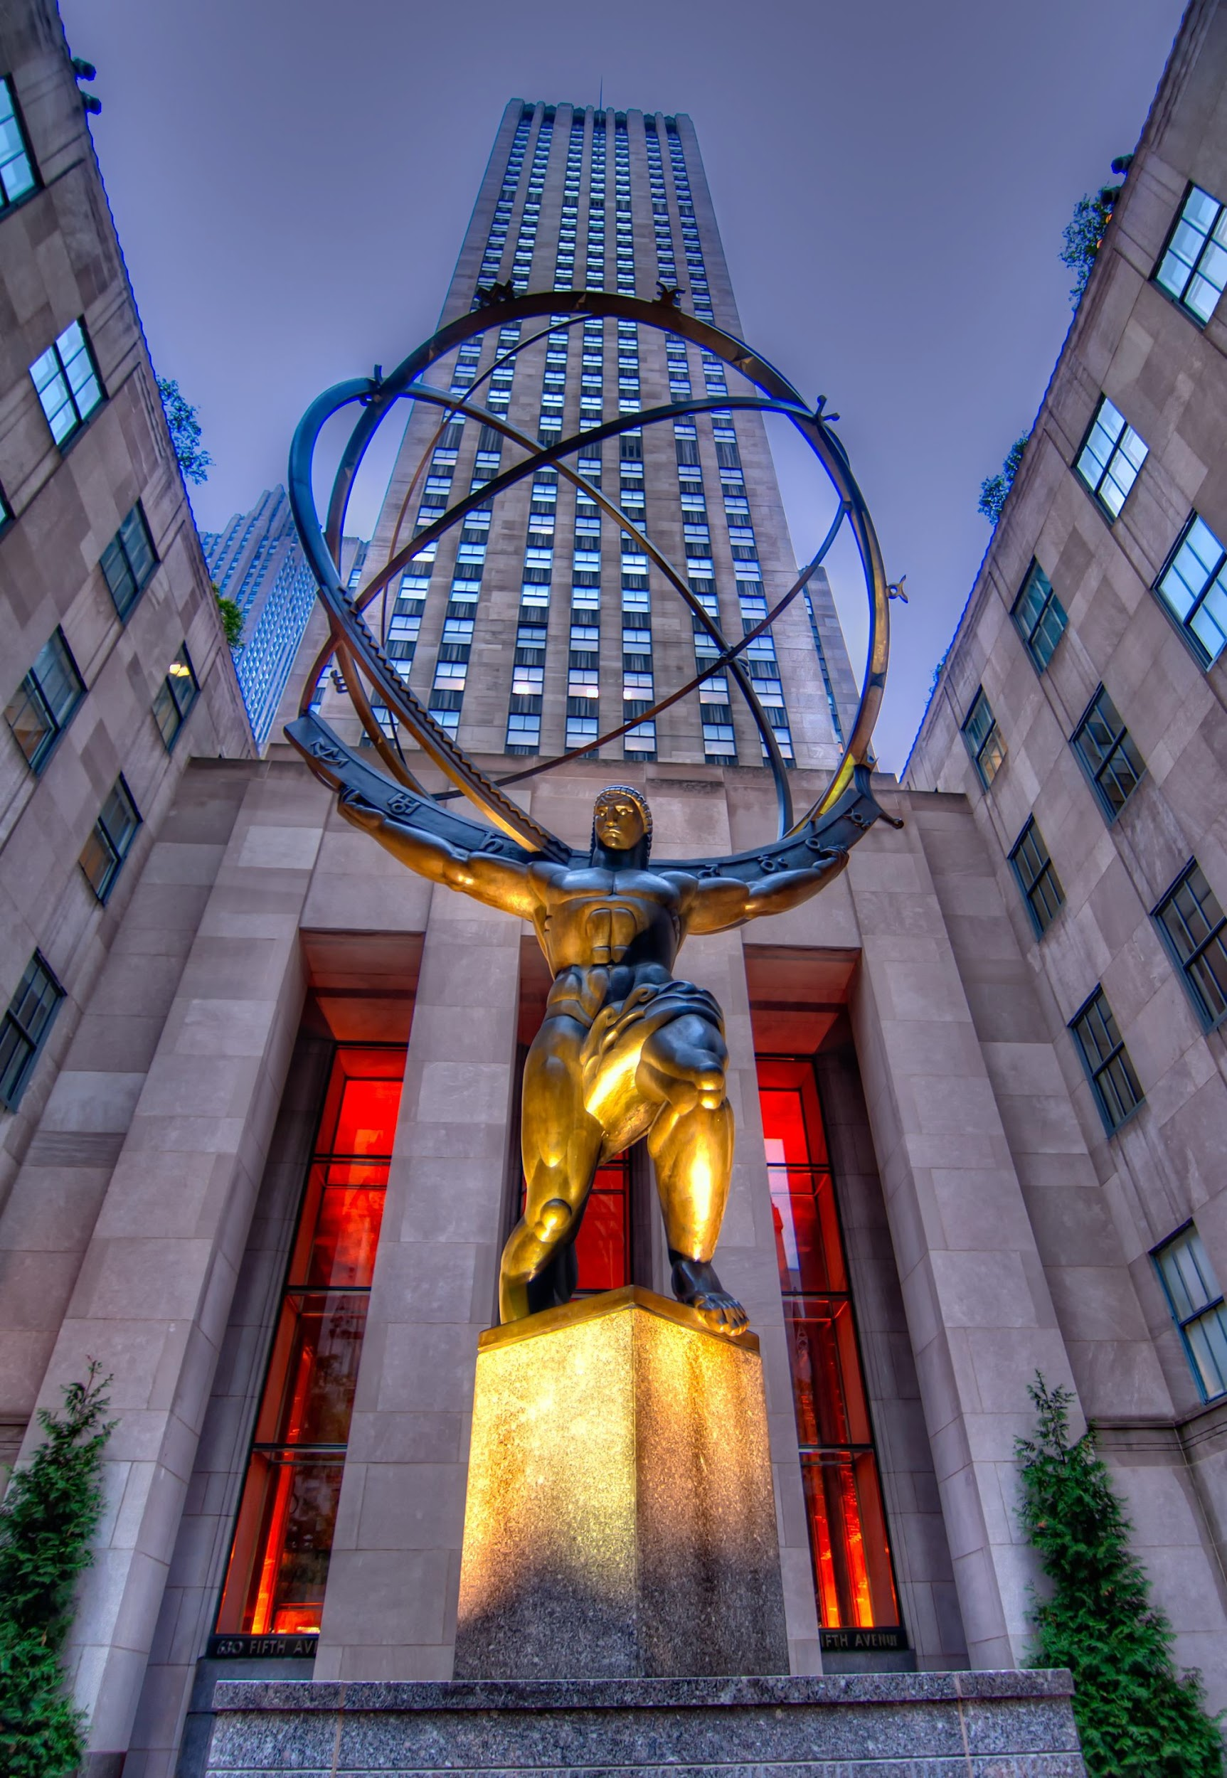
Avant-Garde Art
This is the Atlas sculpture at Rockefeller Center. Many Art Deco buildings were decorated with murals and sculptures
Notes:
Once again, we see art emphasizing the buildings’ message and purpose. John D. Rockefeller Jr. was a businessman and philanthropist, as well as a devout believer in international understanding and relations.
Atlas sits in front of the International Building, and thus it emphasizes what its creators deemed important about the building’s message.

Slide 32
The Art Deco style also shaped the world of photography, influencing everything from portrait backdrops and studio architecture to the sleek, geometric composition of images. Photographers embraced bold lines, dramatic lighting, and stylized poses, echoing the movement’s emphasis on glamour, modernity, and innovation.

Slide 33
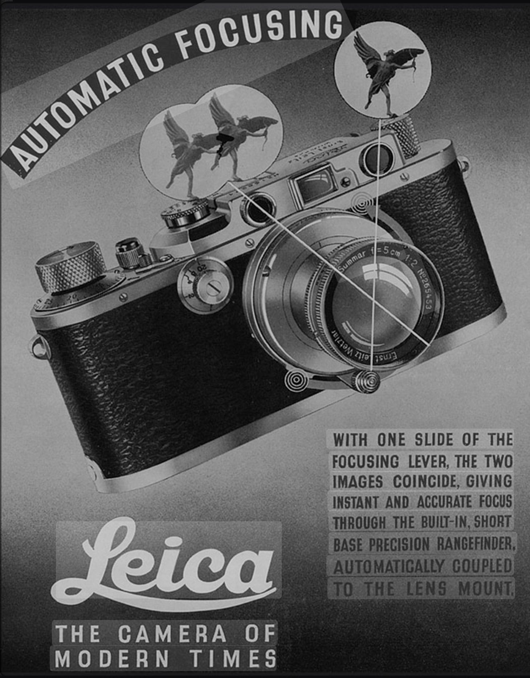
Advances in cameras, film, and studio lighting during the Art Deco era made photography more portable and dramatic. Rich contrasts and glamorous portraits echoed the movement’s modern style and helped spread its allure worldwide.

Slide 34
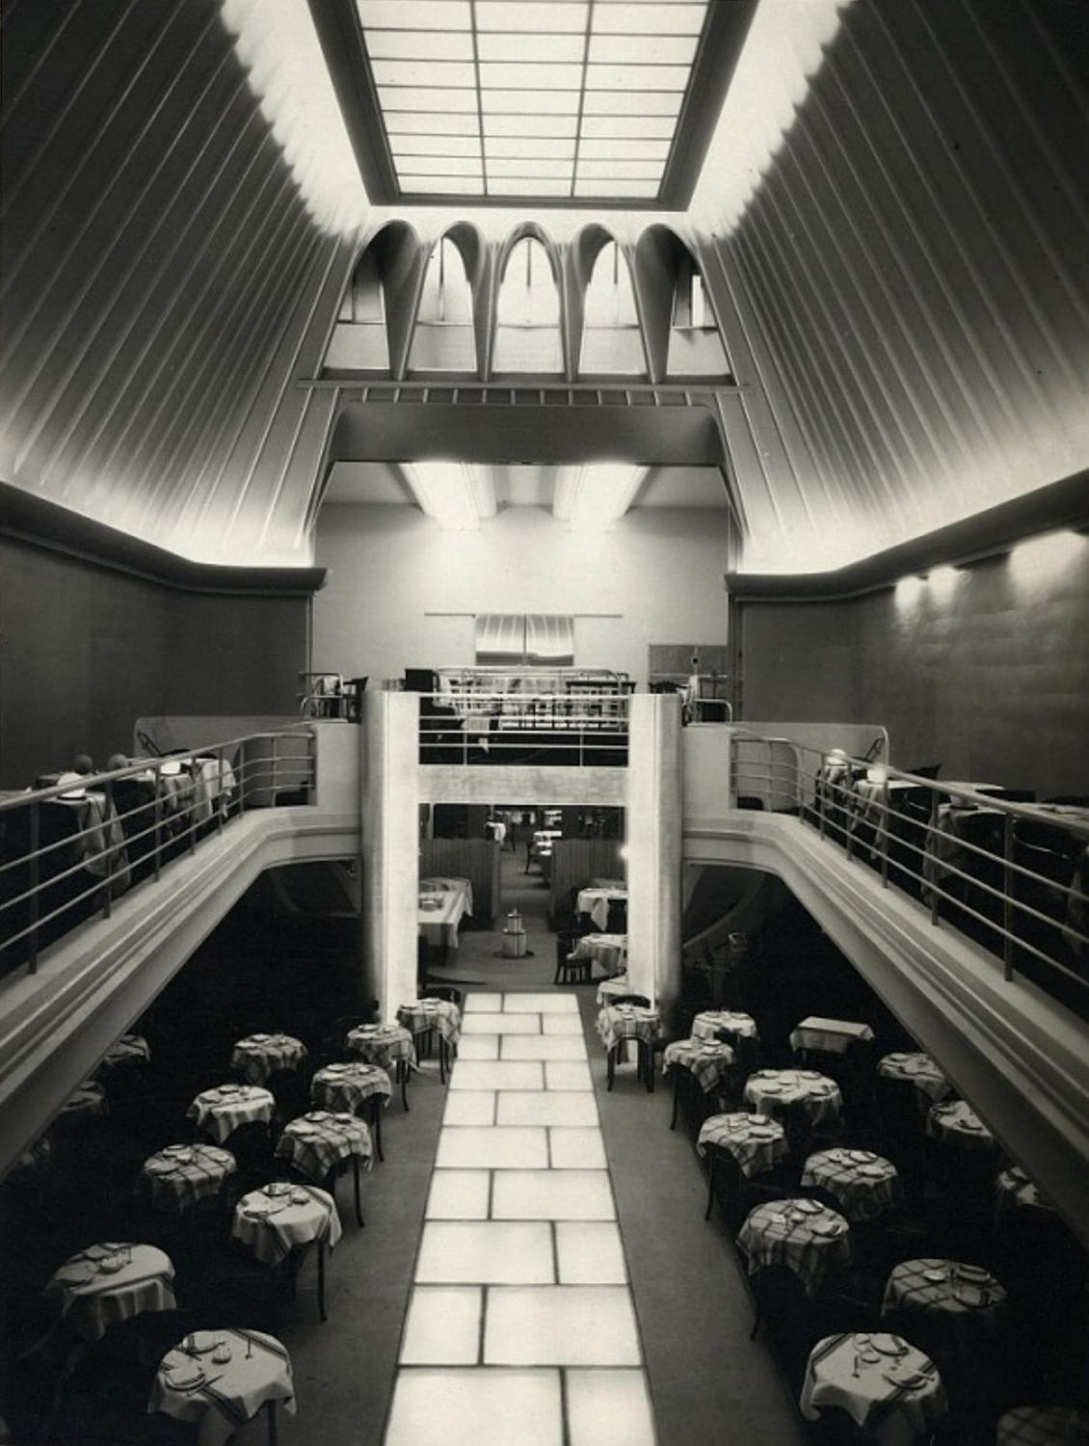
Thérèse Bonney, Paris 1925
Notes:
Thérèse Bonney was one of the first American women photographers and photojournalists, best known for documenting Art Deco architecture and design during the 1920s and 1930s.

Slide 35
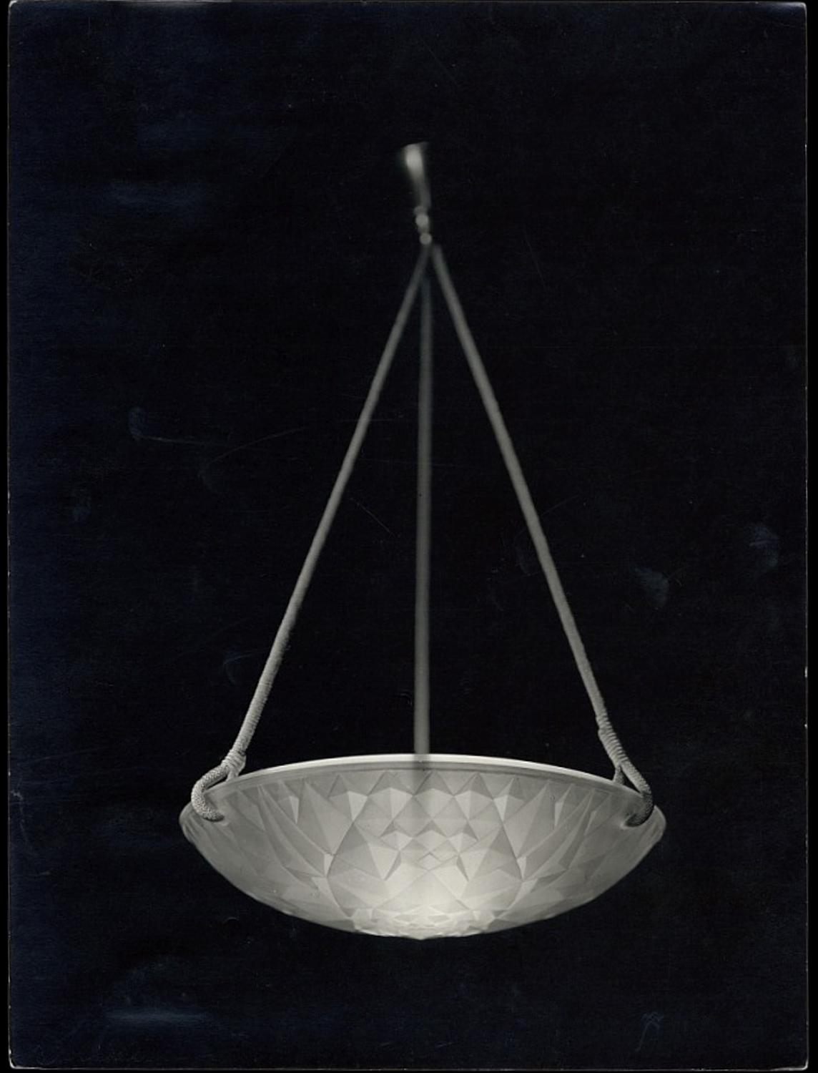
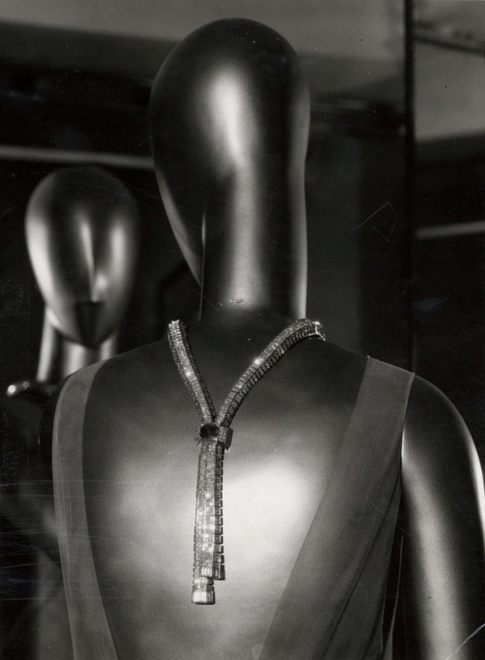
Thérèse Bonney, Paris 1925

Slide 36
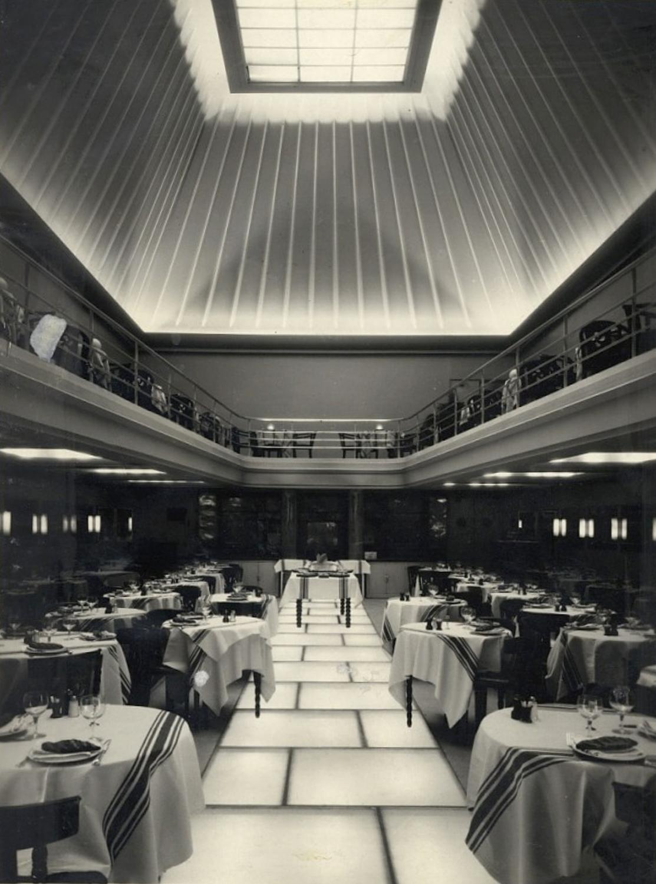
Photo: Thérèse Bonney

Slide 37
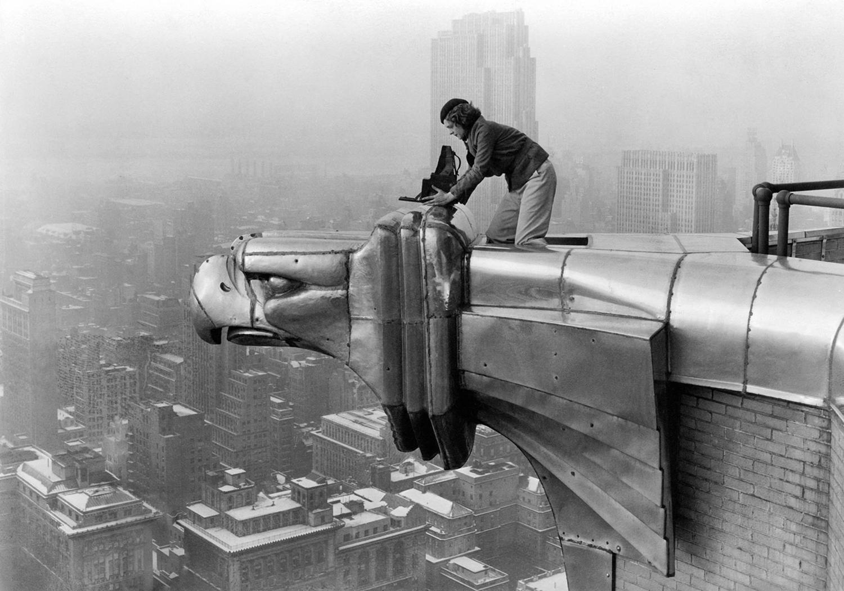
Another big change during this time was the entry of women into the workforce, where they made significant contributions to the history of photography and design.
Photographer Margaret Bourke White (pictured) made significant contributions to Art Deco.
Notes:
Margaret Bourke-White was a pioneering American architectural and commercial photographer of the 1920s and 1930s, recognized as one of the first women to achieve prominence in the field and a leading figure in shaping modern photography.

Slide 38
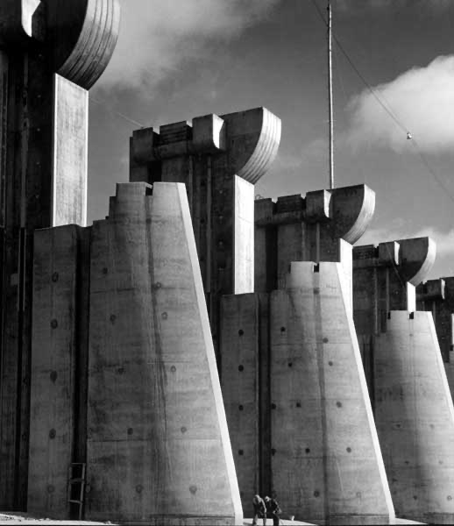
Margaret Bourke-White’s Fort Peck Dam (1936) captures the Art Deco era’s celebration of modern industry, using bold geometry and dramatic perspective to reflect the movement’s Machine Age ideals. While not “Art Deco” in a formal, decorative sense, it is very much in the spirit and timeframe of the style.

Slide 39
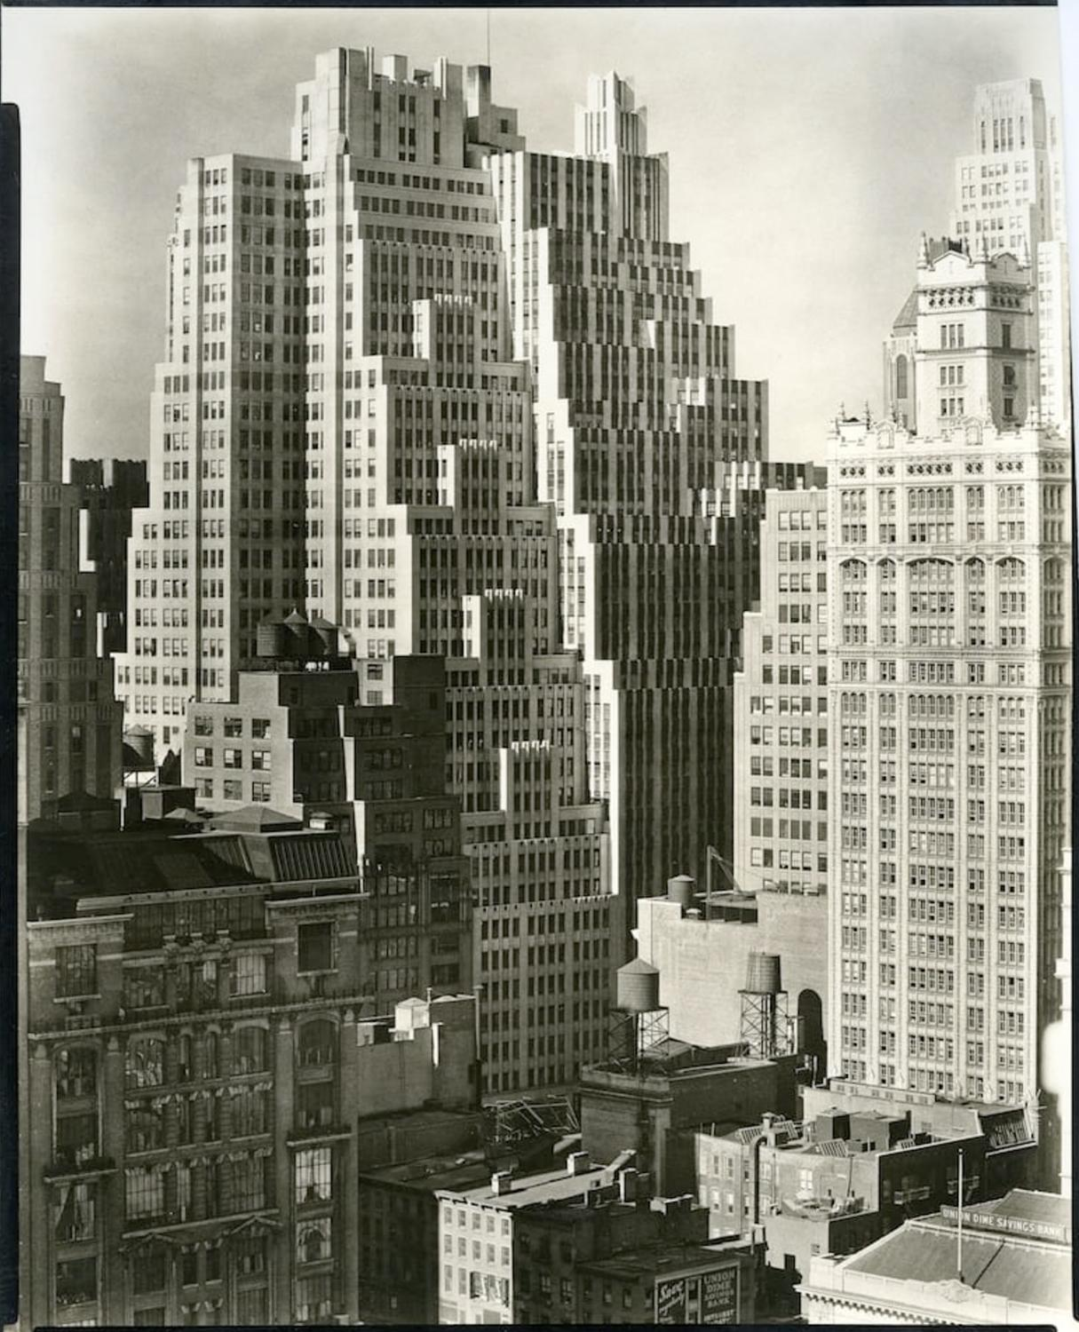
Photo: Berenice Abbott
Notes:
Berenice Abbott was an American photographer best known for Changing New York (1935–1939), her iconic series documenting the city’s transformation during the Art Deco era. Her images captured skyscrapers, streets, and everyday life, preserving the energy of a rapidly modernizing city.

Slide 40
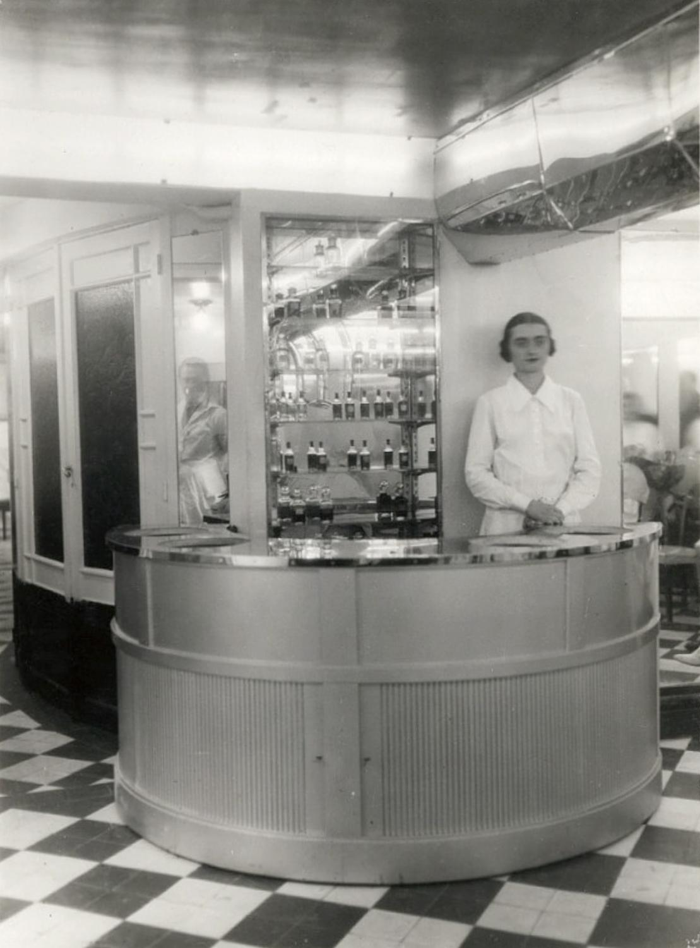
Assignment for next class:
Take photos of Art Deco in your neighborhood or around the city.
Think of light, form, meaning and moment.

Slide 41
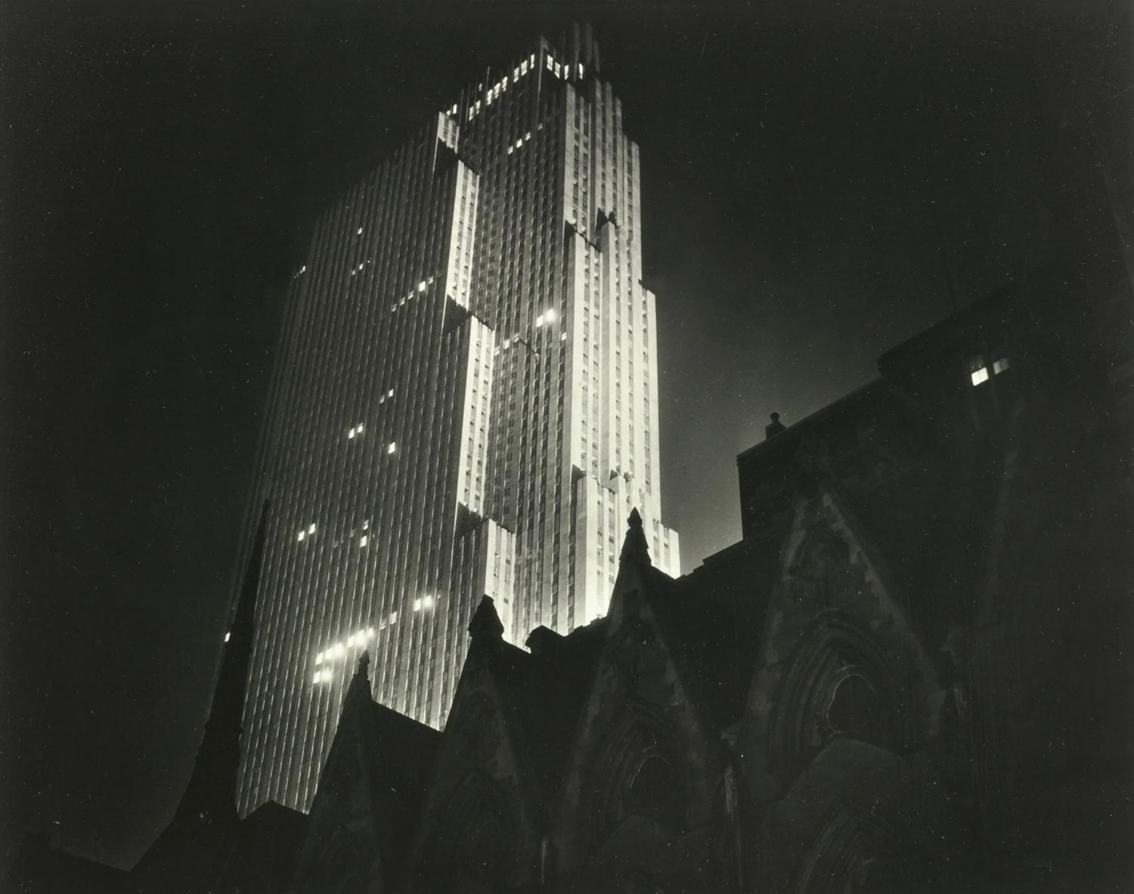
LIGHT
Paul J. Woolf, RCA Building, 1938
Notes:
Light is the essential foundation that creates images, shaping their tone, mood, texture, and depth by defining highlights and shadows. Without light, no photograph can exist.

Slide 42

FORM
Paramount Theater, Oakland CA
Notes:
Form refers to the three-dimensional shape and structure of a subject, giving it depth and a sense of volume. Different camera angles and perspectives can emphasize or reveal the form of an object.

Slide 43

MEANING
Photo: Thérèse Bonney
Notes:
Meaning is the capacity of an image to evoke an emotional response, tell a story, and give meaning to its subject.

Slide 44

MOMENT
Photo: Berenice Abbott, 1929
Notes:
According to Henri Cartier Bresson, often called the father of modern photojournalism, moment refers to “the simultaneous recognition, in a fraction of a second, of the significance of an event as well as of a precise organization of forms which give that event its proper expression."

Slide 45


