Slide 1
Describing Deco

Slide 2
What does an architect do, really?
Notes:
-Keep track of student responses for potential use in the next “Designing Deco” session!
-Instructor can also ask what an architect would have had to consider when designing their own school.

Slide 3
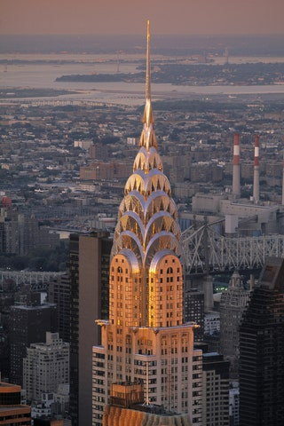
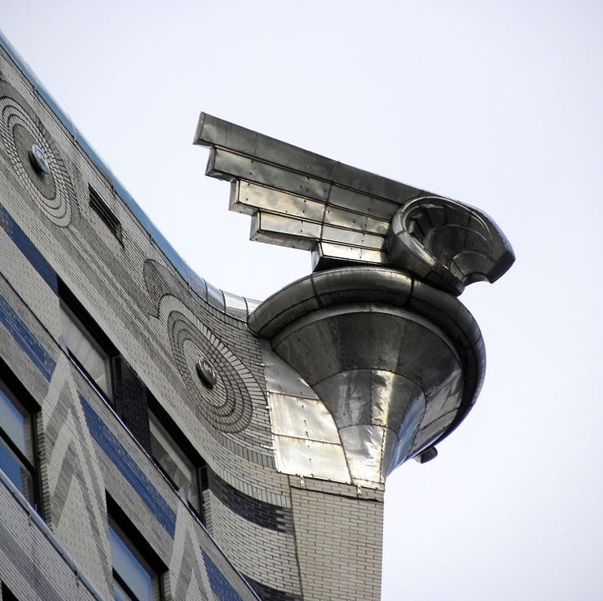
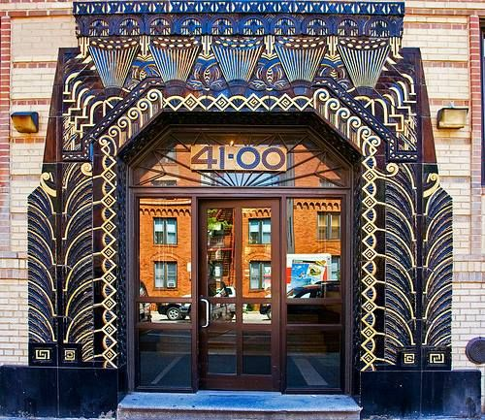
What is Art Deco?
Art Deco is an aesthetic and architectural style that became popular in the 1920s and 30s.
It is a creative form that emerged during the machine age, and used those technologies in an artistic way.
It was influenced by many different time periods and global cultures.

Slide 4
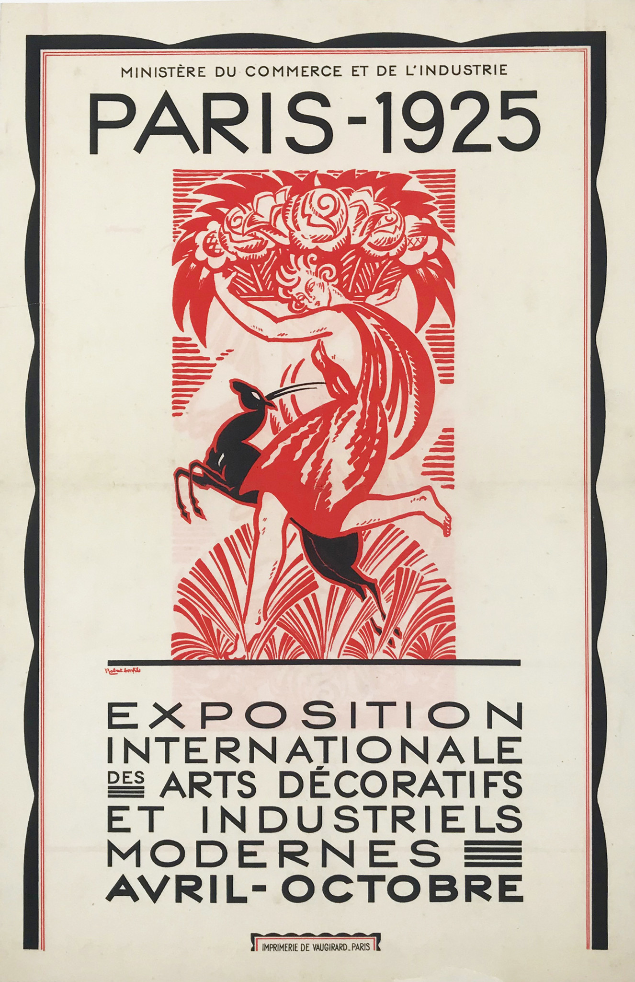
Art Deco’s Origins
• Art Deco was first displayed to the world at the 1925 Paris World’s Fair
• The World’s Fair showed off new technologies, designs, and ideas to visitors from around the world
• The new “modern” designs showed off here were later named after the exhibit itself, the Exposition Internationale des Arts Decoratifs

Slide 5
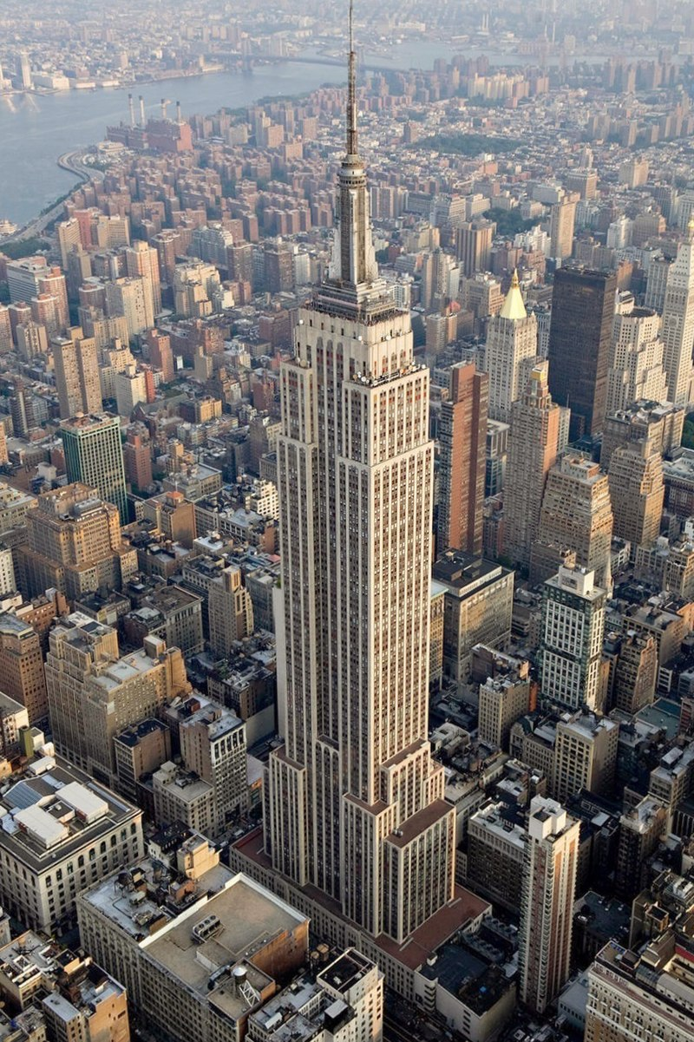
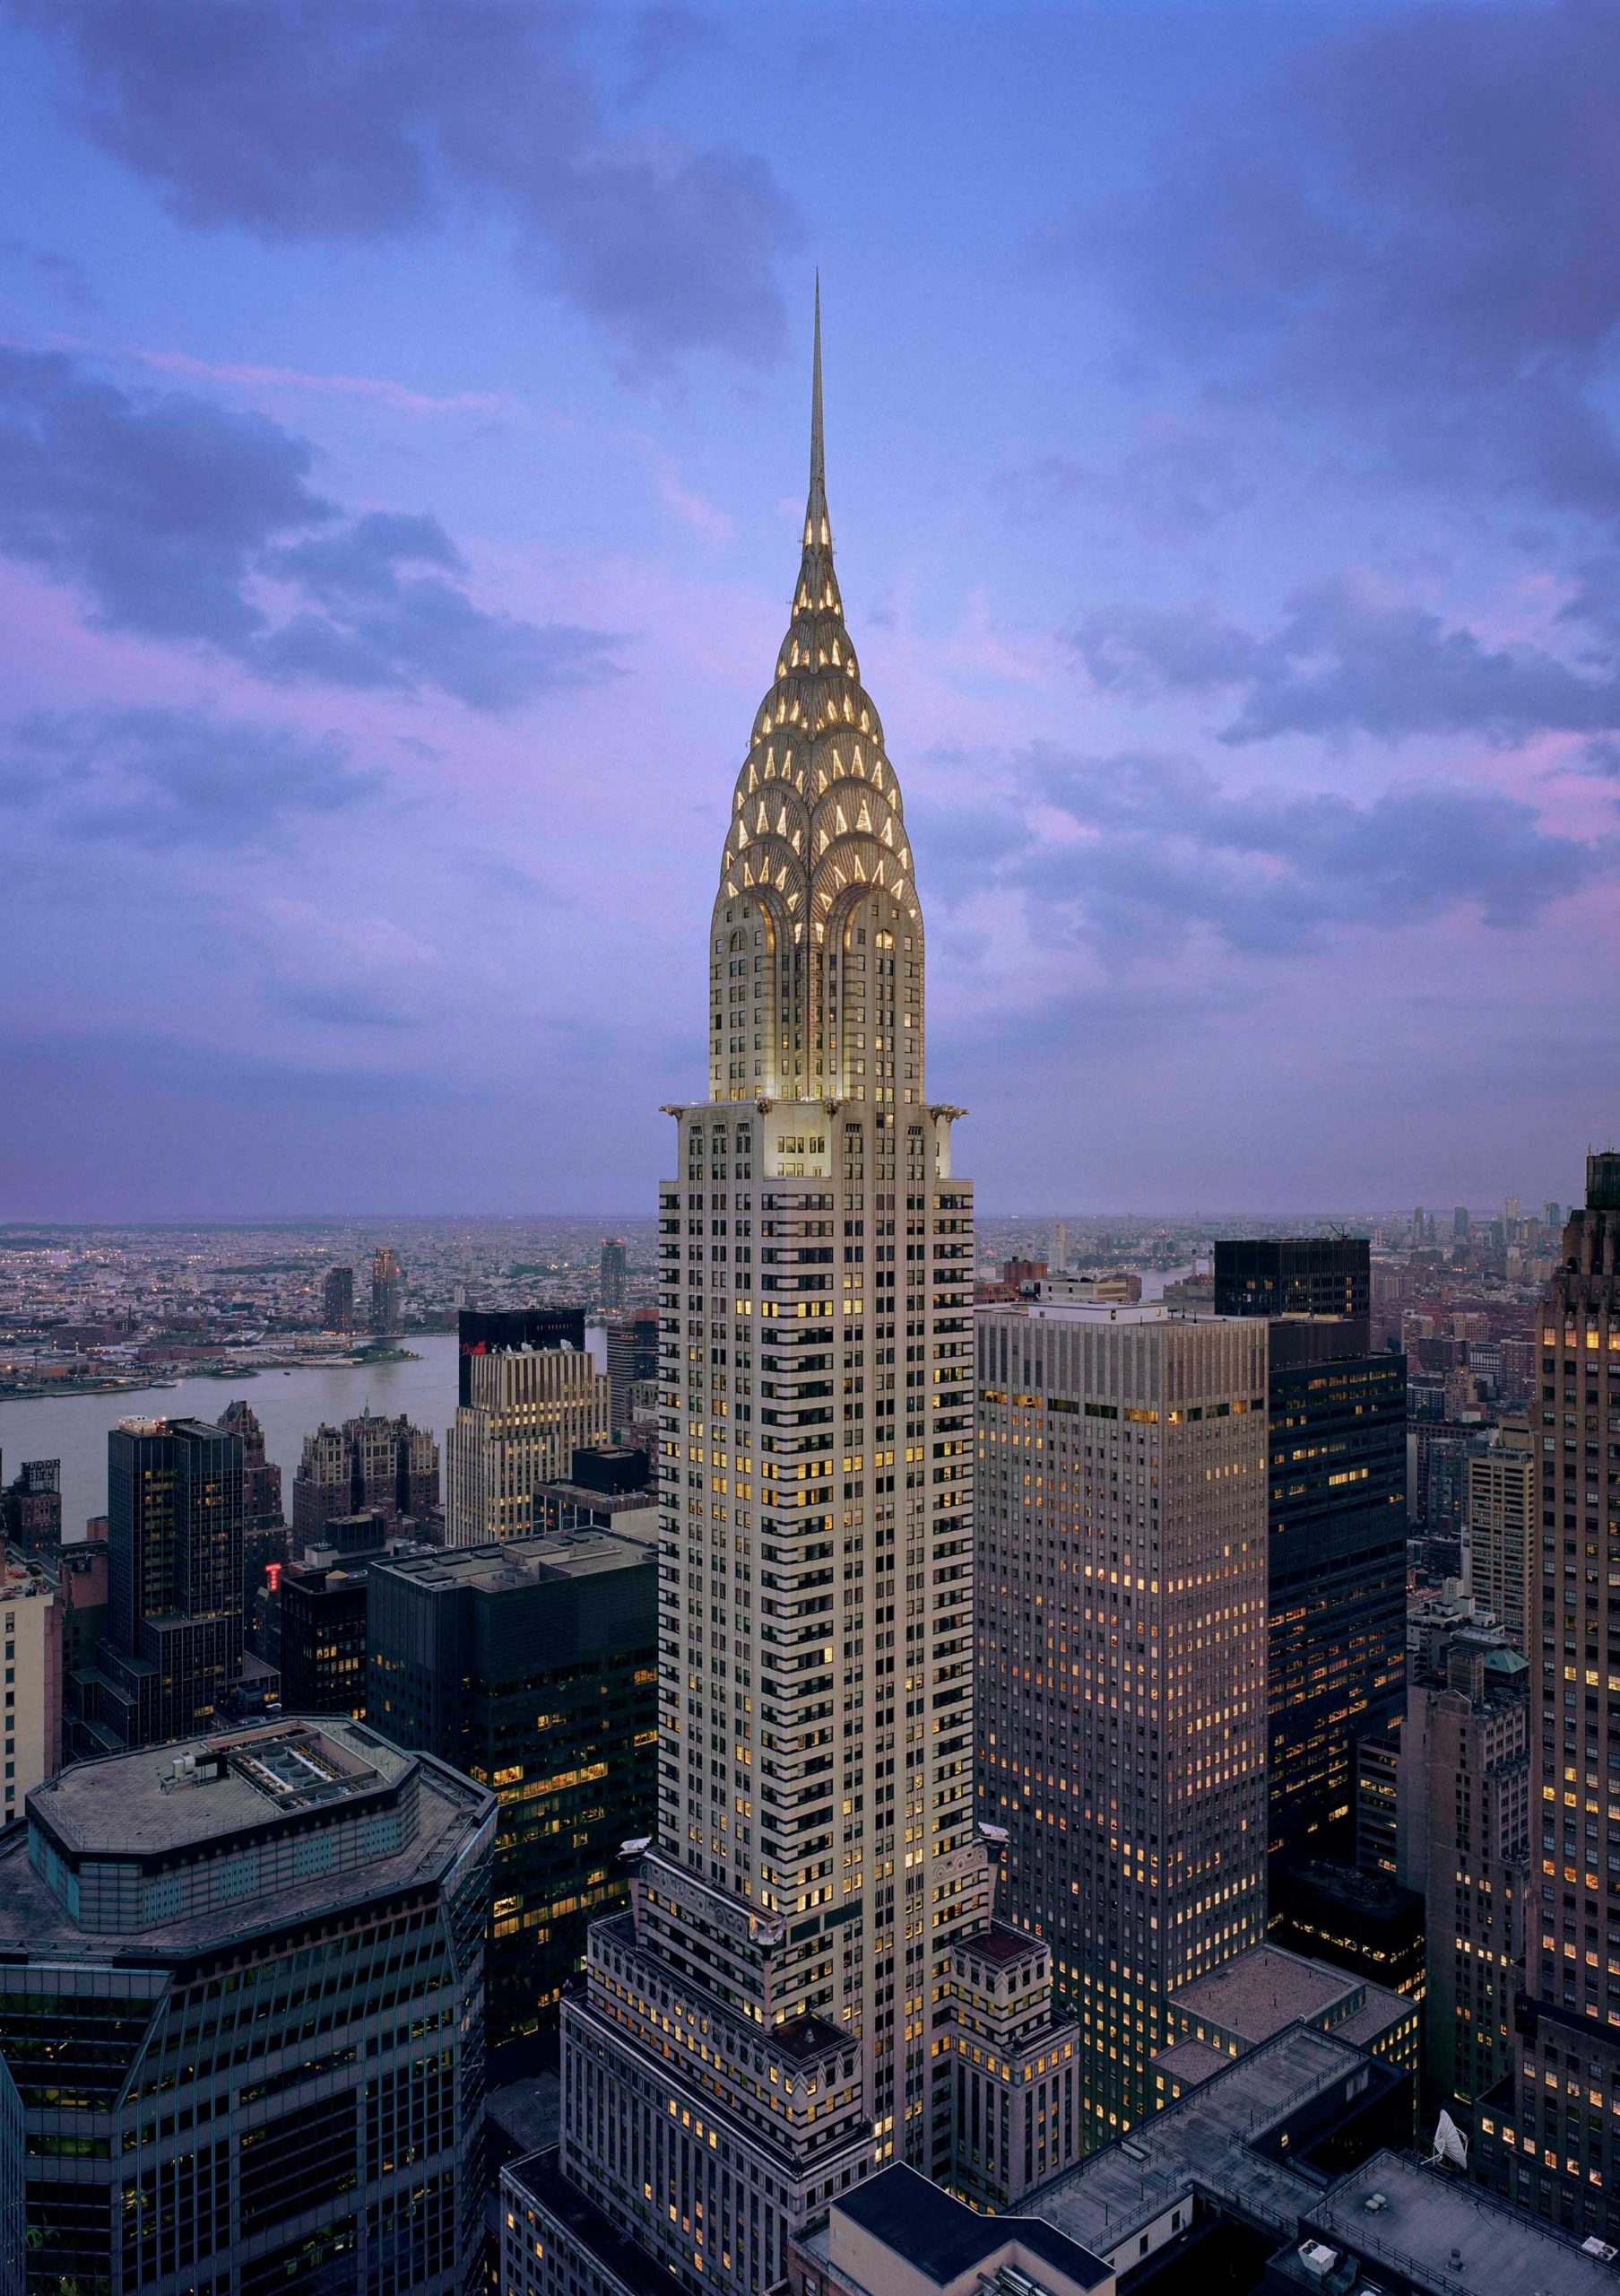
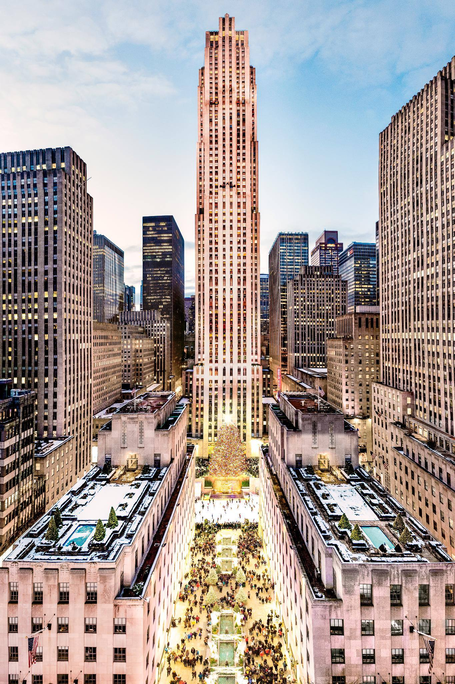
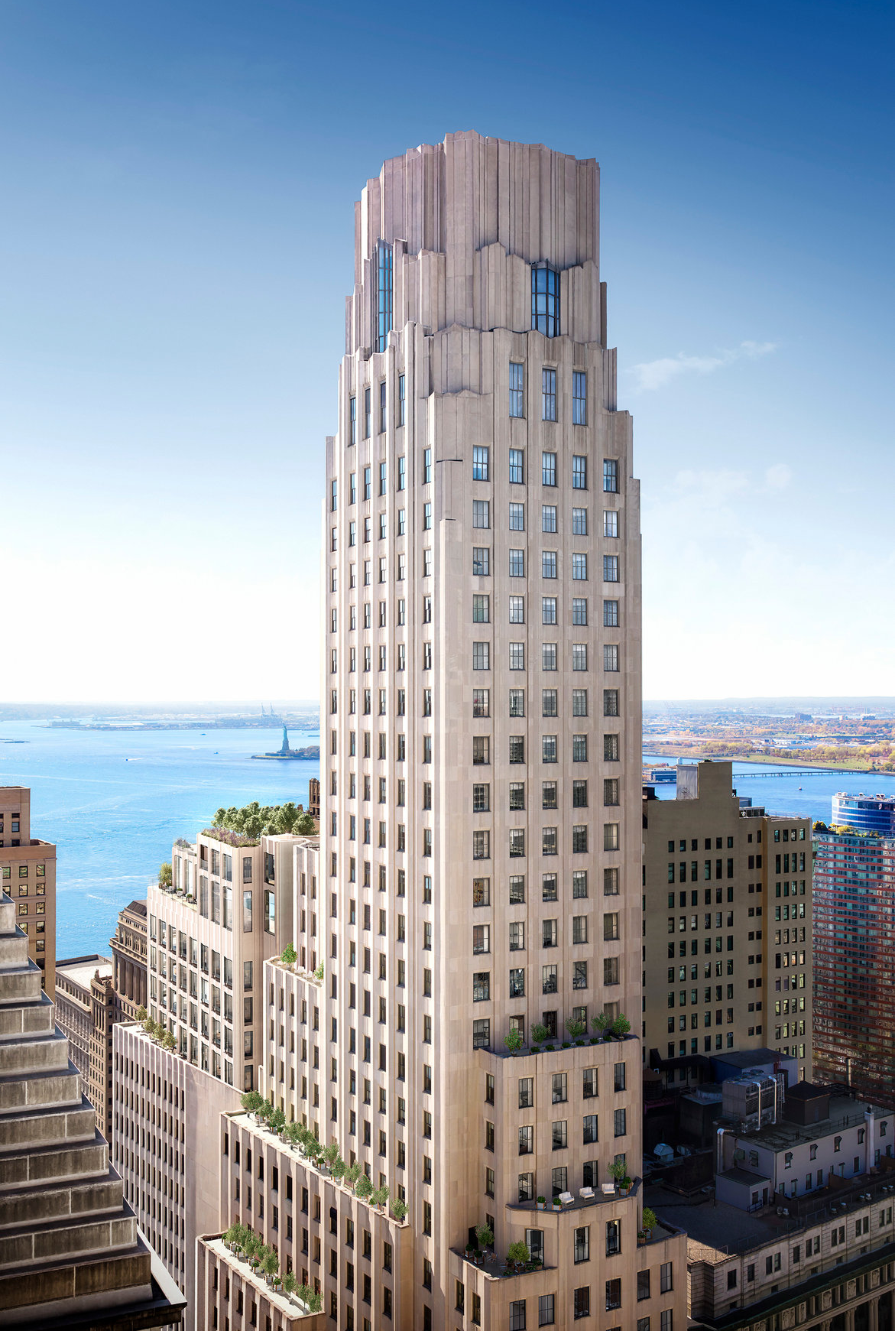
An Era of Skyscrapers
Empire State
Building
Rockefeller Center
Chrysler Building
One Wall Street
1931
1930
1931-1939
1931

Slide 6
Vocabulary & Features
Of Art Deco
Notes:
-The following vocabulary terms track with the students’ worksheets. As you go through these slides, allow relevant time for students to write down definitions or ask questions.

Slide 7
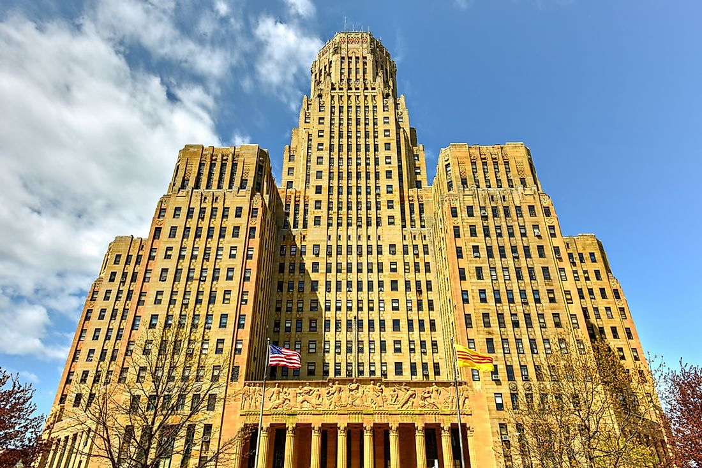
Massing
Notes:
-Massing is the physical shape of a building.

Slide 8
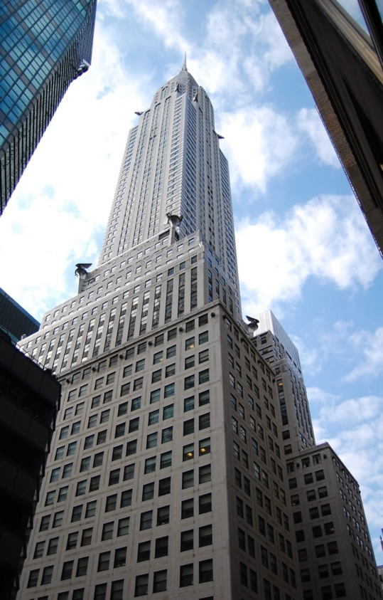
Wide bases and narrow tops
Notes:
-This popular kind of shape was actually created in response to a NYC zoning law. In 1916, the city passed a law which regulated the shape of skyscrapers to make sure that light and air would reach the sidewalk below. Tall buildings blocked sunlight and cast shadows and made neighboring buildings dark. Before skyscrapers, this wasn’t a huge problem for the city, as buildings could only be built so high anyway.
-The law stated that once the building reached a certain height, the overall mass had to be reduced, thus creating setbacks, or the stepped pyramid look.

Slide 9
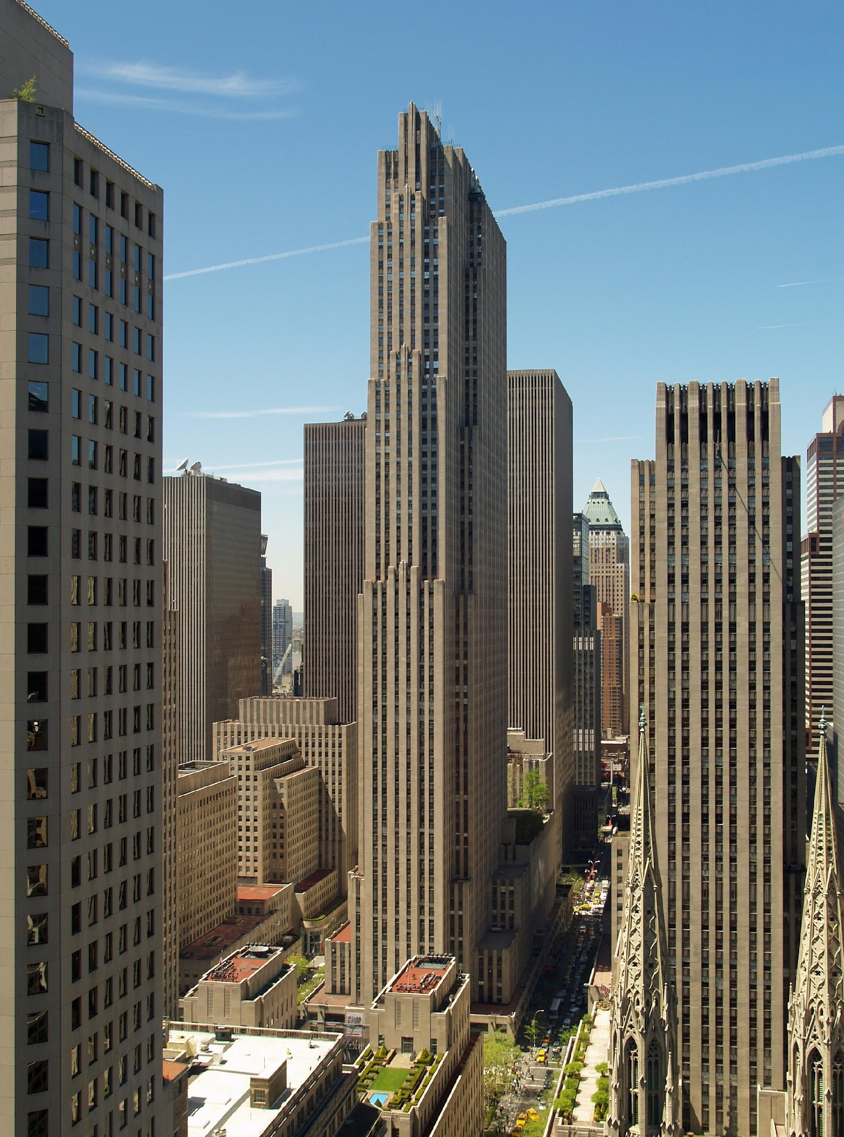
Vertical
Accentuation
Notes:
-Art Deco buildings often use vertical shapes and lines to emphasize, or accentuate, the vertical height of the building.
-The phrase Art Deco didn’t exist until 1966. So until then, architects actually called this style the “vertical style!” It was all about emphasizing the buildings height. Recessed windows helped with this effect, as did uninterrupted brick columns on either side of those windows. See: spandrels!

Slide 10
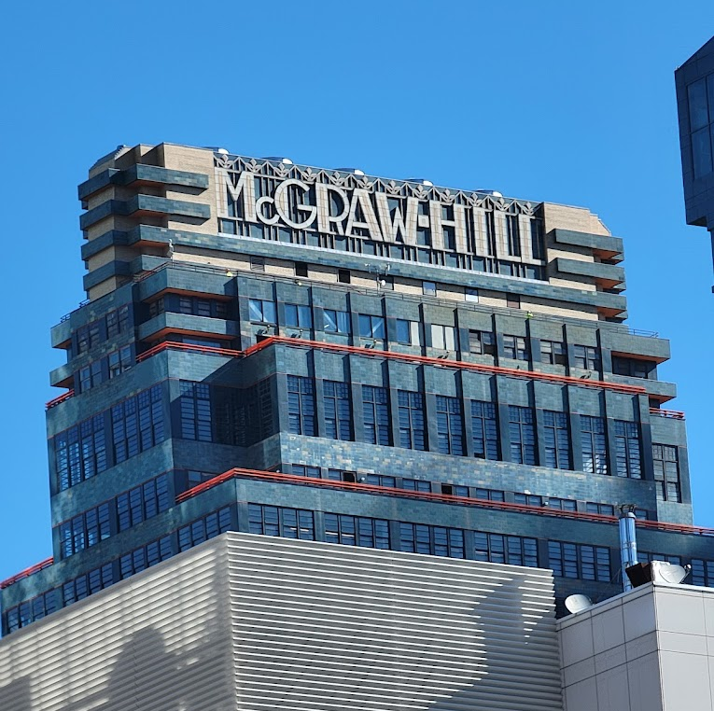
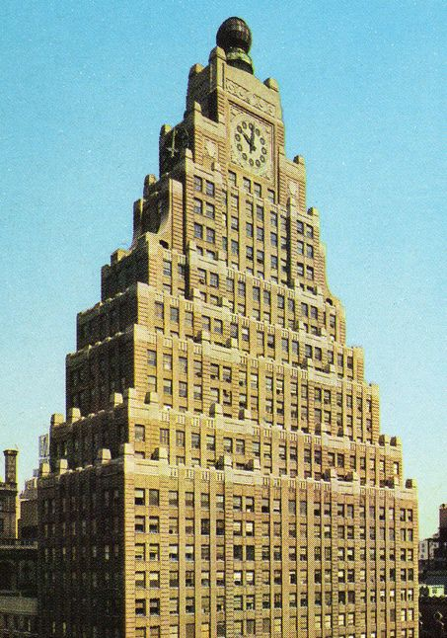
Unique roofs
Stepped levels
Notes:
These stepped levels tie into the common shape of a wide base and narrow top, so these pyramid like levels also tie into the zoning restrictions created at the time.

Slide 11
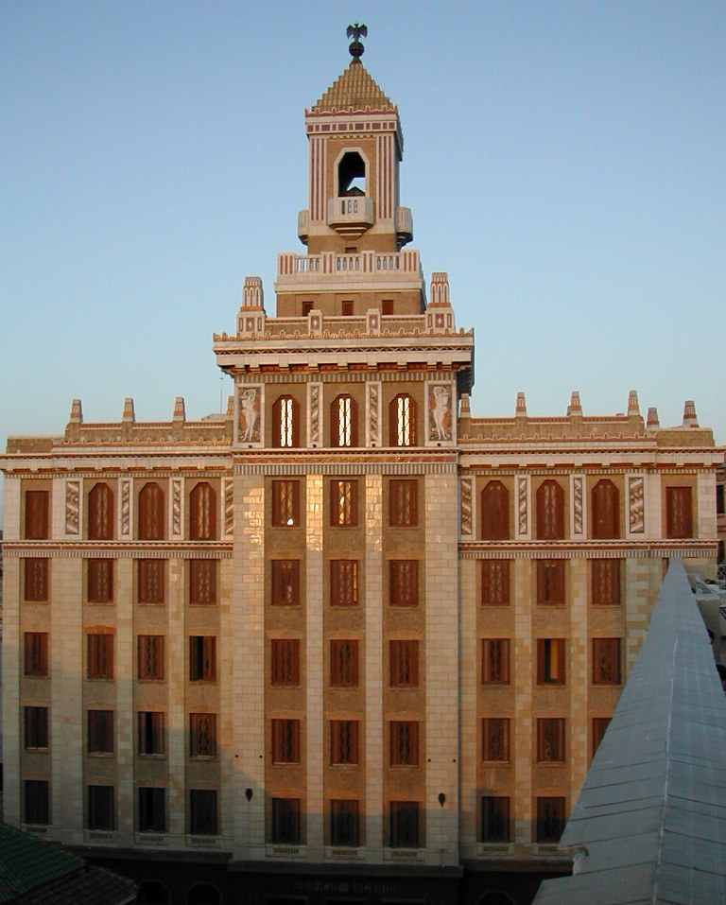
Parapets
Notes:
-Parapets are a low wall along the roof of a building. Originally protective or defensive, the parapets of Art Deco architecture are largely decorative

Slide 12
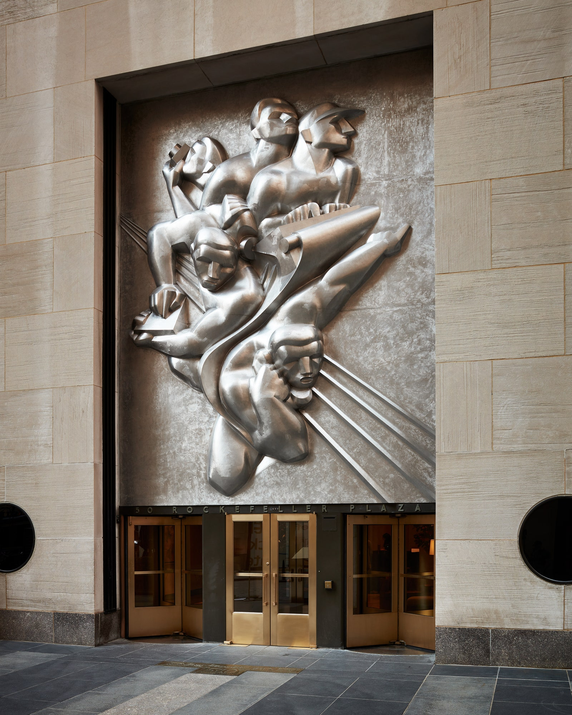
Sculptural
Relief
Notes:
-Sculptural relief features sculptures that project from their backing material, instead of being carved into the stone or metal itself.
-Many ornaments like these were meant to explain what the building’s purpose was! This is the Associated Press building, so the sculpture references the newspaper business at the time.

Slide 13
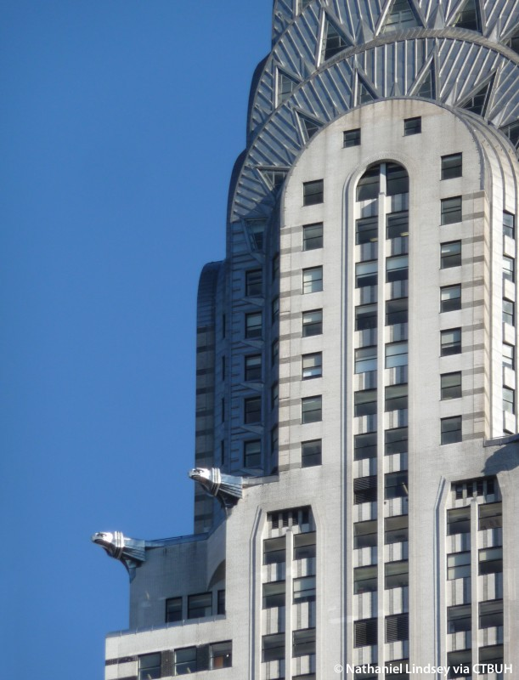
Spandrels
Notes:
-Spandrels refer both to the triangular space found in the upper corners of arches, and to a rectangular space between windows of adjacent floors. They also help accentuate a building’s verticality, as they help emphasize those vertical lines. See: vertical accentuation!

Slide 14
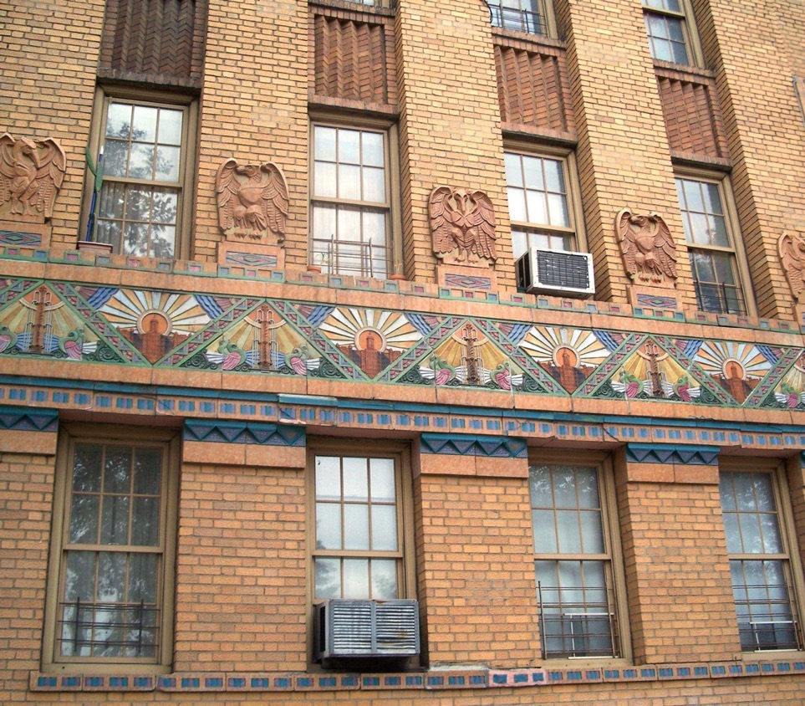
Geometric
Patterns
Notes:
-Floral patterns sometimes found their way into decorations like these as well.

Slide 15
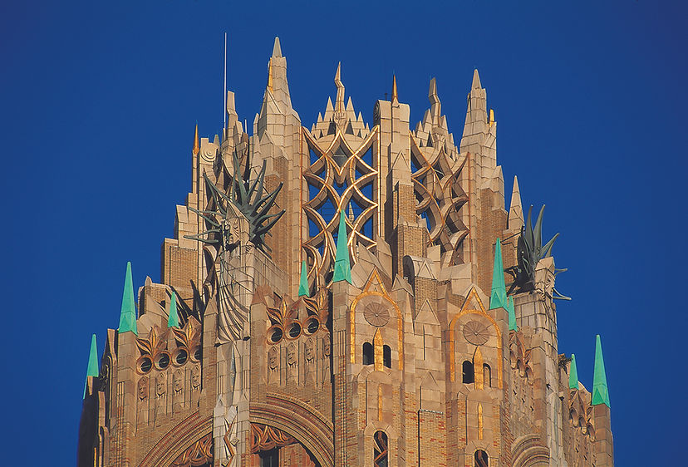
Terracotta
Notes:
-Terra cotta is a clay-based ceramic material. Along with new minds of metal alloys and different colors of brick, the frequent use of this material in decoration was part of a common Deco phenomenon to use brash colors whenever possible

Slide 16
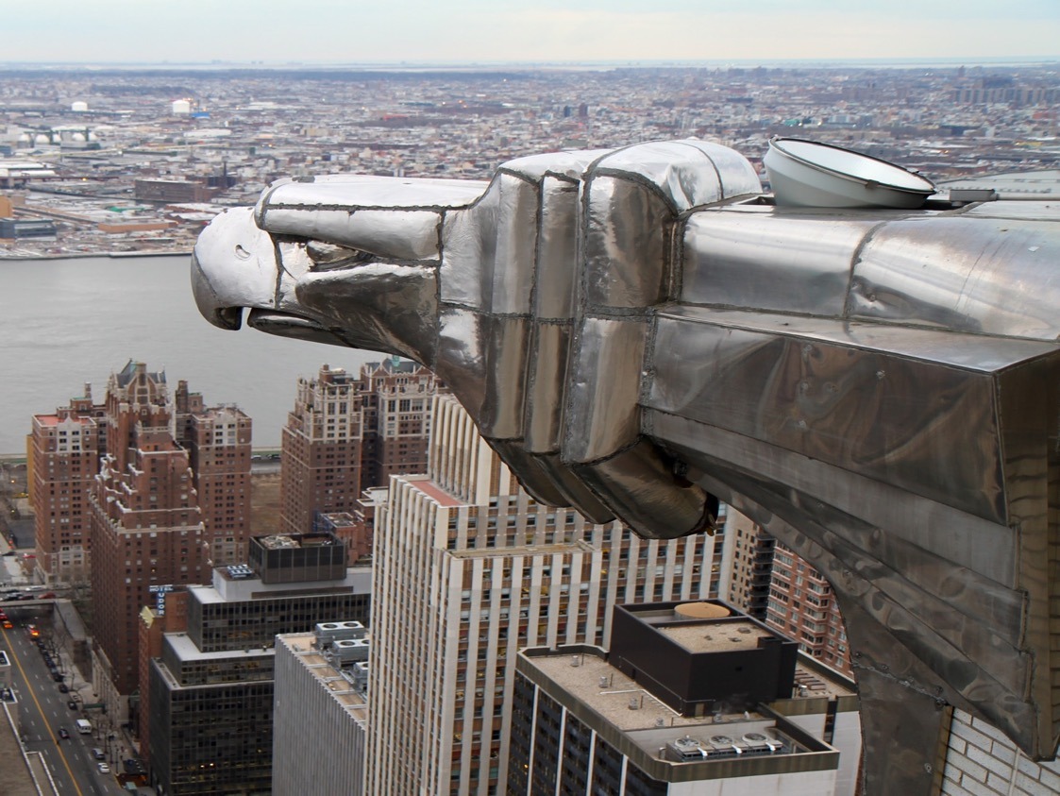
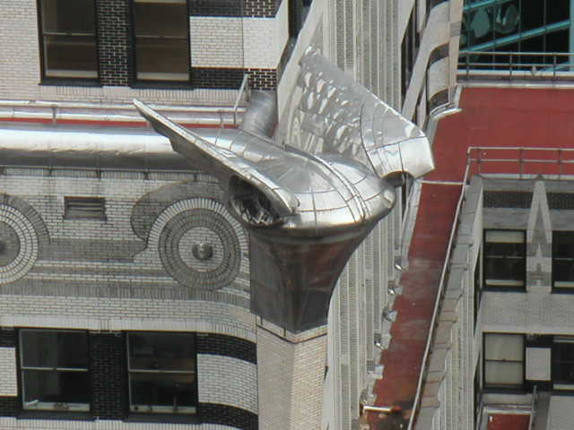
Sculptures showing off new technology
Notes:
-These metal gargoyles decorate the Chrysler building. Note the hood ornament and car wheels in the designs. Like many Deco decorations, these gargoyles are a clear indication of who the building was made for.
-After WWI, metal production could now be shifted towards peaceful purposes. Better technological innovations that developed ruing wartime could now be put to use to make taller and stronger buildings.
-Metal alloys (combinations of two or more metals, or a metal and a non-metal), were very important in architecture, as they were often stronger, more weather resistant, and less likely to rust than their pure-metal equivalents. Bronze, for example, is an alloy of copper and tin, with other components sometimes mixed in. This new technology allowed for metal accents like the decoration on top of the Chrysler Building. Metalwork is an important feature of NY Deco buildings.

Slide 17
Art Deco’s Cultural Influences
Art Deco has a broad range of influences from many different cultures and time periods.
Even in New York City, Art Deco design features design motifs and elements from around the world.

Slide 18
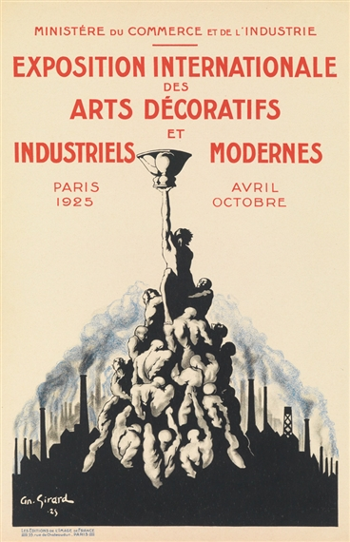
Art Deco Influencers
African tribal patterns
Ancient Egyptian art
Asian motifs
Ancient Greek and Roman design
Mayan and Aztec forms
Avant-garde art (new, unusual, or experimental art from the early 20th century)
Notes:
In the following slides, instructors should note the visual similarities and influences found between the two photos.

Slide 19
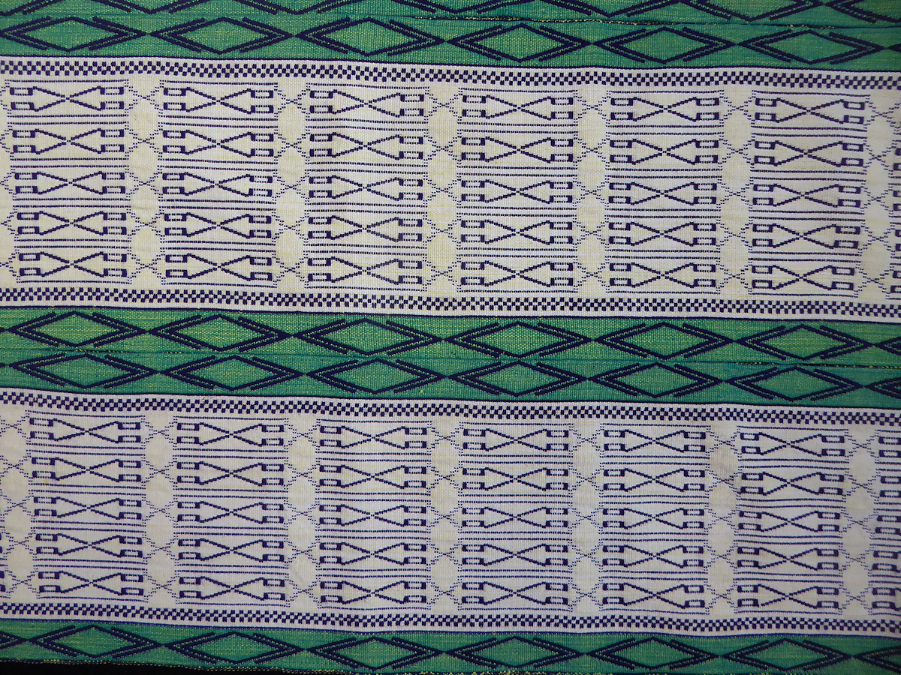
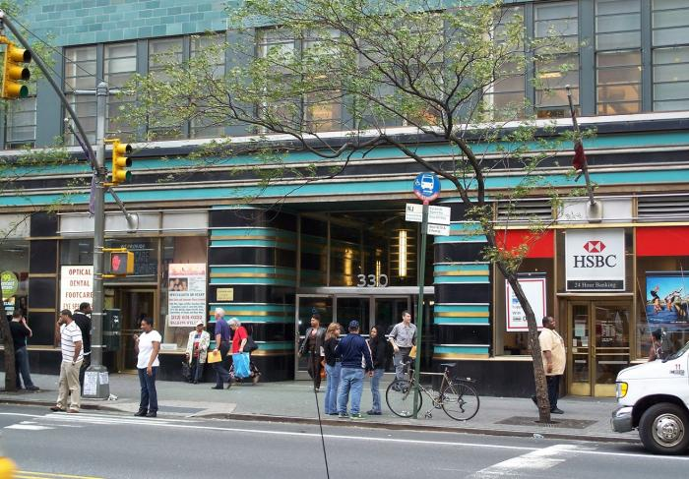
African Designs
Manjak fabric, woven in Senegal
McGraw Hill Building entrance

Slide 20
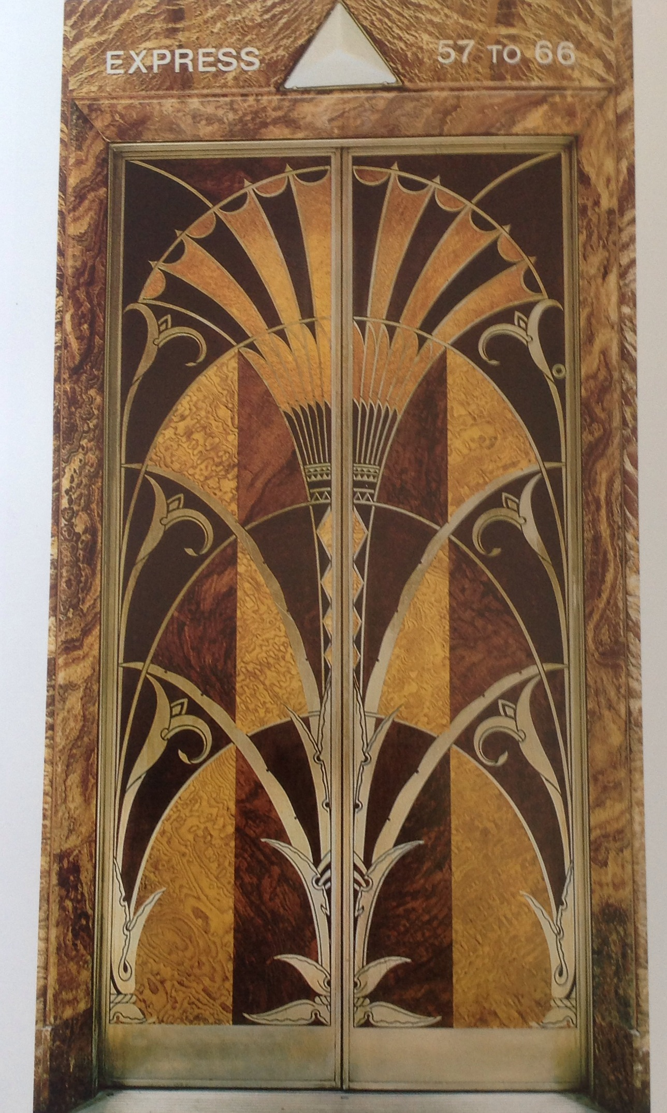
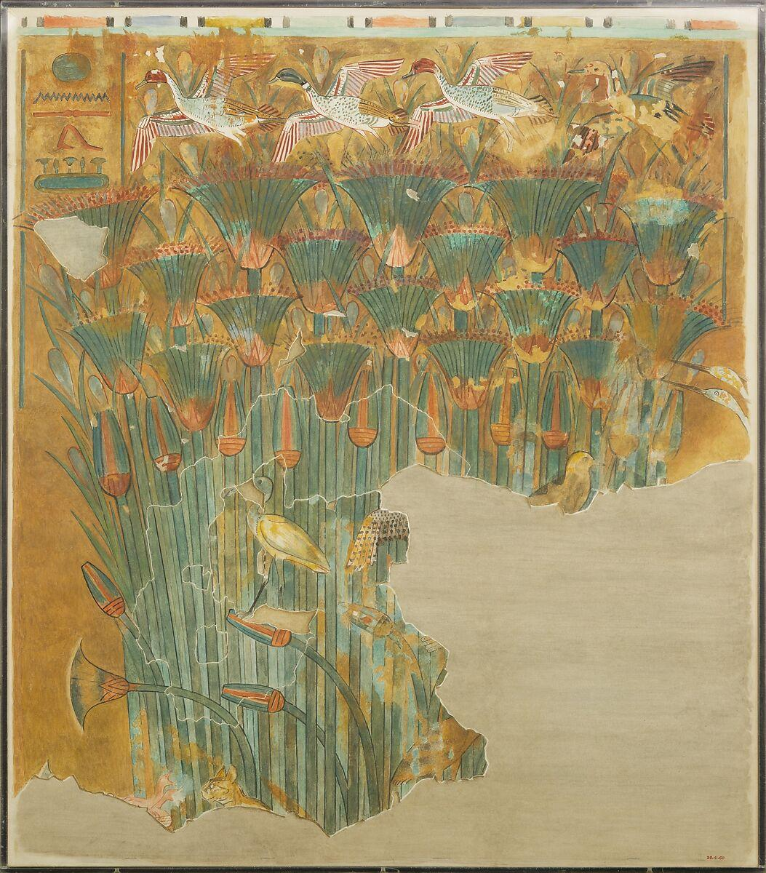
Ancient Egyptian Art
Chrysler Building
elevator
Papyrus marsh, New Kingdom
Notes:
-Alternate image: https://www.metmuseum.org/art/collection/search/548437
-Instructors can point out the marshes and the distinct bell-like shape in the ancient art, drawing a clear visual comparison to the Chrysler building elevator

Slide 21
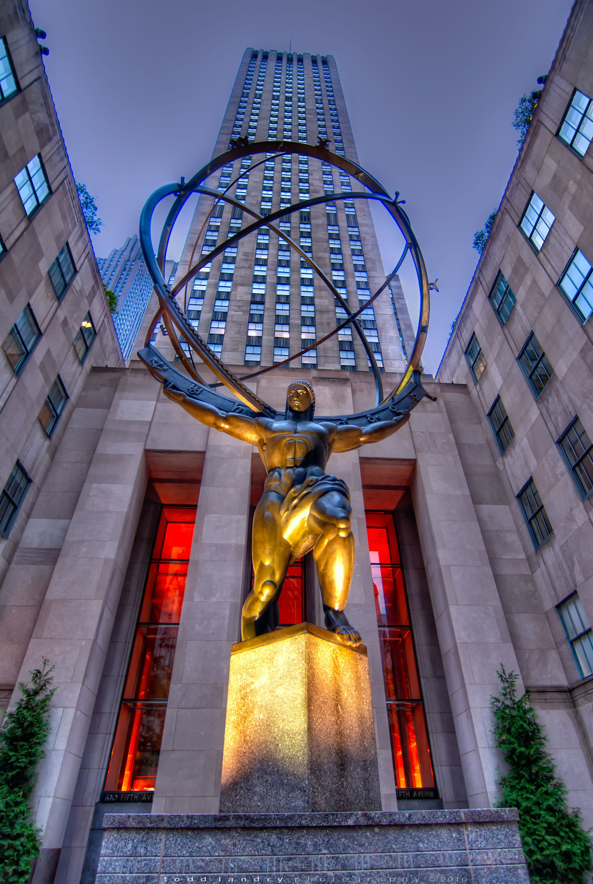
Avant-Garde Art
This is the Atlas sculpture at Rockefeller Center!
Many Deco buildings were decorated with murals and sculptures
Notes:
-Once again, we see art emphasizing the buildings’ message and purpose. John D. Rockefeller Jr. was a businessman and philanthropist, as well as a devout believer in international understanding and relations.
-”Atlas” sits in front of the “International Building,” and thus it emphasizes what its creators deemed important about the building’s message.

Slide 22
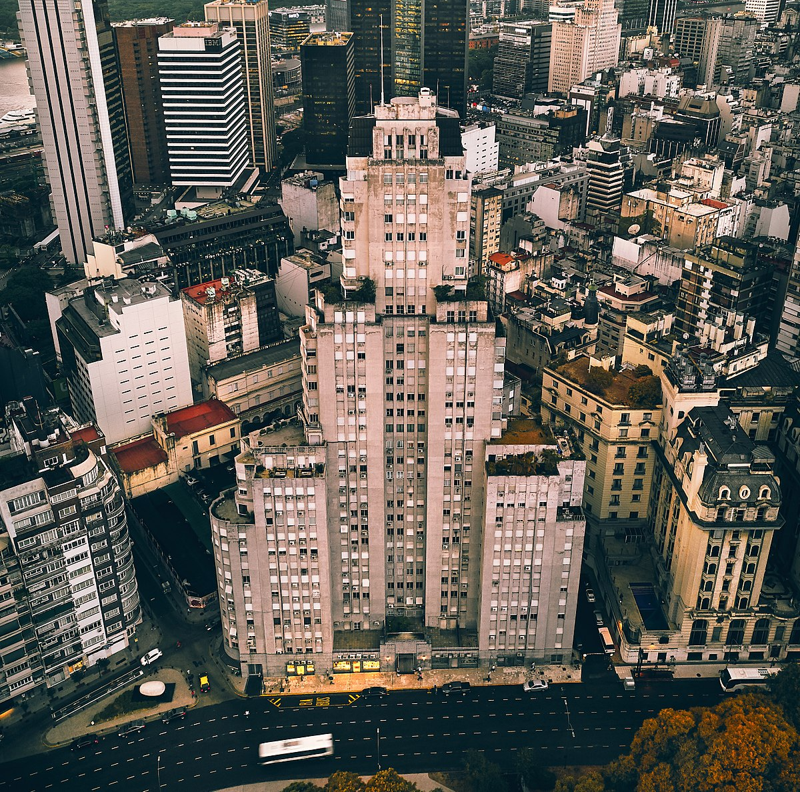
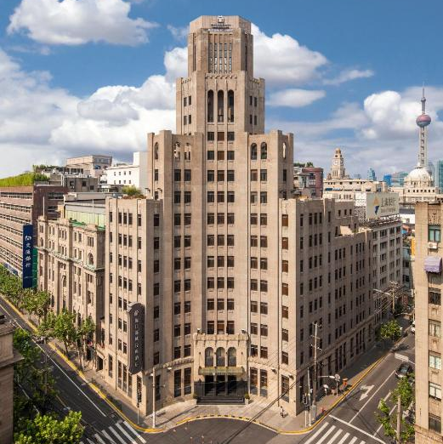
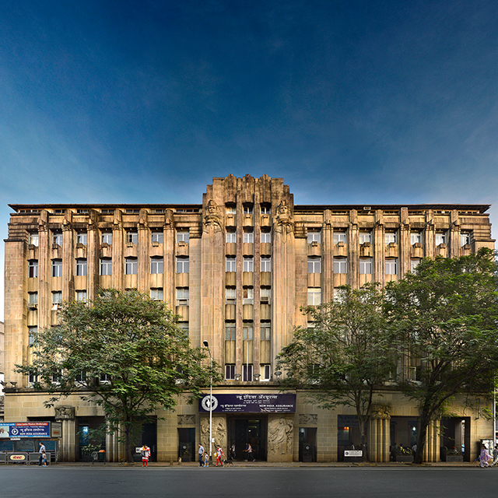
Art Deco Around the World
Eiffle Tower
Edificio Kavanagh
The Metropole Hotel
India Assurance Building
Paris, France
Buenos Aires, Argentina
Shanghai, China
Mumbai, India
Notes:
Emphasize to students that, while Art Deco was hugely influential in NYC, it also has a strong global presence.

Slide 23
Where else have you seen Art Deco?

Slide 24
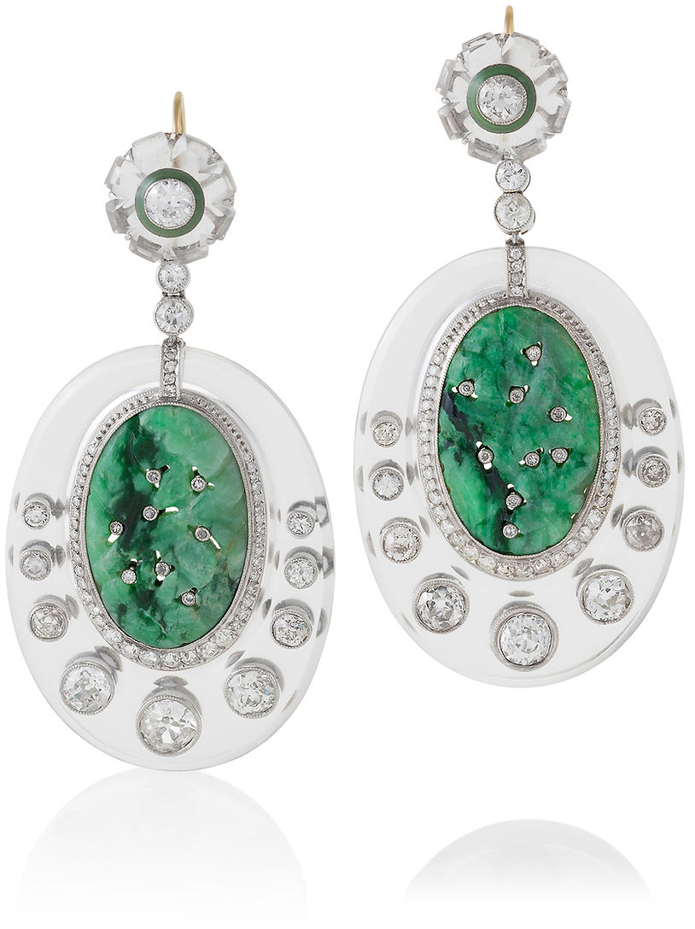
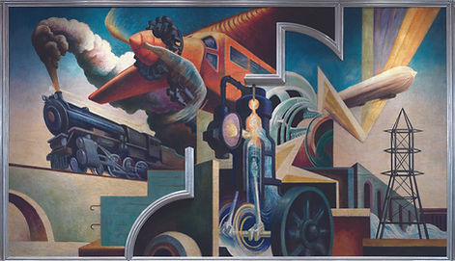
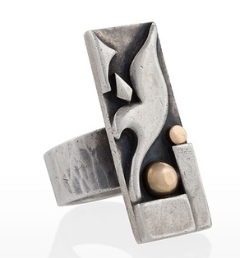
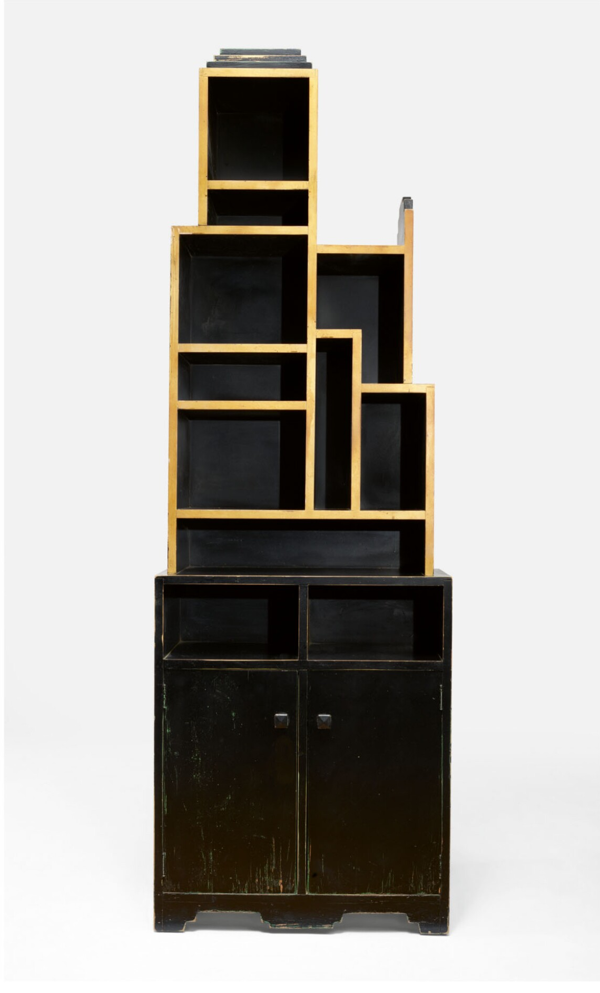
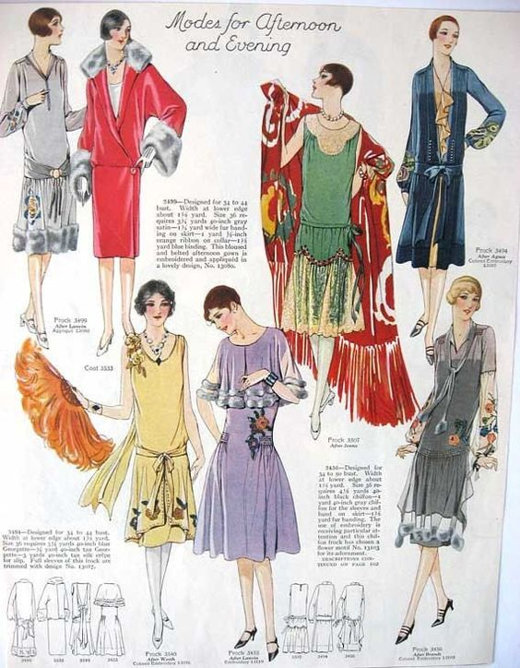
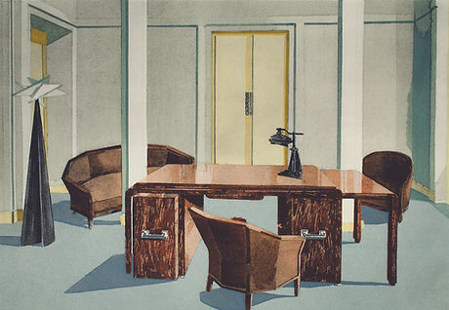
Jewelry
Art
Furniture
Fashion
Notes:
Note: the second furniture picture is a Paul Frankly piece literally called a “skyscraper cabinet.” He famously designed furniture pieces that resembled buildings.

Slide 25
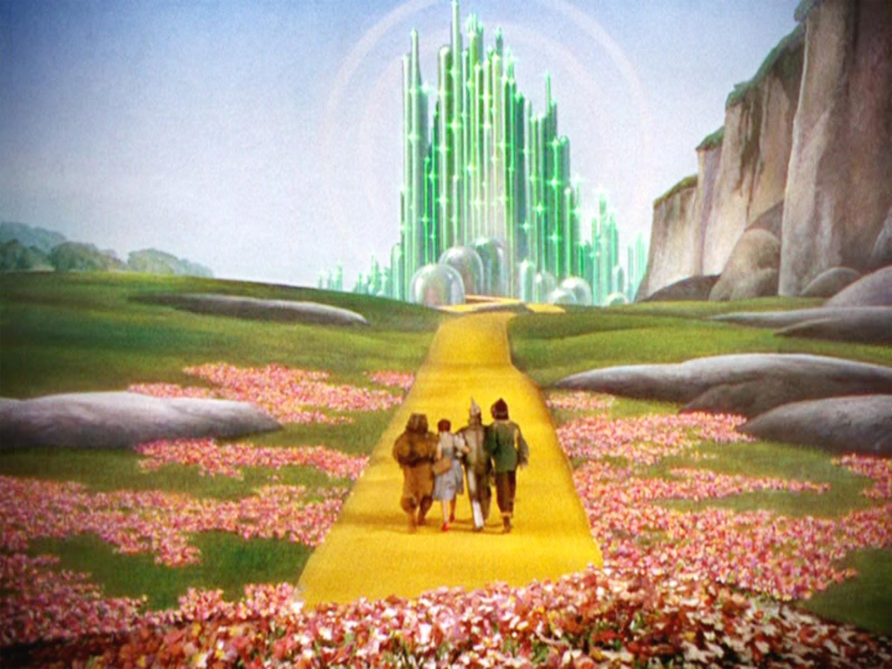
Art Deco in Pop Culture
The Great Gatsby
(2013)
Emerald City

Slide 26
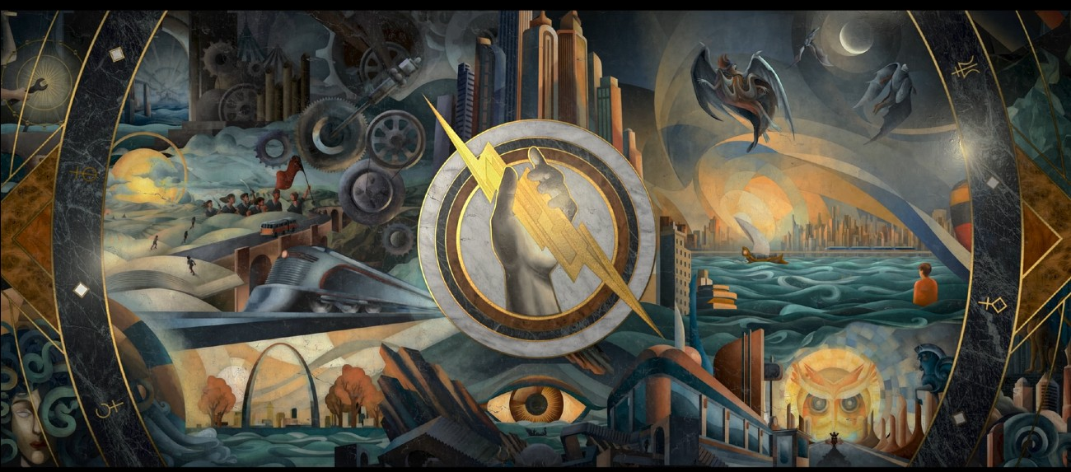
Art Deco in Pop Culture
Percy Jackson and the Olympians
Notes:
This image is from the end credits of the new Disney Plus Percy Jackson adaptation.

Slide 27
Thank You!

